Slide 1

The Diurnal Cycle of Tropical Oceanic Mesoscale Cold Pools
Piyush Garg, Stephen W. Nesbitt
University of Illinois Urbana-Champaign, Urbana IL
Timothy J. Lang
NASA Marshall Space Flight Center, Huntsville AL
Georgios Priftis
University of Alabama-Huntsville, Huntsville AL
IOVWST Meeting 2021 Contact: pgarg7@illinois.edu

Slide 2
Background
A new tensor-based, storm-centric cold pool identification algorithm was devised in Garg et al. (2020) using space-borne scatterometer (ASCAT) winds.
Horizontal gradient of winds was used as the metric to observe tropical oceanic mesoscale cold pools (termed as gradient features or GFs).
RapidScat was in a non-sun-synchronous orbit from 2014-2016 and thus allows us to observe a diurnal perspective of oceanic winds.
GF algorithm was thus applied on RapidScat data to create the first-ever diurnal climatology of tropical oceanic mesoscale cold pools.

Slide 3
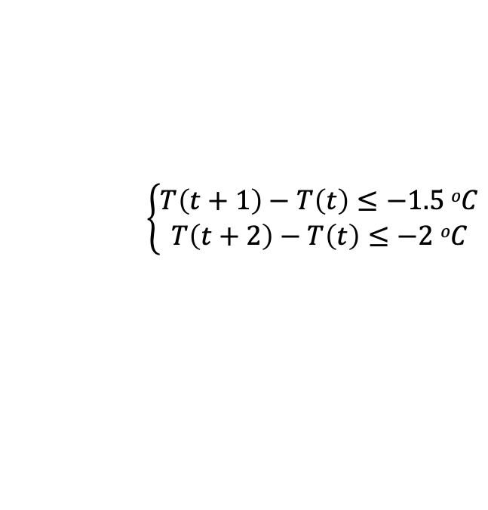
Datasets
RapidScat and ASCAT 12.5 km vector wind data from 2014-2016
Tropical Rainfall Measurement Mission (TRMM) 3B42 Rainfall.
Tropical oceanic mooring buoy network over Pacific, Atlantic and Indian oceanic basins.
ECMWF Reanalysis v5 (ERA5) total column water vapor (TCWV).
Globally-merged Infrared (IR) Brightness temperature from IMERG.
$$\left\{\begin{aligned}T\left(t+1\right)−T\left(t\right)≤−1.5 oC \\ T\left(t+2\right)−T\left(t\right)≤−2 oC\end{aligned}\right.$$

Slide 5
Science Questions
Are there any regional differences between ASCAT and RapidScat observed Cold Pools?
What are the diurnal modes of tropical oceanic cold pools?
How can we formulate a conceptual model to explain the diurnal modes of tropical oceanic mesoscale cold pools?

Slide 6
Science Question I
Are there any regional differences between ASCAT and RapidScat observed Cold Pools?

Slide 7
RapidScat-Observed GF Climatology
Are there any regional differences between ASCAT and RapidScat observed Cold Pools?

Slide 8
Difference between ASCAT and RapidScat- Observed GF Climatology
Are there any regional differences between ASCAT and RapidScat observed Cold Pools?

Slide 9
Science Question II
What are the diurnal modes of tropical oceanic cold pools?

Slide 10
Buoy-observed Cold Pool Statistics

Slide 11
Regional Classification of GF and Buoy-Observed Cold Pools

Slide 12
Comparison of RapidScat GF v/s Buoy-Observed Cold Pool Diurnal Modes
What are the diurnal modes of tropical oceanic cold pools?

Slide 13
What are the diurnal modes of tropical oceanic cold pools?

Slide 14
Science Question III
How can we formulate a conceptual model to explain the diurnal modes of tropical oceanic mesoscale cold pools?

Slide 15
How can we formulate a conceptual model to explain the diurnal modes of tropical oceanic mesoscale cold pools?

Slide 16
How can we formulate a conceptual model to explain the diurnal modes of tropical oceanic mesoscale cold pools?

Slide 17
How can we formulate a conceptual model to explain the diurnal modes of tropical oceanic mesoscale cold pools?

Slide 18
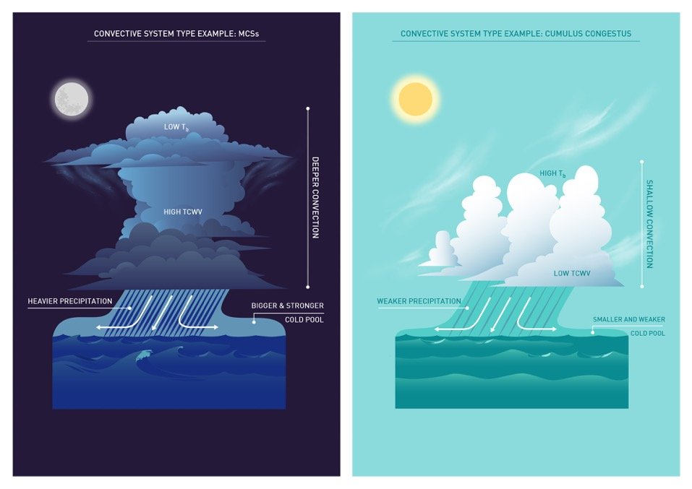
How can we formulate a conceptual model to explain the diurnal modes of tropical oceanic mesoscale cold pools?

Slide 19
Summary and Conclusions
Science Question I
GF Algorithm applied on RapidScat data provided the first-ever diurnal climatology of tropical oceanic cold pools.
ASCAT and RapidScat have regional differences in GF number, size and precipitation across the tropics and sub-tropics.
Science Question II
Both RapidScat and buoy-observed cold pools have bimodal diurnal frequency distributions with a primary late night/early morning peak and a secondary afternoon maxima.
All the buoy- and RapidScat-observed variables also had a prominent bimodal diurnal distribution.
Science Question III
GF-attributed Minimum T_{b} and maximum TCWV climatology match well with RapidScat’s global GF climatology.
T_{b} and TCWV showed a similar late night/early morning and afternoon peaks.
GF size and precipitation have a strong relationship with T_{b} and TCWV– consistent with observations of MCSs.

