Slide 1
C-band High and Extreme-Force Speeds CHEFS
Ad Stoffelen
Marcos Portabella
Alexis Mouche
Federica Polverari
Gerd-Jan van Zadelhoff
Maria Belmonte
With contributions from:
Wenming Lin
Joe Sapp
Jean Bidlot
Paul Chang
Zorana Jelenak
Mark Bourassa
Doug Vandemark
James Edson
Lucia Pineau-Guillou
Stefanie Linow

Slide 2
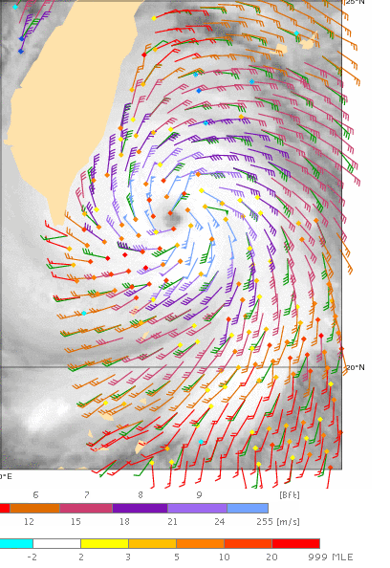
Overview
EUMETSAT ITT
      Extreme winds calibration
      VH test data
KNMI
      EPS-SG design and VH
      GMF and retrieval
      Calibration strategy
ICM
      Scatterometer science
IFREMER
      SAR wind retrieval
      Data lab
NOAA hurricane hunters

Slide 3
EUMETSAT ITT Objectives
VH GMF: The understanding of the future C-band VH information contribution to high and extreme wind retrievals from C-band scatterometer missions;
Spatial scaling of extremes: The definition of spatial scaling issues and related consequences for product sample resolutions and validation approaches;
Understanding of extremes: To further understanding of satellite remote sensing of high and extreme wind conditions over the ocean.

Slide 4
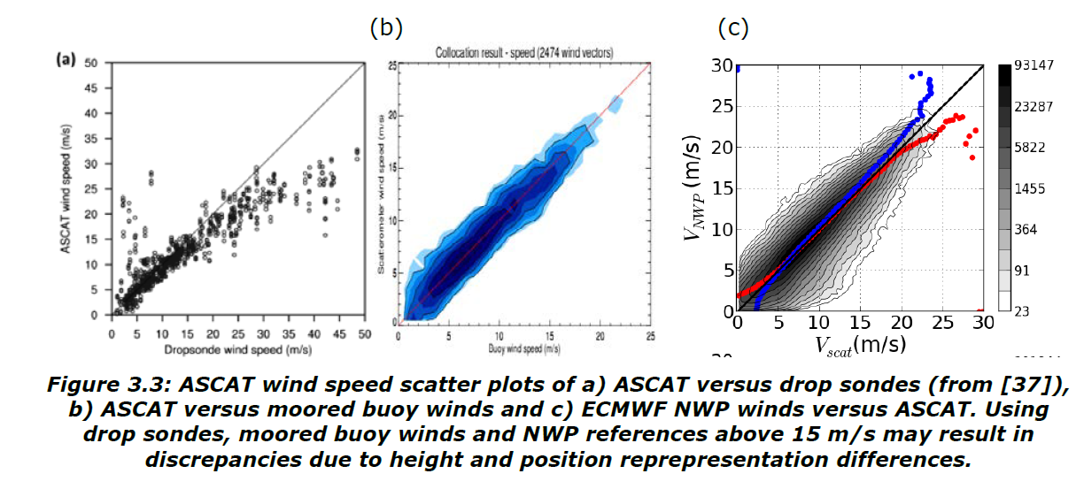
Inconsistencies
Chou et al., 2013
Are dropsondes too high, or moored buoys and ECMWF too low at 20-25 m/s ?

Slide 5
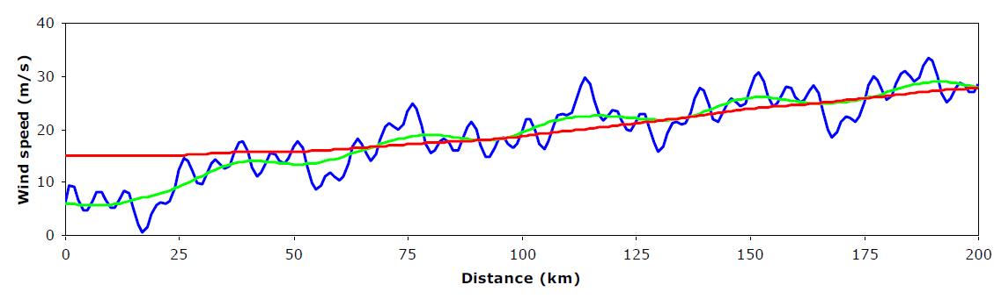
Schematic of wind speed from
ECMWF model, buoy and ASCAT
1-minute sustained winds can be much higher than scatterometer winds (factor of 2?)
An in situ wind PDF is quite different from a scatterometer and ECMWF wind PDF, particularly at the extremes; PDFs cannot be directly matched
An in situ measurement is NOT surface truth for a scatterometer WVC wind; we need scale-dependent analysis

Slide 6
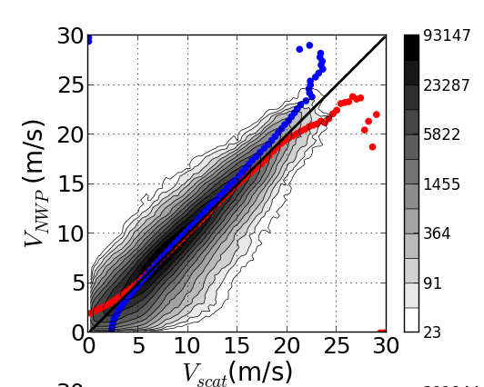
Truthful?
A binned result, e.g.,<y|x> or <x|y>, is not meaningful if it is not known how faithful x represents y in terms of physical phenomena and time and space aggregation
Particularly at the extremes of the PDF
scatter plots are essential

Slide 7

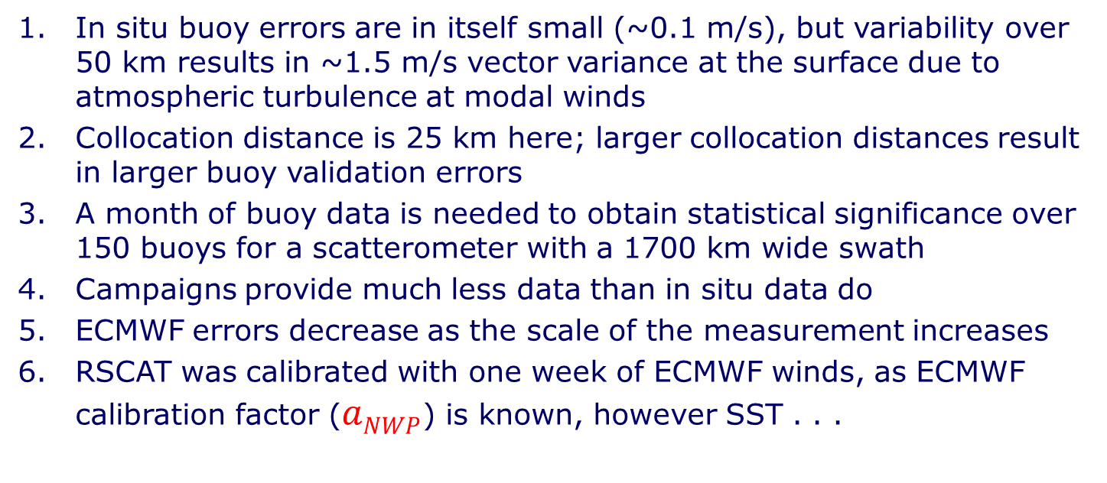
Triple collocation (scat scale)
Scatterometer Buoys ECMWF
SDE [m/s] ε_{u} ε_{v} ε_{u} ε_{v} ε_{u} ε_{v}
25 km RapidScat 0.64 0.67 1.33 1.38 1.17 1.15
50 km RapidScat 0.56 0.53 1.41 1.47 1.06 1.07
$u_{i}$ = $a_{i}(t_{i}+δ_{i}+b_{i}) , ε=\left\langle δ\right\rangle , i=(in situ, scat, NWP)$
In situ buoy errors are in itself small (~0.1 m/s), but variability over 50 km results in ~1.5 m/s vector variance at the surface due to atmospheric turbulence at modal winds
Collocation distance is 25 km here; larger collocation distances result in larger buoy validation errors
A month of buoy data is needed to obtain statistical significance over 150 buoys for a scatterometer with a 1700 km wide swath
Campaigns provide much less data than in situ data do
ECMWF errors decrease as the scale of the measurement increases
RSCAT was calibrated with one week of ECMWF winds, as ECMWF calibration factor ($aNWP$) is known, however SST . . .

Slide 8
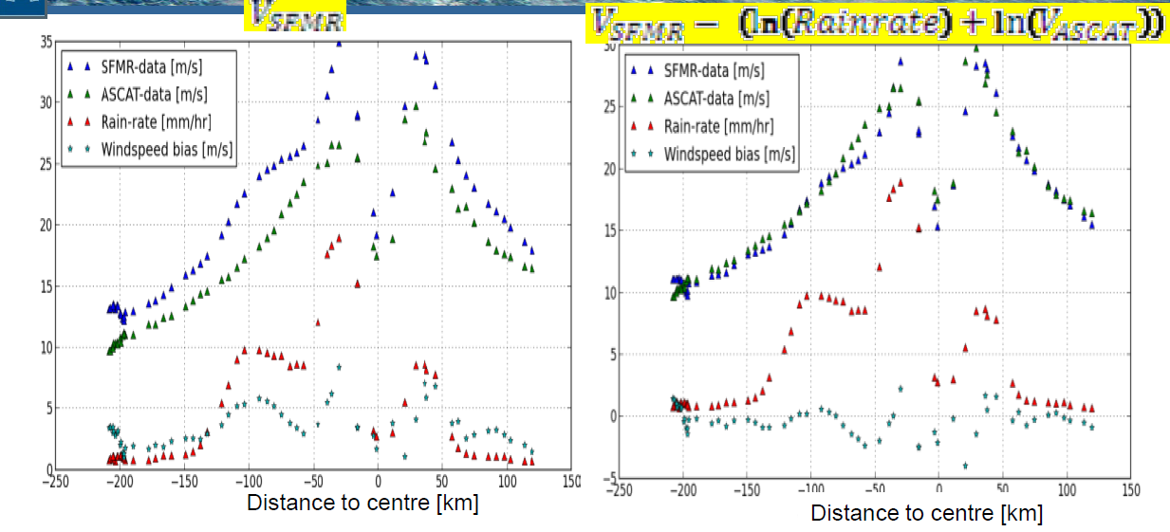
On WVC scale
V_{SFMR} V_{SFMR} – ln(RainRate) – ln(V_{ASCAT})
CMOD5 winds are lower than SFMR (VV pol) => add ln(V_{ASCAT}) ?
CMOD5 winds equal buoy winds for 15 to 20 m/s; which to trust ?
SFMR winds go up when it rains => -ln(RR);

Slide 9
Way forward
KNMI got stuck due to
        Disconnect between modal (buoy) and extreme regime (SFMR)
        Lack of SFMR calibration (SST, wind, rain)
GPS dropsondes provide true measure of local 10m wind;
how true ? Somehow comparable to 1-min winds?
GPS dropsondes calibrate SFMR 10m winds on its basic footprint; similar representation ? Scatter ?
Calibrated SFMR data are integrated over a scatterometer WVC length to provide a resource for satellite scatterometer calibration; is a 1D (radial) average sufficient ? Probably it is
Can SFMR integration to a WVC provide guidance to the sub-WVC variability ? Needed to understand relationship WVC and 1-min. winds and to better assign hurricane categories
Error attribution in all steps
Notes:
50 km/hour down and averaging over lowest 150 m suggest dropsonde is representative of ~20s

Slide 10
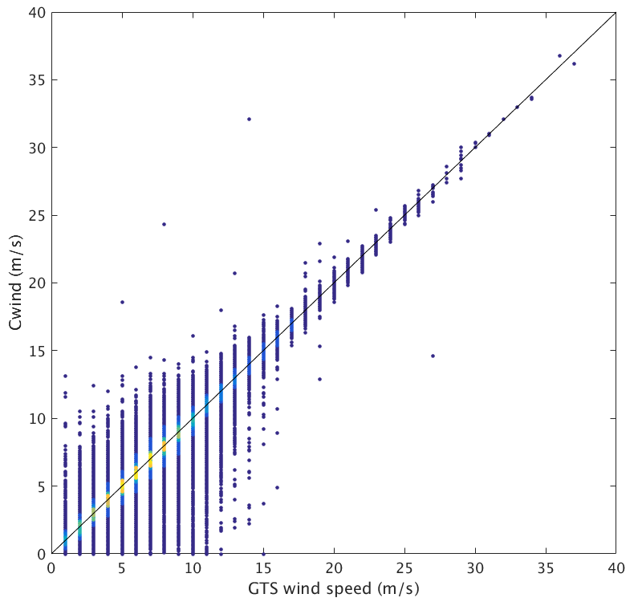
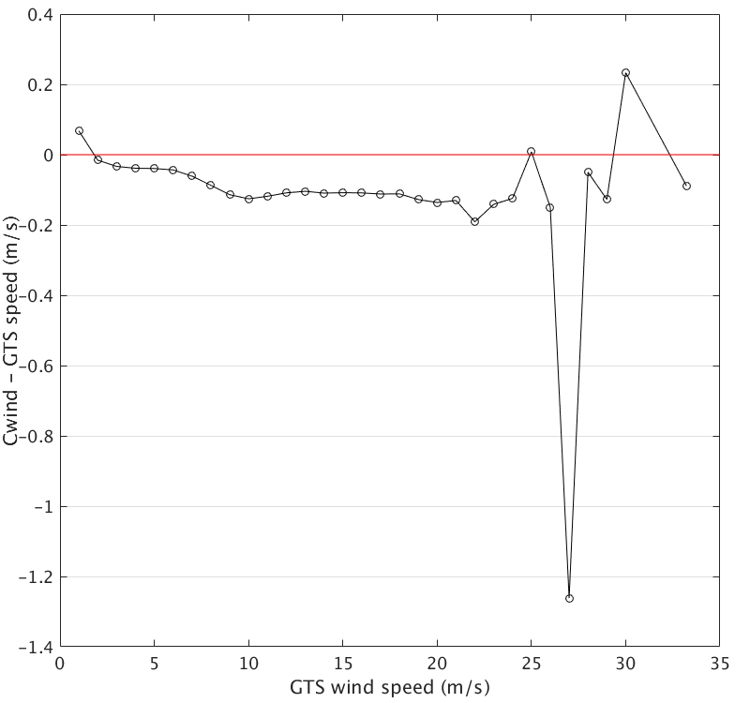
Compare NRT to archive
2009-2014
GTS: last 10 minutes of hour
Anything >10-minute values in hurricanes not suitable
GTS data appears useful potentially (small bias)
Triple collocation analysis of the wind characteristics of different types of moored buoys in terms of height and mooring against ECMWF and/or ASCAT wind references
Sea state?
© Wenming Lin

Slide 11
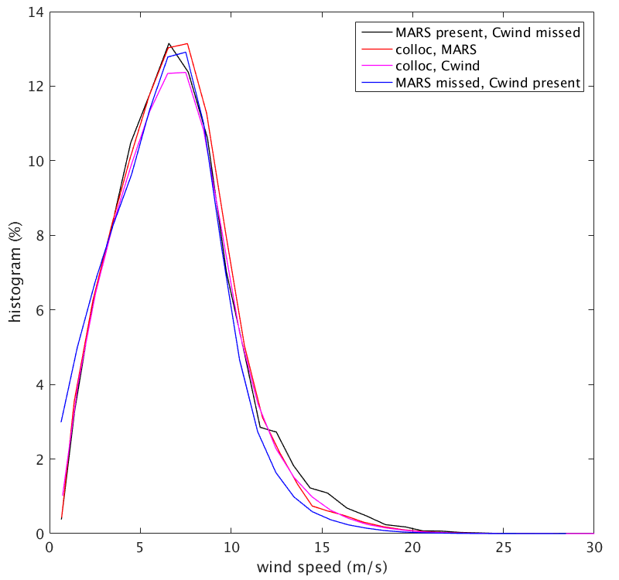
Number of extremes
Wind speed PDF of archived buoy winds collected from NDBC, TAO, PIRATA and RAMA (Cwind), as collocated with the same data received by GTS at ECMWF (called MARS; purple), vice versa (red), Cwind PDF if no GTS found (blue) and vice versa (black). Red and purple correspond to 3.2 million collocations, black to 3.3 million points and blue to 1.7 million. Collocation is considered successful when location, hour and heights match.
MARS data base is largest and has most extremes in PDF
Issues with anemometer and T-sensor height inconsistencies
© Wenming Lin

Slide 12
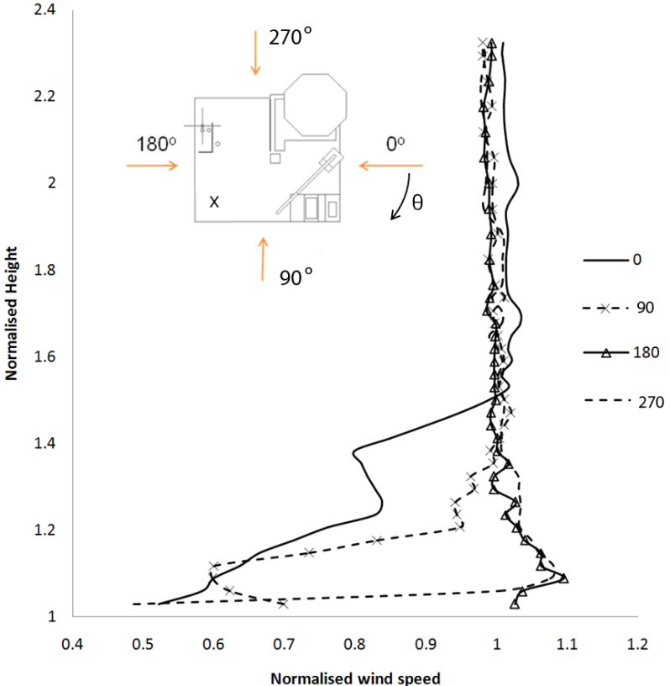
Other references?
+ve and –ve wind flow distortion around platforms
Verification shows differences to platforms 2x higher as to buoys; what is this scatter? Does it cause bias? Useful as calibration reference?
Platform motion (ships)
Hasager et al., 2013

Slide 13
Dropsondes
Dropsondes form the basis for further assessments dedicated to the high and extreme winds conditions.
Dropsondes are compared against SFMR and SAR on the local scale and with ASCAT and ERA5 on larger scales.
Direct comparison of moored buoys and dropsondes is unlikely.
Dropsondes will be segregated in different vertical sampling, in different profile (shear) conditions and in different drift conditions
The scatter in dropsonde winds at 20 ms⁻¹ versus ASCAT winds is relatively large and the dropsonde profile fits to compute 10-m winds from dropsondes will be evaluated and used for QC.
Since ASCAT retrievals have good relative accuracy around 20 ms⁻¹, they will be used as a (relative) reference to understand biases and scatter in both moored buoys and dropsondes.
Collocations of SFMR with moored buoys may exist occasionally to explore biases and scatter (2018 campaign with 1 UKMO buoy at 45 knots ☺).

Slide 14
Improve calibration
Peak around midnight on 7/8 October 2014 of 42 m/s
(150 km/h)
ASCAT-A appears low as compared to ASCAT-B
Current calibration bias B-A of 0.1 dB (0.1 m/s)
Required accuracy is 0.2 dB
Due to GMF saturation, 0.1 dB at 40 m/s is 4 m/s !
For extremes more careful instrument calibration is needed
Next generation ASCAT will have VH pol. channel

Slide 15

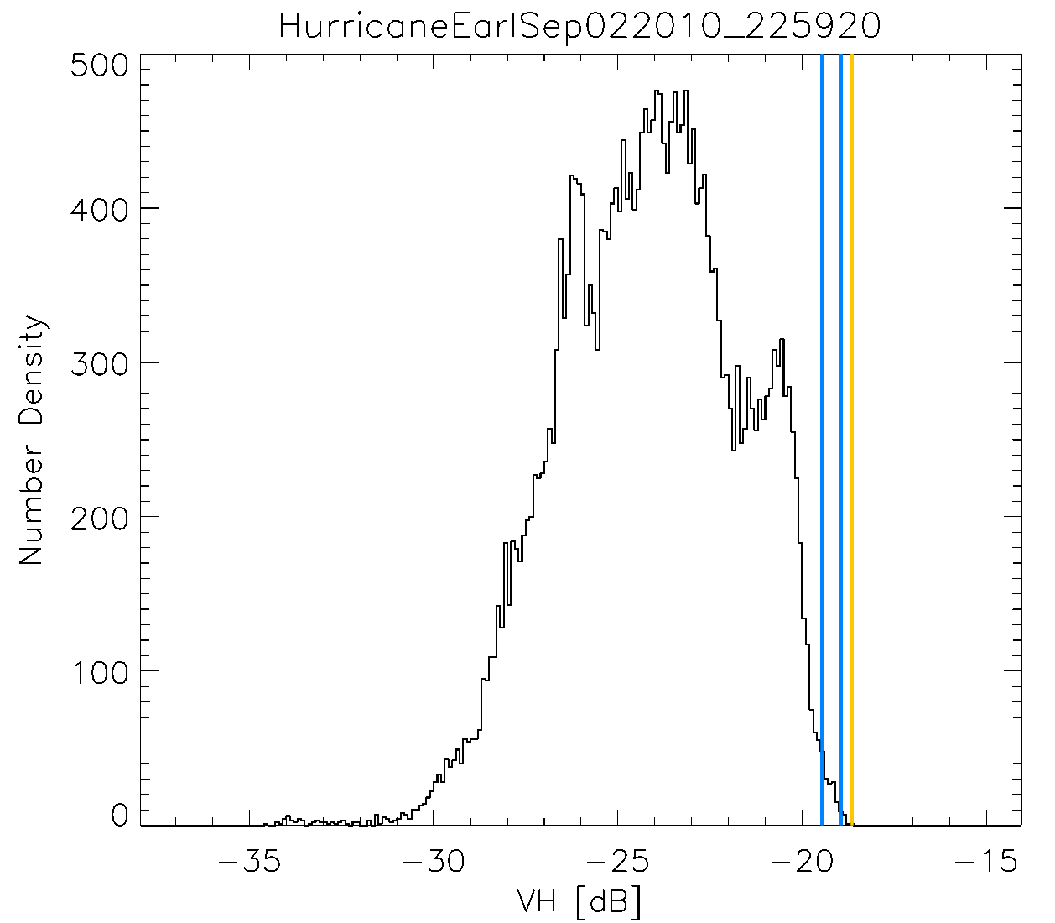
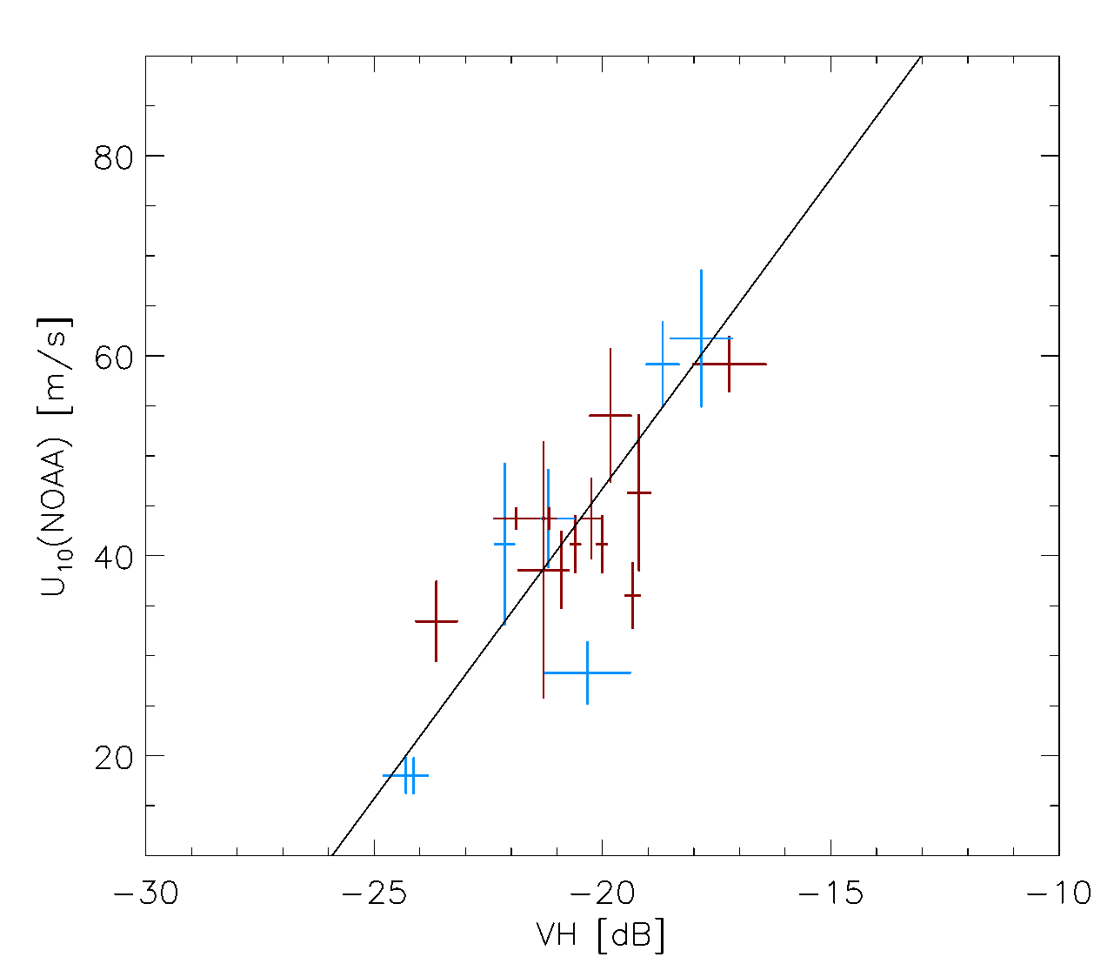
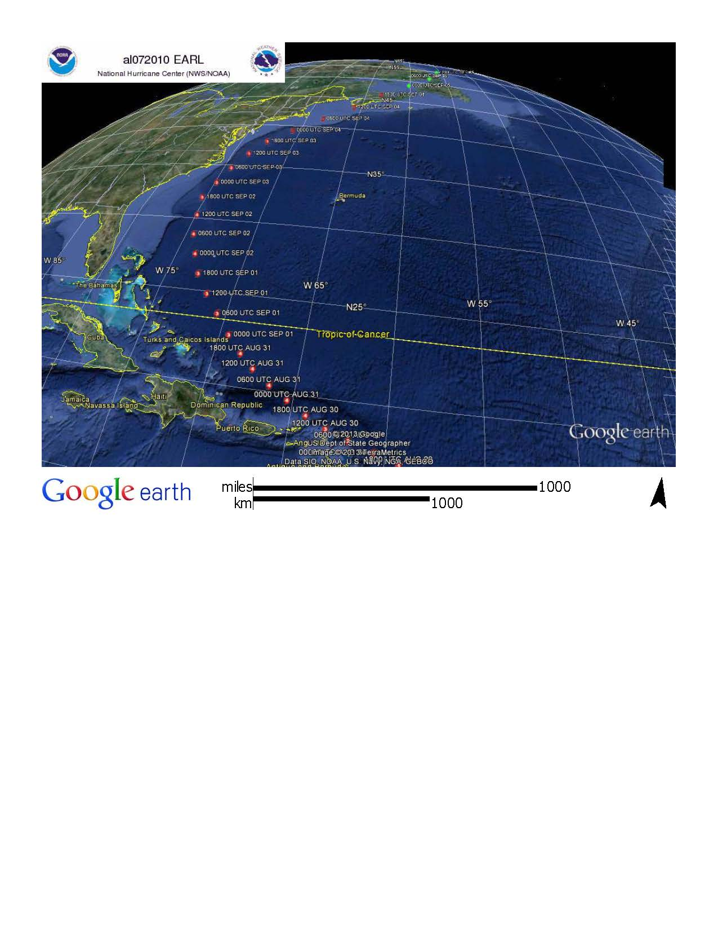
Comparing the NOAA best track estimate (max. 1-minute sustained surface wind speed) versus the averaged VH-signals of the 0.995 and 0.9995 percentile values.
+12 hours
-12 hours

Slide 16
Comparing the NOAA best track estimate (max. 1-minute sustained surface wind speed) versus the averaged VH-signals of the 0.995 and 0.9995 percentile values.
Cross polarization data can be used to retrieve the ‘near real time’ Maximum wind speed.
Cross polarization data appears not to saturate up to ~60m/s wind speeds

Slide 17

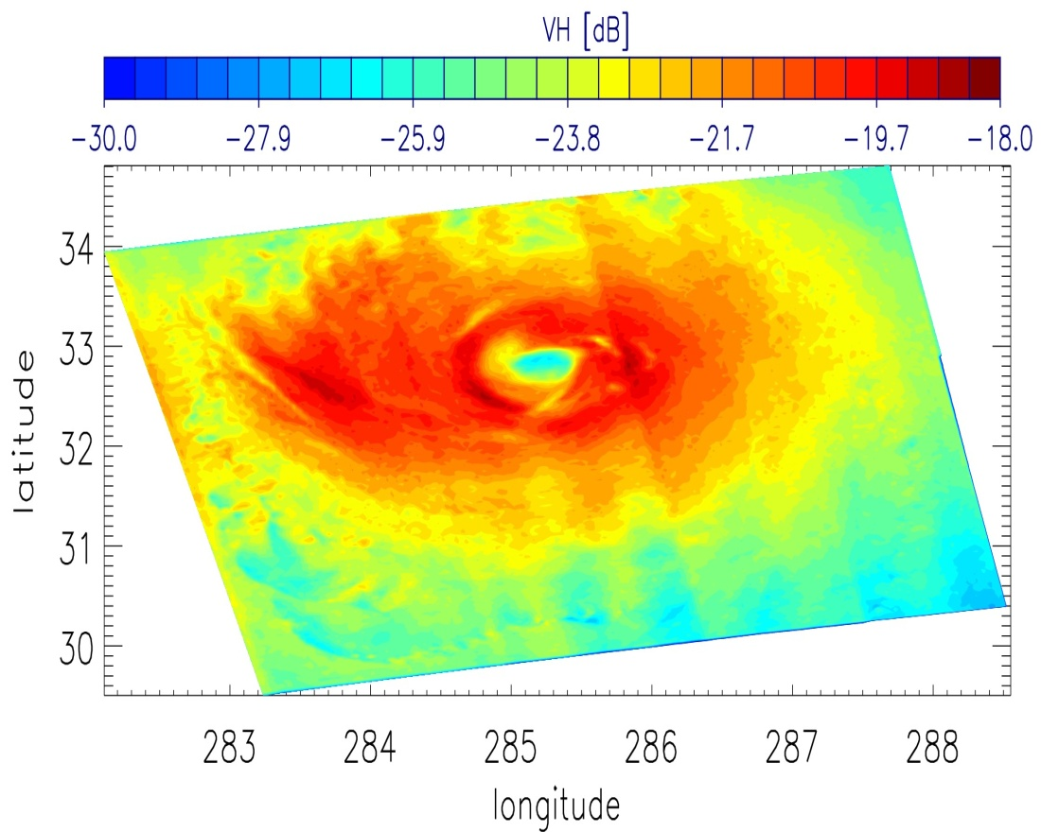
Retrieving Extreme wind speeds using C-band instruments
Gerd-Jan van Zadelhoff, Ad Stoffelen, P. Vachon, J. Wolfe, J. Horstmann, M. Belmonte Rivas, F. Fois
van Zadelhoff et al. (amt-7-437-2014)

Slide 18
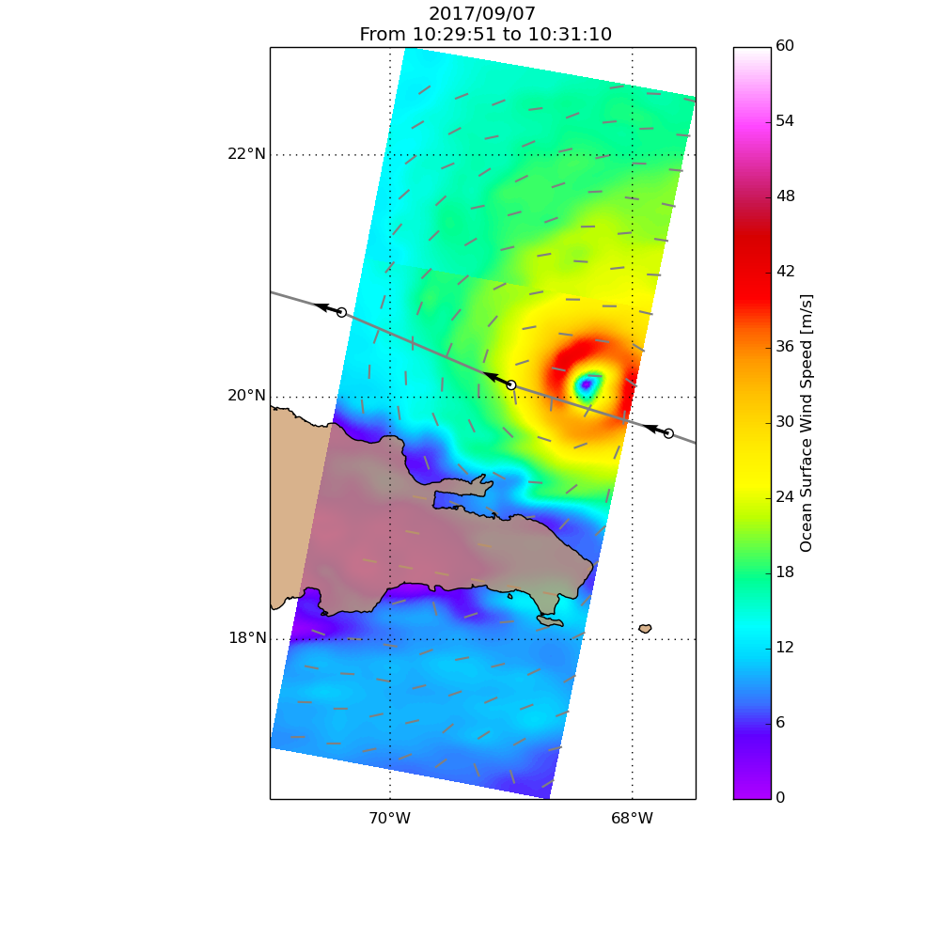
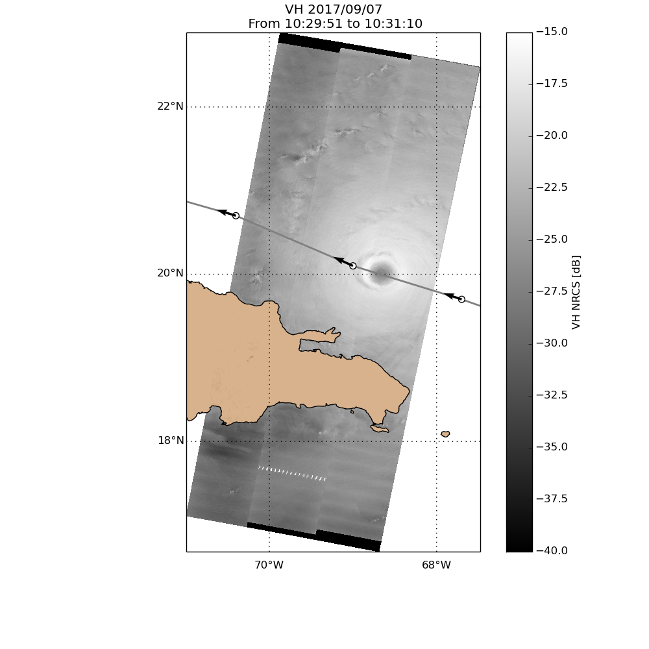
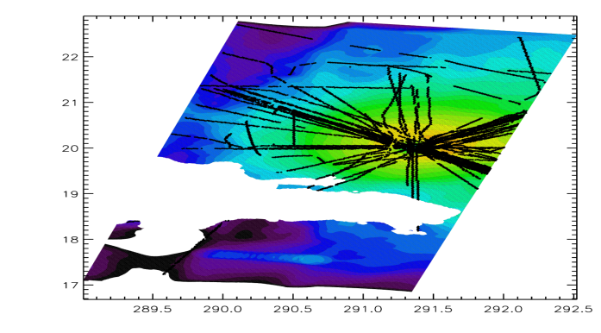
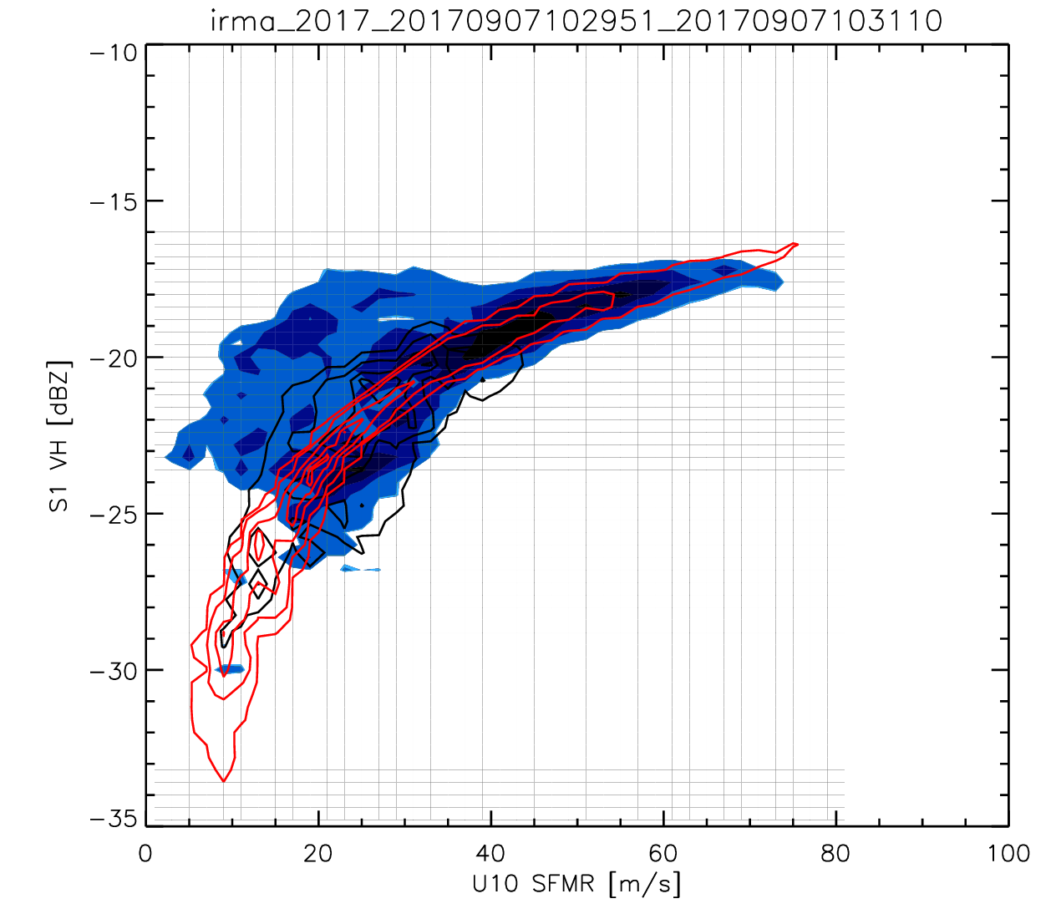
Irma – 2017/09/07 10:30 UTC
Collocated SFMR flight legs
S1 VH – SFMR U10 collocation
(RS2 –SFMR (van Zadelhoff et al. 2014)
Mouche et al. 2017
Model wind speed
(Mouche 2017)
S1 VH measurement

Slide 19
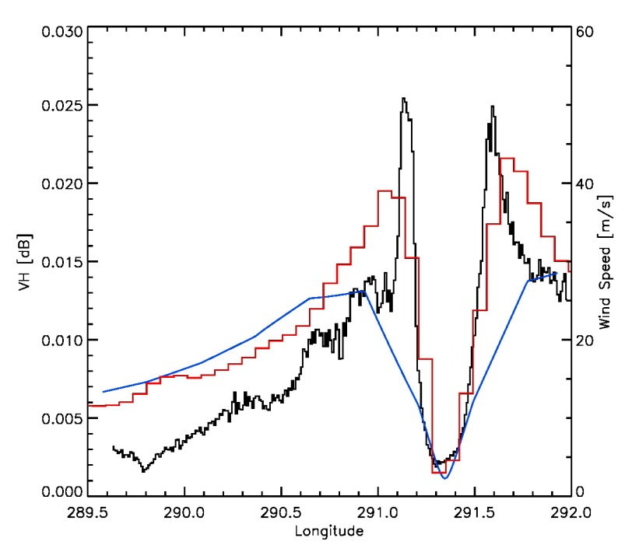
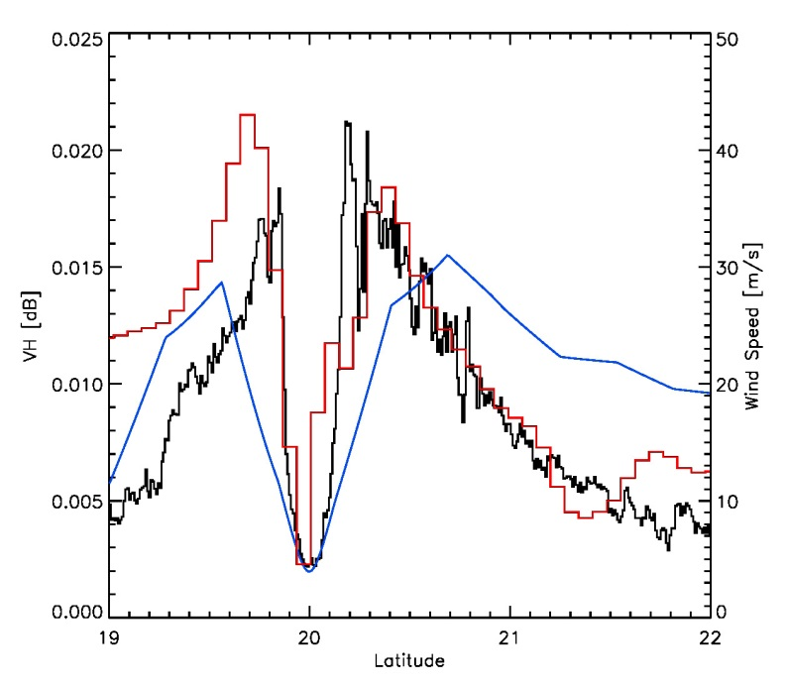
Using ECMWF/ERA5 data for the VH-GMF
ECMWF model data can be used to check incidence angle and wind direction dependence to derive the GMF.
ERA5 was the preferred data set → the resolution and model are constant for the S1 & RS2 datasets
However the ERA5 resolution is too low to enable comparisons close to the hurricane eye.
To the right two slices) are shown for hurricane IRMA:
VH-slice
ECMWF (oper.) (grid: F1280)
ERA-5 (grid : N320)

Slide 20
CHEFS
9 months parallel efforts at KNMI, ICM and IFREMER
Select and collect satellite observations at VH, VV and HH;
Select and collect reference wind data and ancillary geophysical information;
Collocate radar parameters from satellite with geophysical parameters from reference data.
Assess wind variability effects, notably on the SAR signal (VV and VH);
Cal/Val of SFMR with dropsonde wind data;
Assess Sentinel-1 VH beam response to extreme winds;
Revisit the VH GMF;
Define day-1 SCA processing method;
Generate SCA test data and validation.

Slide 21
Meet at 18:00 P31?
Collect issues for obtaining a consolidated extreme wind reference
Collect contributions to obtaining a consolidated extreme wind reference
Define a way forward beyond CHEFS
You are most welcome!

Slide 22
Backup Slides

Slide 23
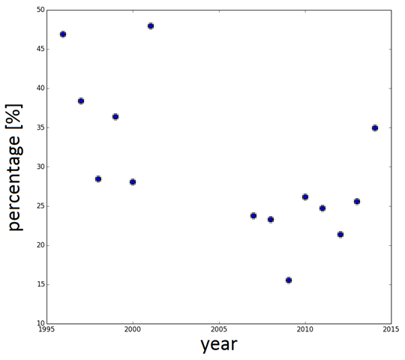
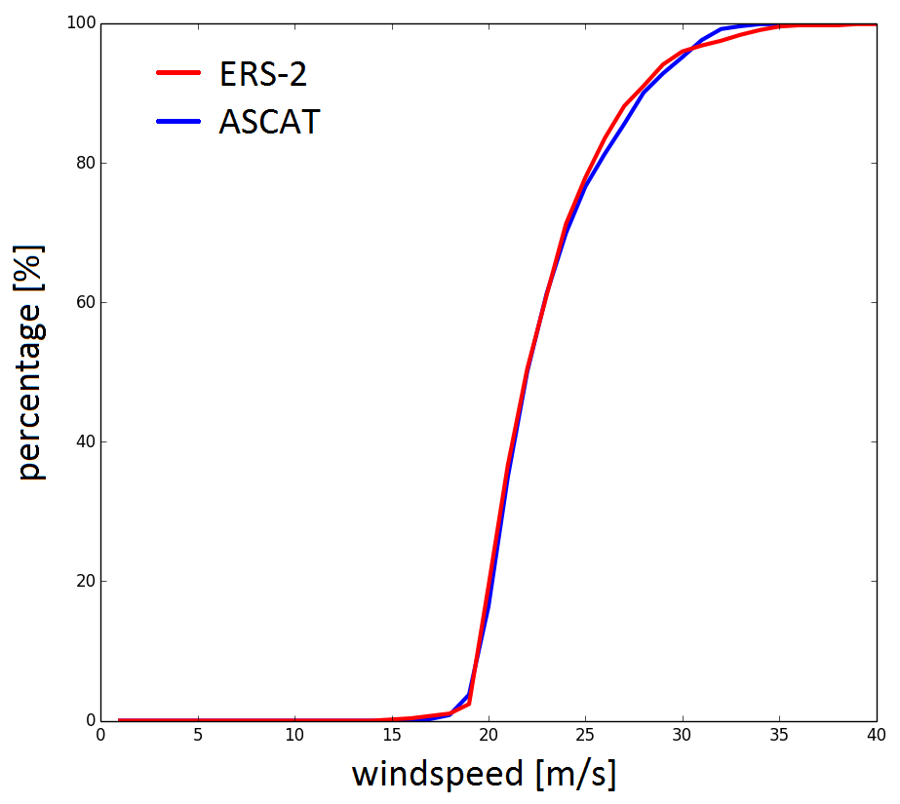
Climate extremes
PERCENTAGE OF HURRICANES >20 M/S IN ERA-INTERIM FOR SCAT WINDS > 20 M/S
ACCUMULATED PDF OF SCATTEROMETER WINDS ABOVE 20 M/S
23

Slide 24
Stress-equivalent wind
Radiometers/scatterometers measure ocean roughness
Ocean roughness consists in small (cm) waves generated by air impact and subsequent wave breaking processes; depends on gravity, water mass density, surface tension σ, and e.m. sea properties (assumed constant)
Air-sea momentum exchange is described by τ = ρ_{air} u* u* , the stress vector; depends on air mass density ρ_{air} , friction velocity vector u*
Surface layer winds (e.g., u₁₀) depend on u* , atmospheric stability, surface roughness and the presence of ocean currents
Equivalent neutral winds, u_{10N} , depend only on u* , surface roughness and the presence of ocean currents and is currently used for backscatter geophysical model functions (GMFs)
Stress-equivalent wind, u_{10S} = √ρ_{air} . u_{10N}/√ρ₀ , is suggested to be a better input for backscatter GMFs, since more closely related to τ

Slide 25
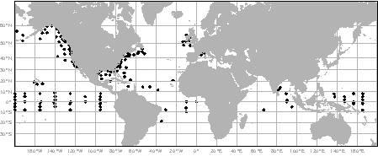




How good are these winds?
Triple collocation errors
ASCAT, buoy and ECMWF data from winter 2012/ 2013
Small scatterometer wind errors on scatterometer scale
All scatterometers have very similar local quality
Buoys measure local variability
 | Scatterometer |  | Buoys |  | ECMWF
m/s | σ_{u} | σ_{v} | σ_{u} | σ_{v} | σ_{u} | σ_{v}
ASCAT‑A 25‑km | 0.63 | 0.71 | 1.21 | 1.35 | 1.39 | 1.44
ASCAT‑B 25‑km | 0.63 | 0.66 | 1.26 | 1.39 | 1.38 | 1.42
25
Jur Vogelzang, KNMI
Notes:
Note that ECMWF wind climate changes by 0.1 m/s globally since June update! This needs to be controlled by bouys.

Slide 26
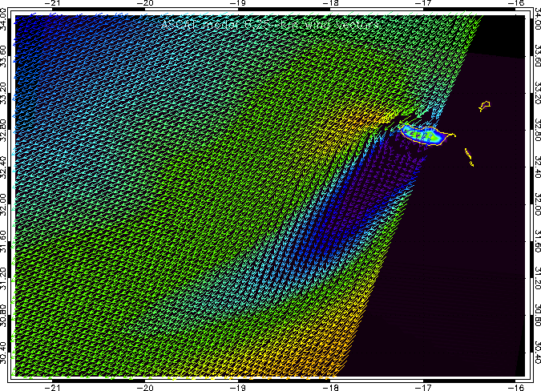
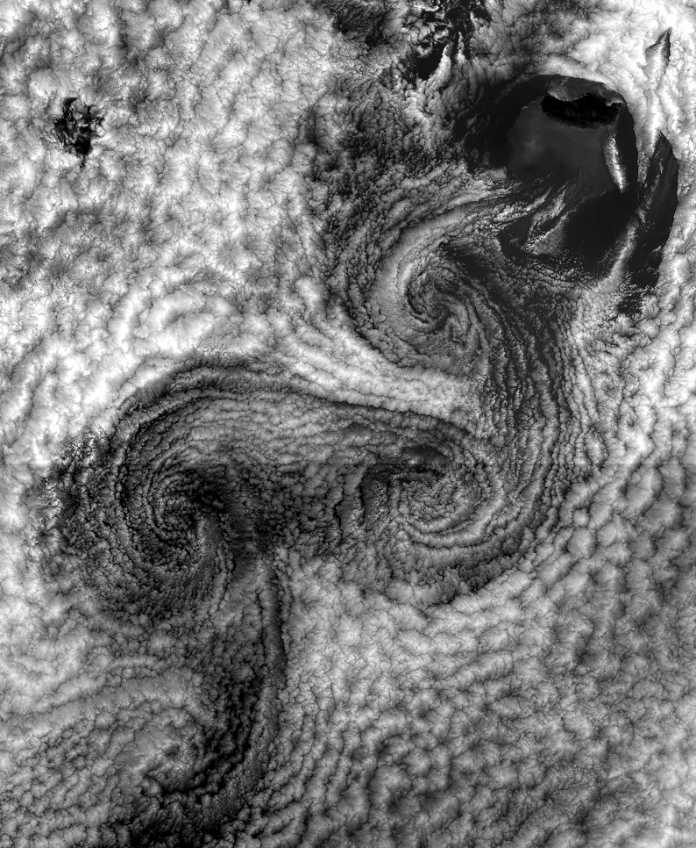
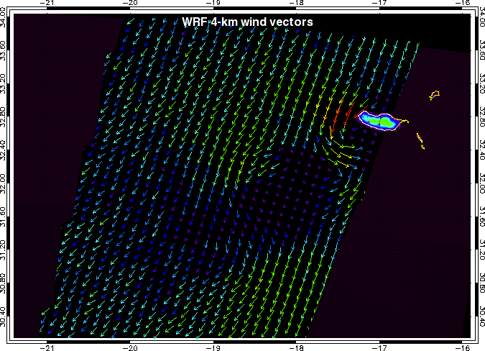
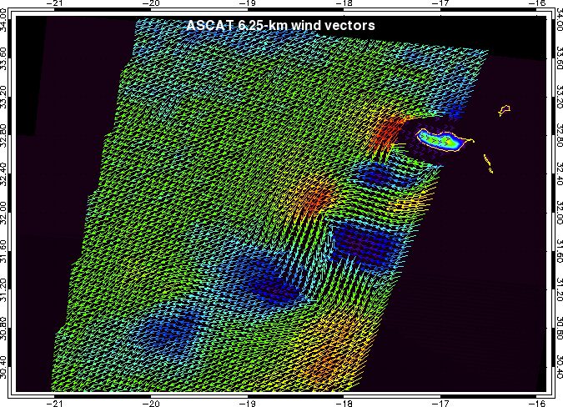
Observations and Models
ECMWF
WRF
ASCAT6.25km
26
Horvath et al., in preparation

Slide 27
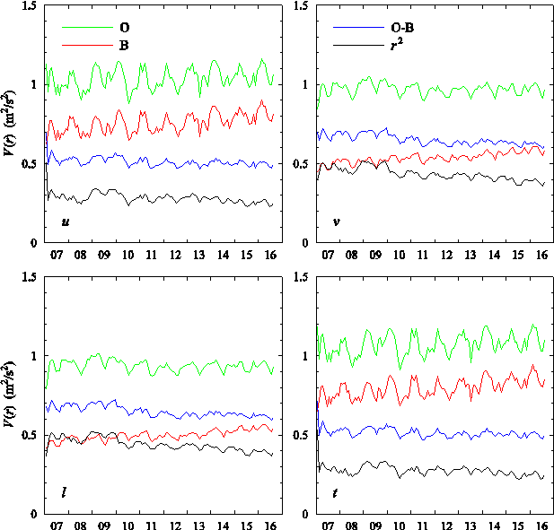
ECMWF OPS improves
Scatterometer O variance under 200 km constant
<200-km variance B increases to 80% (u), resp. 60% (v) of O
O-B decreases, particularly for v
l≈v and u≈t, but u≠v and l≠t
Jur Vogelzang, KNMI

Slide 28
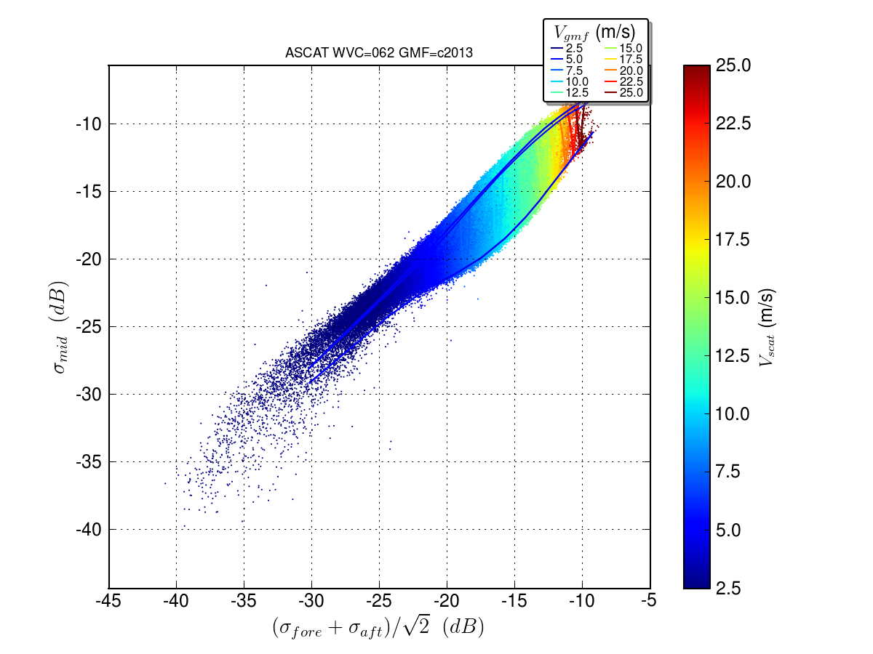



Slide 29
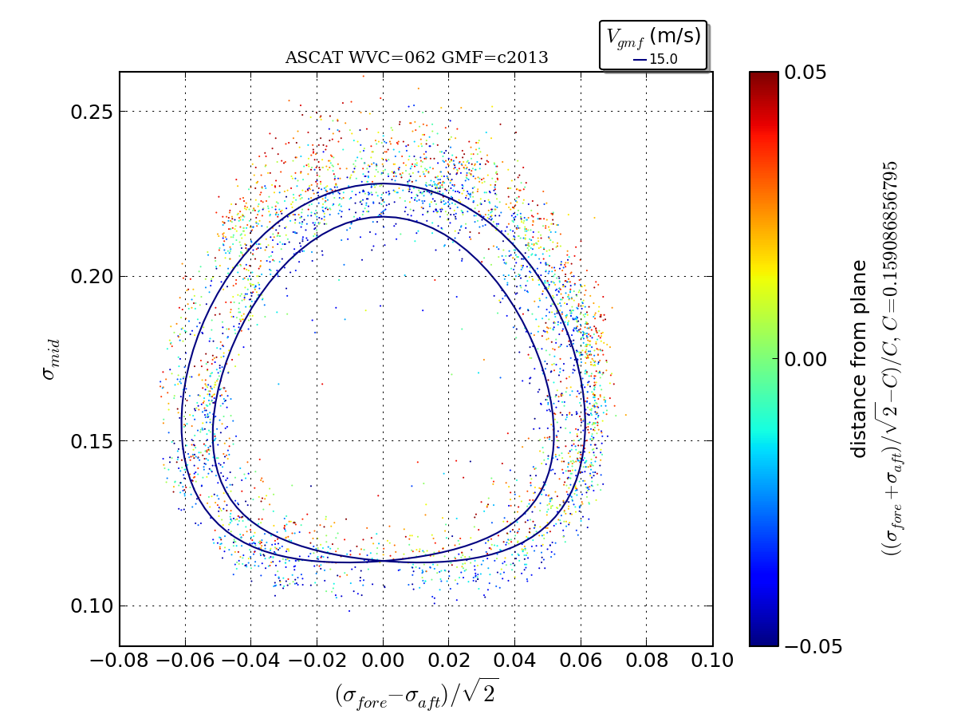


Slide 30
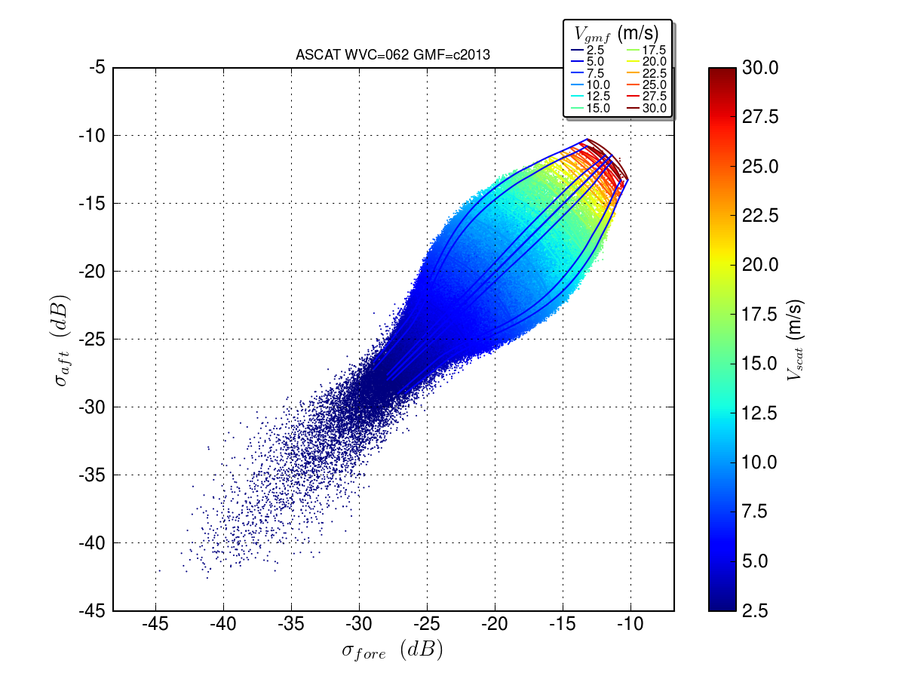



Slide 31
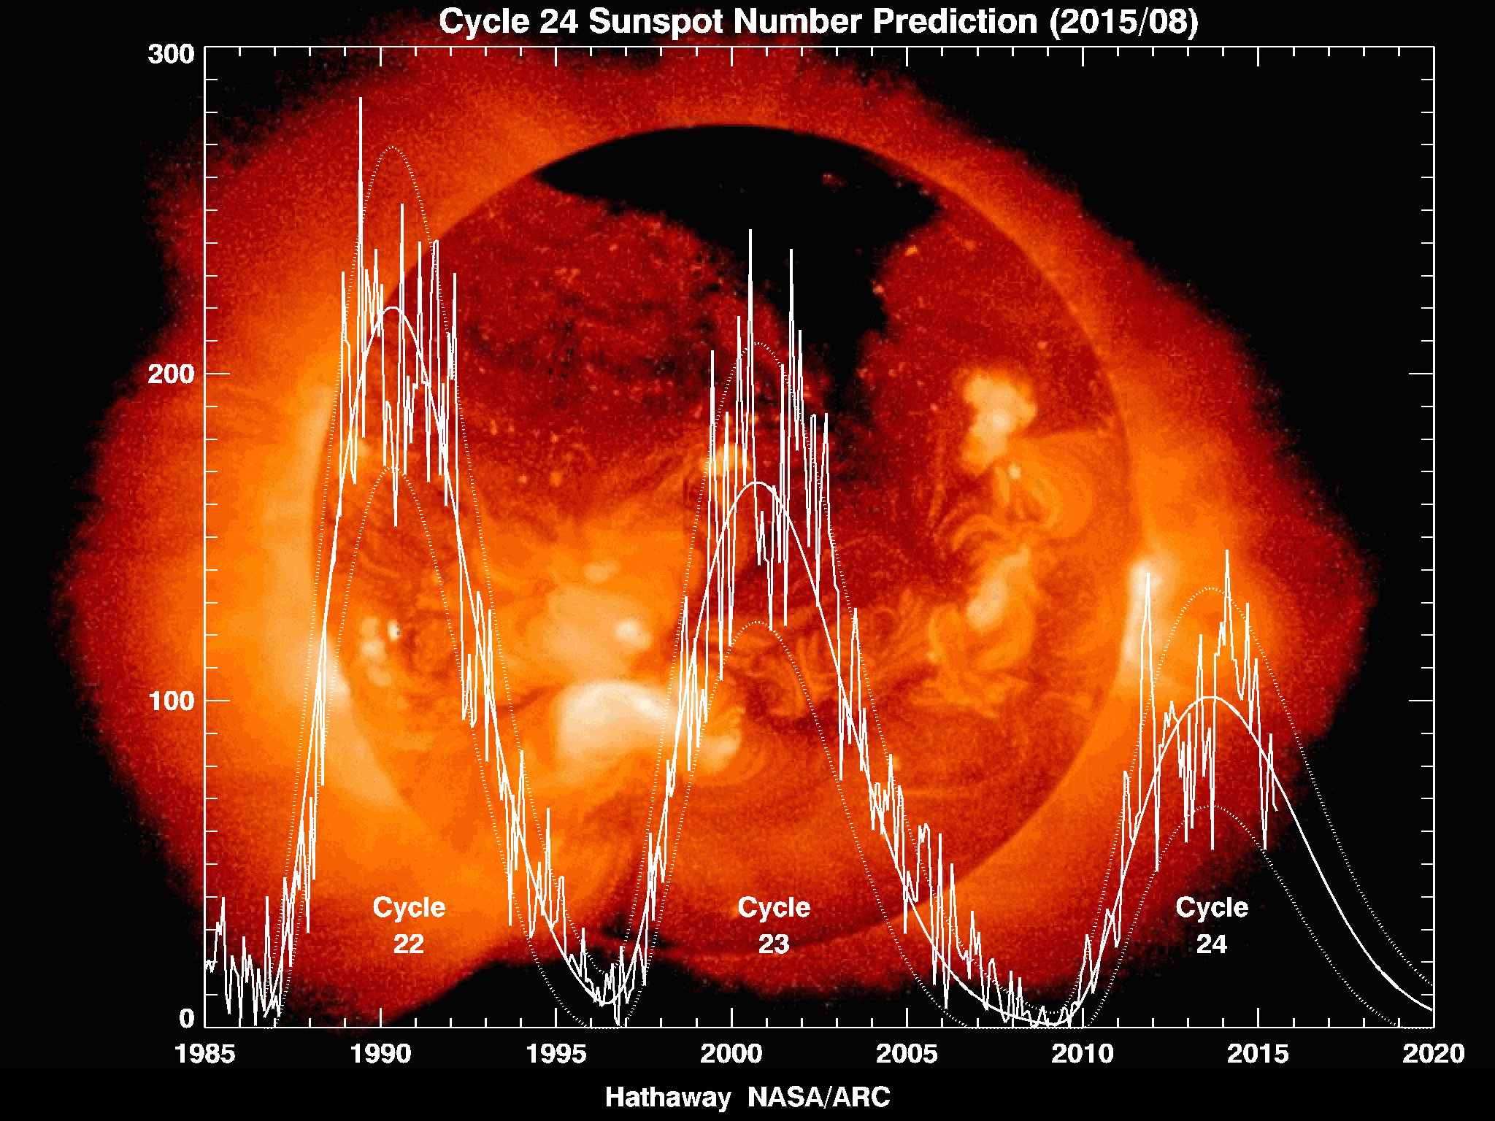
Faraday rotation
Ionospheric rotation of e.m. radiation phase
V => αV + (1-α)H
=> α(VV + VH)
+ (1-α)(HV + HH)
=> α[αVV + (1-α)VH
+ αVH + (1-α)VV]
+ (1-α)[αHV + (1-α)HH
+ αHH + (1-α)HV]
All detected H for VH:
αVH+ (1-α)HH
For small VH, substantial HH contamination may occur
Depends on sun, LTAN
RadarSat, S1

