Slide 1
Coupling ocean currents and waves with wind stress over the Gulf Stream
Mark A. Bourassa and Qi Shi
Center for Ocean-Atmospheric Prediction Studies
and Department of Earth, Ocean and Atmospheric Science, Florida State University

Slide 2
Why Do We Want Two-Way Coupling?
Ocean and atmospheric models are advancing to the resolutions where two-way coupling is critical.
  They are doing so to improve model accuracy.
  Small scale processes greatly enhance the vertical transport of energy, materials in the ocean (salt, nutrients, gasses) and the atmosphere (water vapor)
  These changes should impact
    The global and regional energy and water cycles (weather)
    Ocean mixed layer temperature and depth
    CO₂ budgets of the ocean and atmosphere
    Nutrient content for marine organisms

Slide 3



Ocean-Atmosphere-Wave Modeling
Wind stress, Surface heat fluxes
Radiation, Precipitation,
Sea level pressure
Ocean
(ROMS)
Atmosphere
(WRF)
Sea surface temperature
Surface currents
Surface currents
Wave length, height, period and direction
+
Modified MYNN
Wave
(SWAN)
10-meter wind wrt Surface Current
Wave height and wave length
Stress is based on wind shear (wind relative to the current)
Stress is dependent on sea state via COARE’s option for Taylor and Yelland’s roughness length PLUS the roughness of a smooth surface

Slide 4
Changes in October Wind Stress Magnitude
Relative to model with stress independent of waves and currents
CUR&WAV-CTL
The sea state and current dependent model has stronger stress gradients over the Gulf Stream
Making the stress dependent on currents and sea state greatly strengthens these gradients, and currents are a much more important consideration
These stress magnitudes seem to be consistent with ASCAT observations

Slide 5
Changes in October Ocean Ekman Pumping
CUR&WAV-CTL
More like Observations
The influence of currents, in a two-way coupled model, were needed to greatly strengthen the positive and negative current seen on the sides of a major current.
When both waves and currents are considered, the heat budget is dominated by vertical motion and entrainment at the bottom of the mixed layer.
  Curl of stress is greater (more like observations) over SST gradients and current gradients

Slide 6
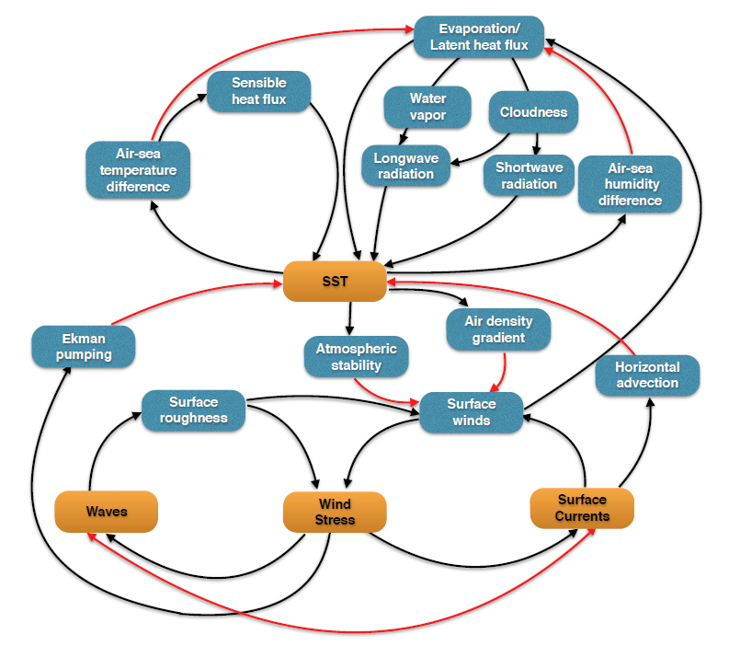
Coupling mechanisms
Dominant processes
± 20 W/m²
± 5
W/m²
± 3
W/m²
± 9 W/m²
± 588 W/m²
± 387W/m²
?
+12%
±5%
Wave-current interaction
All numbers are median value of 30-day daily differences between CUR+WAV and CTL over the Gulf Stream
Notes:
Differences might be on a shorter time scale – need to check that. Since the result is for the median the answers will still be very similar.
Note that we do not test if changes due stability are more important than changes due to the air temperature gradient. We did verify that both change.

Slide 7
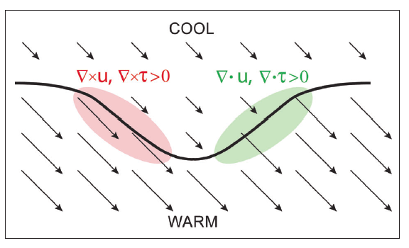
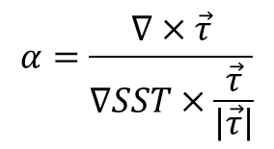
Sensitivity of the wind stress curl to the crosswind SST gradient
Currents have already been shown to have a large impact on the pattern of stresses
They also influence the pattern of SSTs (not shown in this version of the presentation)
The coupling coefficient will be shown to be highly dependent on the physics considered in the parameterization of stress.
Curl
Divergence
(Chelton et al., 2007)
Coupling coefficient
Notes:
Figure 2. Schematic illustration of the divergence and curl of the wind and wind stress fields that result
from spatial variations of the SST field. Near a meandering SST front (the heavy black line), surface winds
are lower over cool water and higher over warm water, shown qualitatively by the lengths of the vectors.
Acceleration where winds blow across the SST front generates divergence (green area). Lateral variations
where winds blow parallel to the SST front generate curl (red area). The divergence and curl perturbations
are proportional to the downwind and crosswind components of the SST gradient, respectively
(see Figure 3).

Slide 8

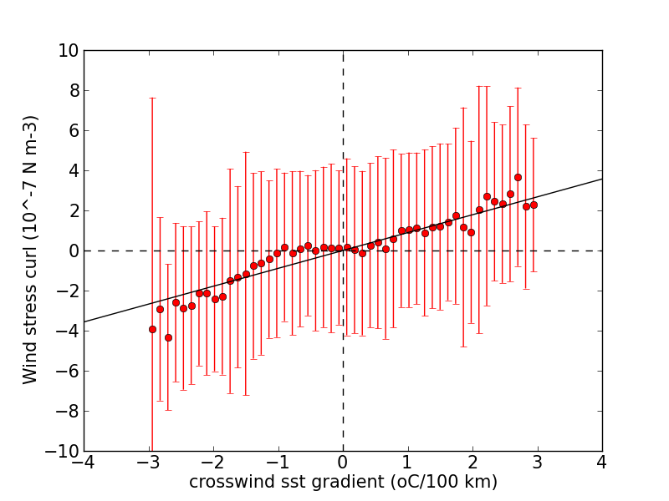

Coupling Coefficient
The coupling coefficient for model data is highly dependent on the stress parameterization.
α=0.89

Slide 9
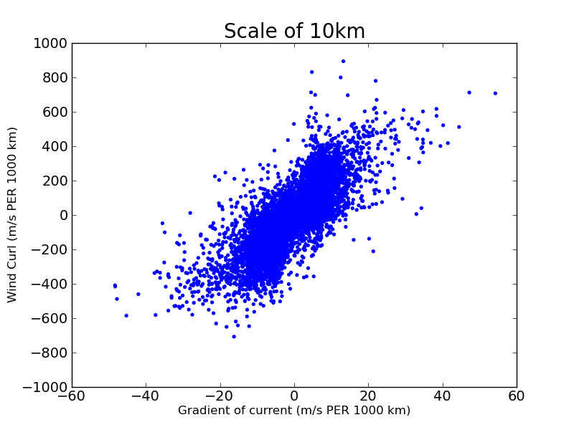
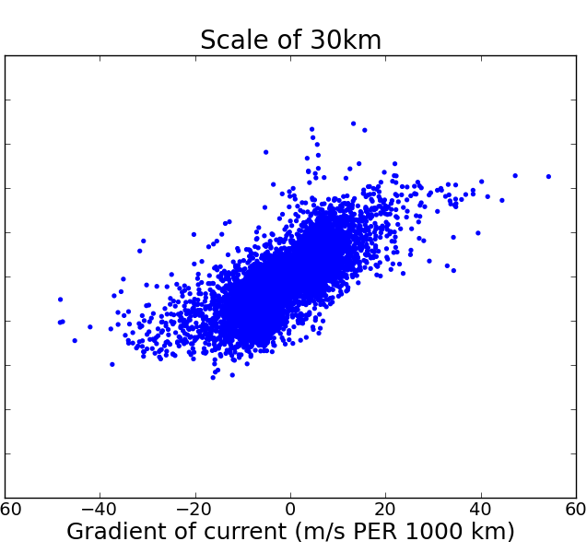
Modeled Wind Curl vs Current Gradient
(as a function of spatial scale)
Wind Curl (m/s per 1000 km)
-6 -4 -2 0 2 4 -6 -4 -2 0 2 4 6
Crosswind ∇Current (m/s per 100 km)
Wind Curl (y) vs. Gradient of current in the direction perpendicular the wind vector (x)

Slide 10
Summary
The modeled curl of wind (and curl of stress) are sensitive gradients of SST and current, in the direction perpendicular to the wind.
  This curl is a key player in coupling the ocean and atmosphere
    Impacting vertical and horizontal motions
    Impacting the local heat budget
This sensitivity of the curl of wind stress is much greater to gradients of currents than to gradients of SST

Slide 11
Coupling ocean currents and waves with wind stress over the Gulf Stream
Mark A. Bourassa and Qi Shi
Center for Ocean-Atmospheric Prediction Studies
and Department of Earth, Ocean and Atmospheric Science, Florida State University

Slide 12
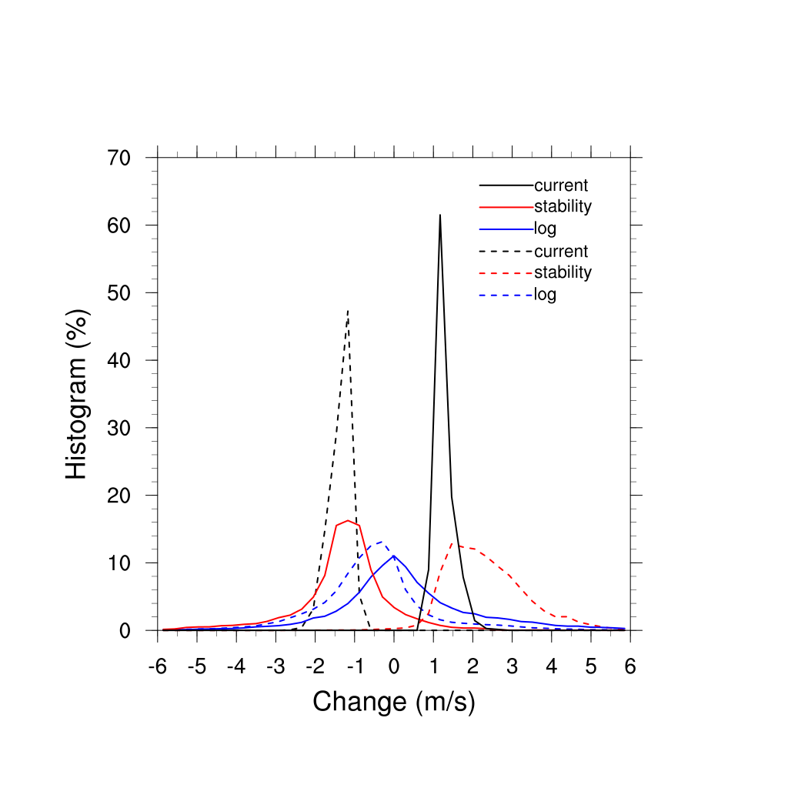
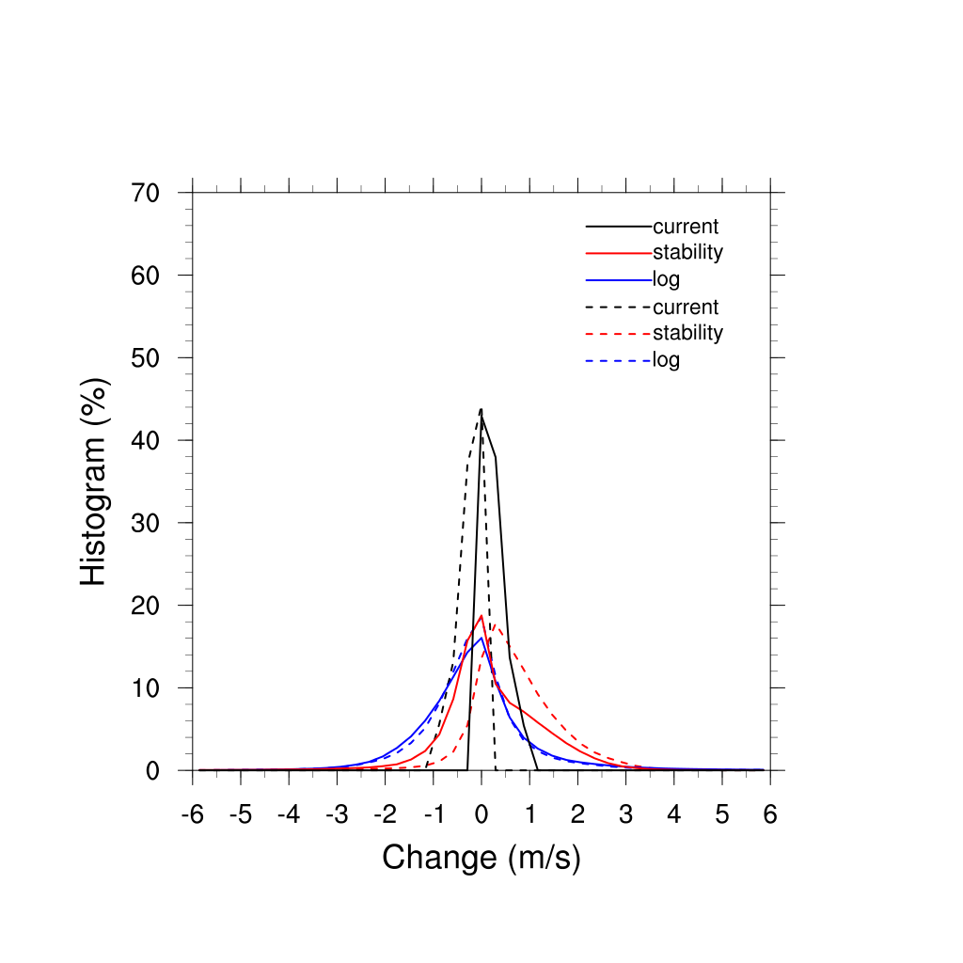
Surface Wind Response
Histograms of the difference of current, stability and log profile terms in the log-wind equation between CUR_WAV and WAVE experiments. The statistics are computed over strong-current (U_{s}>1m/s; left) and weak-current (U_{s}<1 m/s; right) regions. Dashed lines are associated with negative changes in currents.

Slide 13
Changes in October Wind Stress Magnitude
Relative to model with stress independent of waves and currents
CUR-CTL
Not Reasonable
WAV-CTL
Not Reasonable
CUR&WAV-CTL
Seemingly Reasonable
Currents alone tend to reduce EKE production beyond reasonable values
Waves alone tend to increase stress
  But not as needed
Waves together with currents are not a linear sum of the two
  Good for ocean EKE
  Surface currents are critically important

Slide 14
Changes in October Ocean Ekman Pumping
CUR-CTL
WAV-CTL
CUR&WAV-CTL
More like Observations
In the upper two images the mixed layer heat budget is dominated by horizontal transport processes.
In the bottom case, the heat budget is dominated by vertical motion
  Curl of stress is greater over SST gradients (more like observations)

