Slide 1
Air-Sea Coupling and Fluxes: Wind-Wave-Current in High-Impact Weather and Implications for Earth System Modeling and Prediction
Shuyi S. Chen, Ben Barr, Milan Curcic and Brandon Kerns
Department of Atmospheric Sciences
University of Washington, Seattle, WA 98195
(IOVWST, Barcelona, Spain, 25 April 2018)
Notes:
ABSTRACT. One of the most challenging aspects in prediction of tropical weather systems is complex interaction among the convective cloud systems, air-sea fluxes, and environmental conditions, which are controlled by multi-scale dynamic systems such as the Madden-Julian Oscillation (MJO), equatorial waves, and tropical cyclones (TCs). Convective initiation of MJO over the Indian Ocean affect the global weather patterns, including high-impact weather like drought, flooding, and TC development. The multi-scale interactions among air-sea-fluxes, intensity and organization of mesoscale convective systems (MCSs), and their upscaling feedback to the large-scale dynamic system through heating and momentum transport are the key for accurate prediction of extreme tropical weather events. Ocean surface winds and air-sea fluxes and are difficult to observe. The only feasible way to continuously observe surface winds over the global ocean is to measure them from space, and space-based remote sensing techniques for surface winds depend on the properties of the sea surface.
This research aims to 1) better understand the multi-scale interaction of MCSs and the large-scale dynamic system during MJO initiation and 2) improve prediction of high impact tropical weather systems using ASCAT, OSCAT, and QuickSCAT data and a high-resolution fully coupled atmosphere-wave-ocean model. The combined QuikSCAT, ASCAT, and OSACT data will provide a relatively long data record from 1999-2014, which contains multiple MJO events. In situ surface wind observations from the GPS dropwindsondes and ship-based measurements obtained during the DYNAMO (Dynamics of the Madden-Julian Oscillation) field campaign from October 2011-January 2012 will be used to evaluate the scatterometer data and coupled model results. An example of the coupled model simulation of the MJO convection, surface wind, upper ocean temperature, and air-sea fluxes and comparisons with ASCAT/OSCAT and DYNAMO observations will be presented.

Slide 2
Main objectives:
To develop accurate and integrated impact forecasts of extreme wind, rain, waves, and storm surge in hurricanes, to meet societal needs as coastal population and built environment expand worldwide
To better represent air-sea fluxes (sea spray) and aerosol (sea salt) in global coupled models for weather-climate prediction
Results:
Unified Wave INterface (UWIN) and its applications in fully coupled atmosphere-wave-ocean model (WRF-UMWM-HYCOM) predictions of hurricanes and coastal winter storms
Implementation of UWIN in the NASA GMAO GEOS

Slide 3
Coupled Models
Atmosphere Model
Unified Wave INterface (UWIN)
for Coupled Models (CM)
Chen et al. (2013), Chen & Curcic 2016)
Air-Sea Interface Module
Atmosphere surface layer
Interface (waves)
Atmosphere surface layer
Surface boundary conditions
Ocean surface layer
Ocean Model
Ocean surface layer
Coupled observations and data assimilation

Slide 4
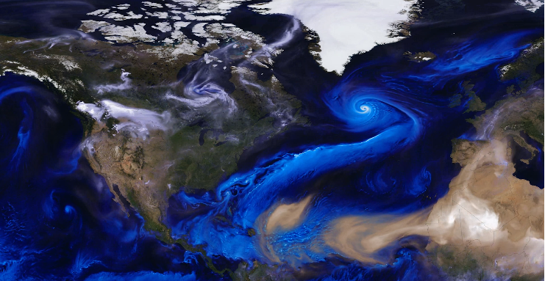
NASA GMAO GEOS-5 model simulation of aerosol (dust-brown, sea salt-blue, and smoke-white) production and transport by weather systems on August 1, 2017.

Slide 5
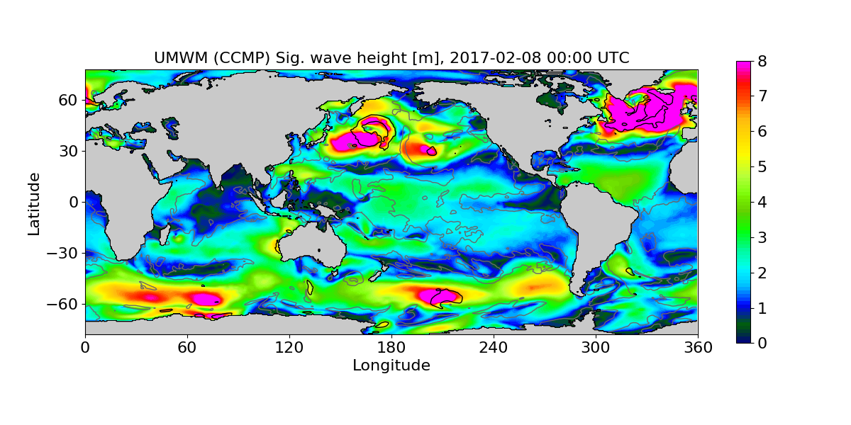
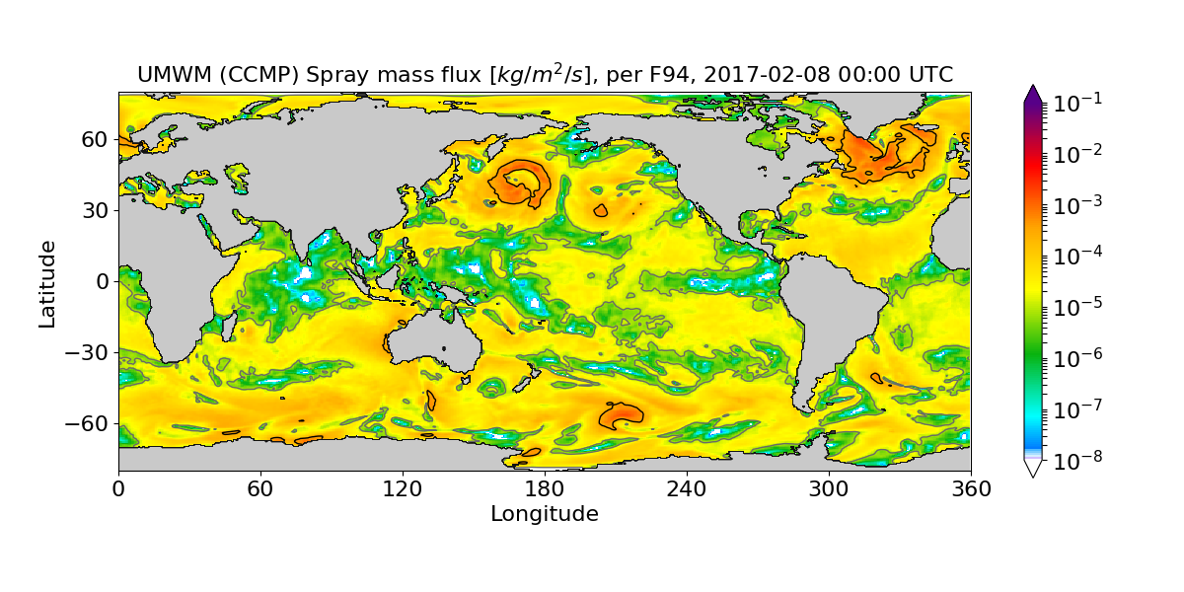
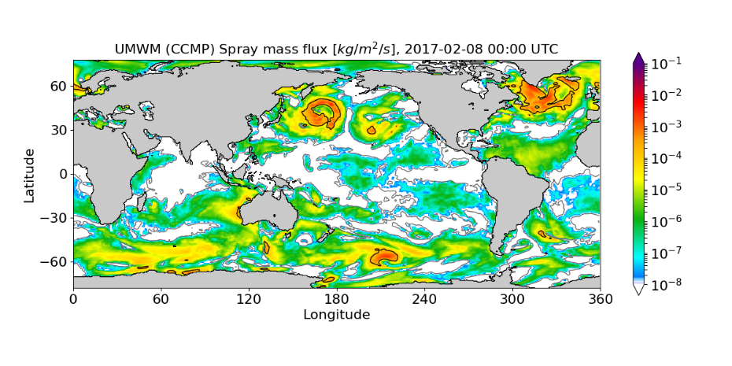
Significant wave height (top) and calculated spray mass flux per F94 (middle) and F09 (bottom) formulations. CCMP 10-m wind speed contours for 6 m s⁻¹ (grey) and 17 m s⁻¹ (black) shown on all plots.

Slide 6
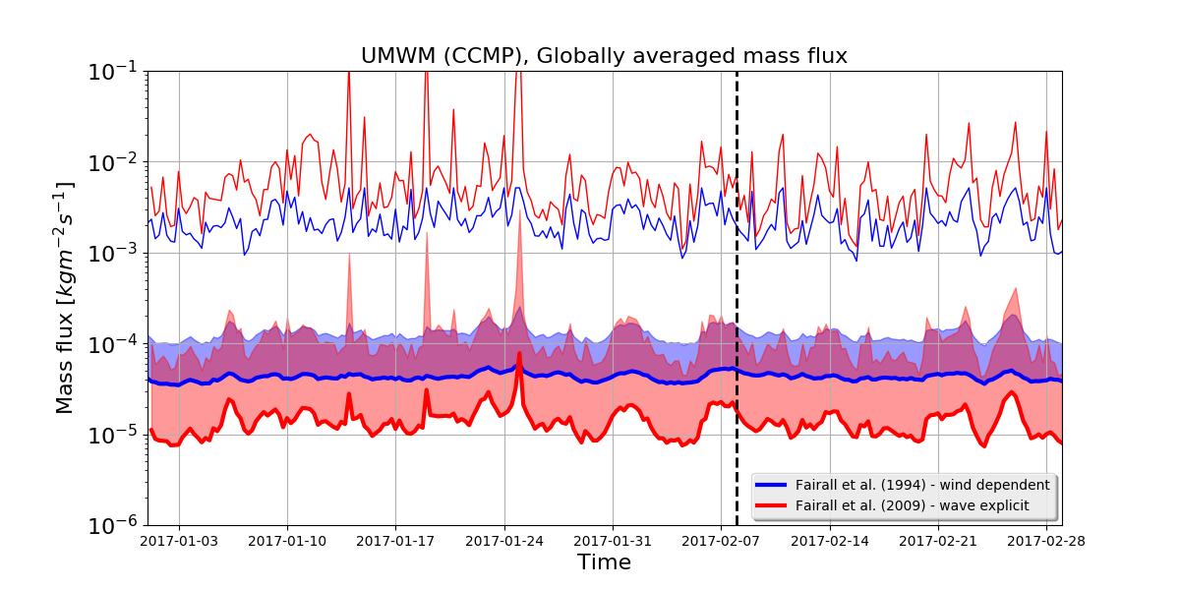
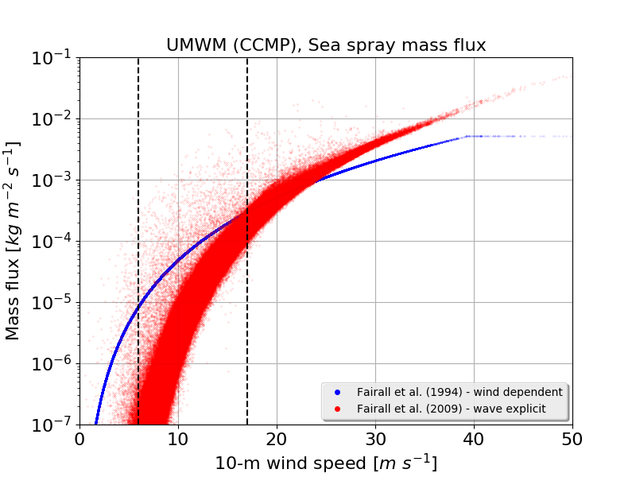
Top: Time series of globally-averaged sea spray mass flux for F94 and F09 formulations. Thick lines show average fluxes, shaded regions represent one standard deviation above the average, and thin lines represent the maximum flux out of all grid points.
Left: Scatter plot of sea spray mass flux for F94 and F09 formulations (all gridpoints and timesteps from Jan-Feb 2017). Vertical dashed lines indicate 6 m s⁻¹ and 17 m s⁻¹ wind speeds.

Slide 7
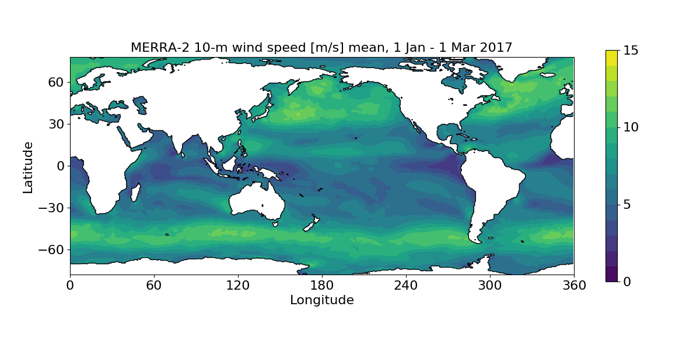
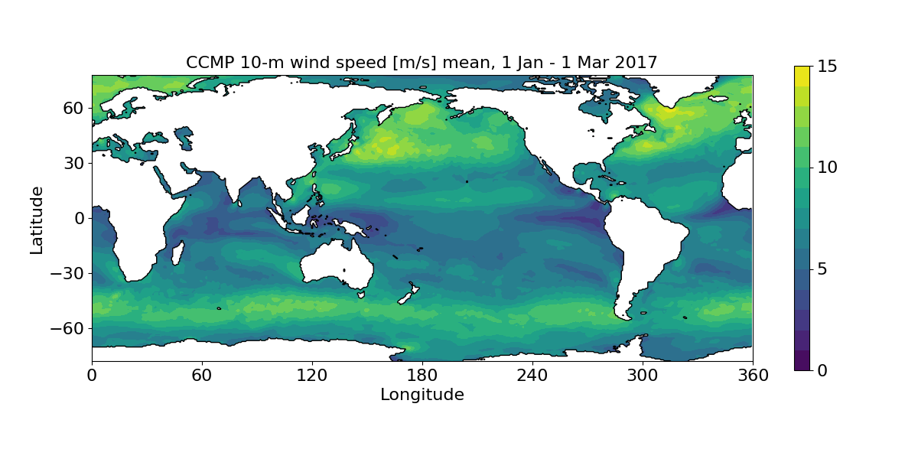
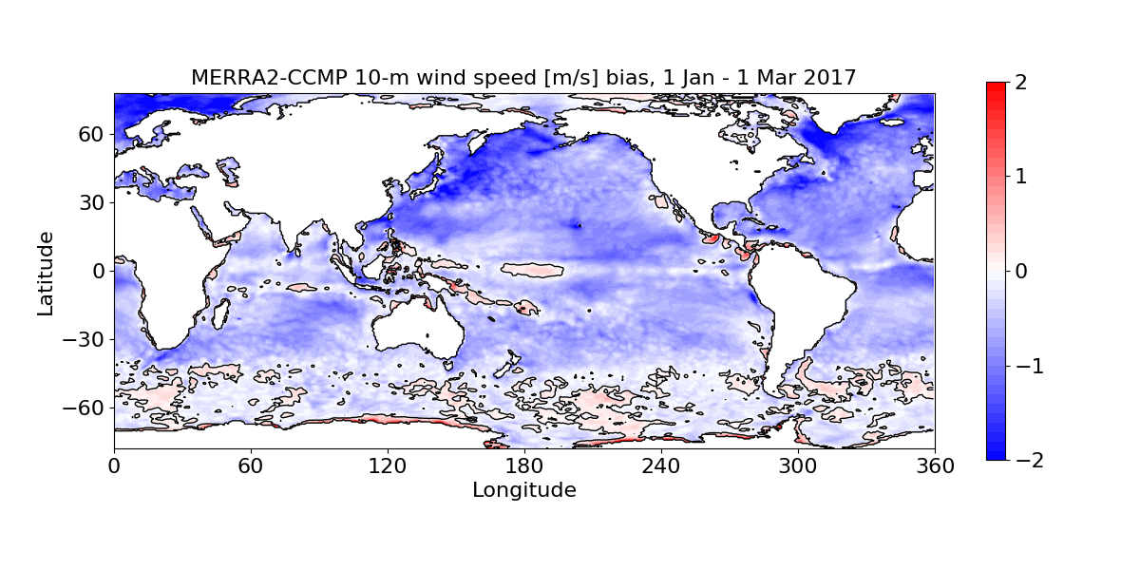
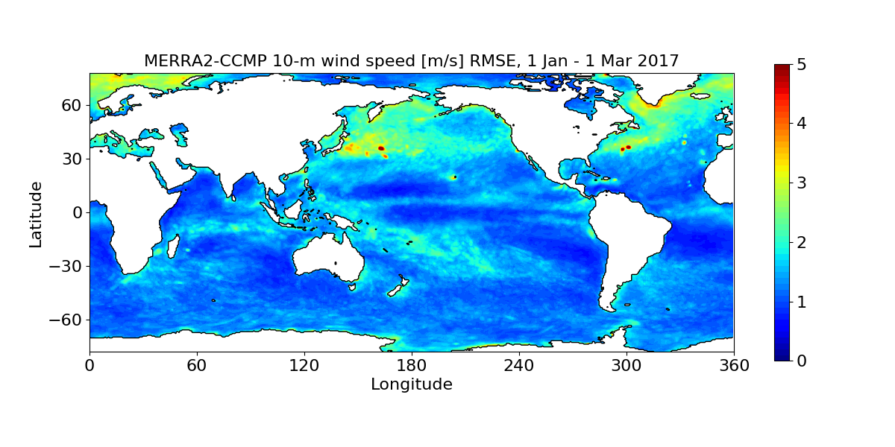
MERRA-2 and CCMP Winds 1 Jan-1 Mar 2017

Slide 8
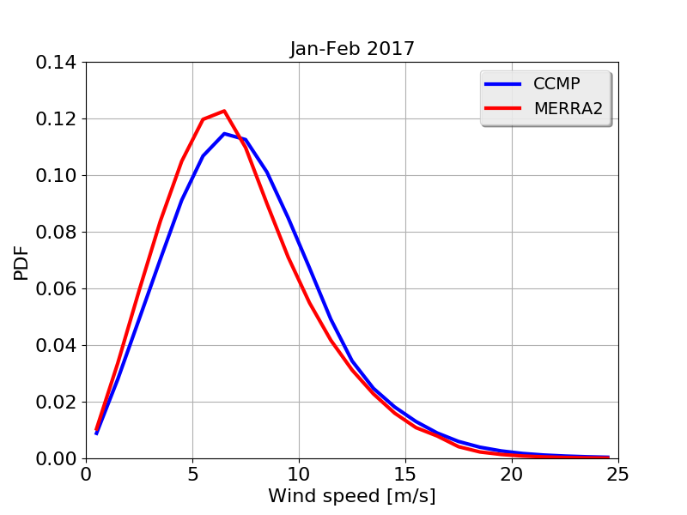

Slide 9
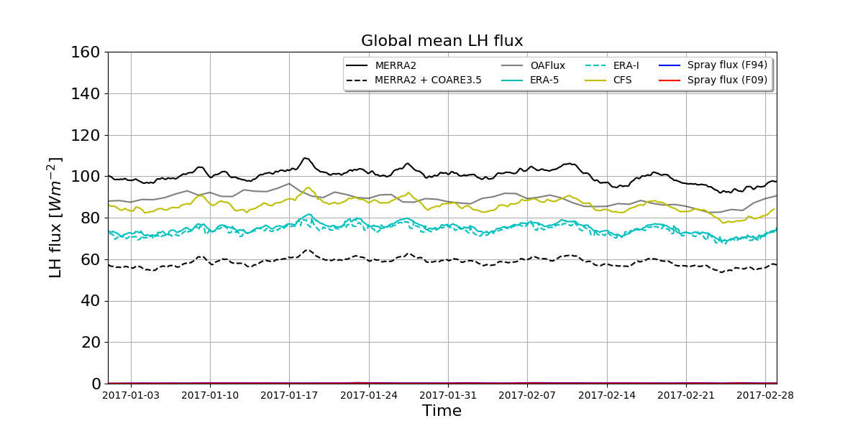

Slide 10
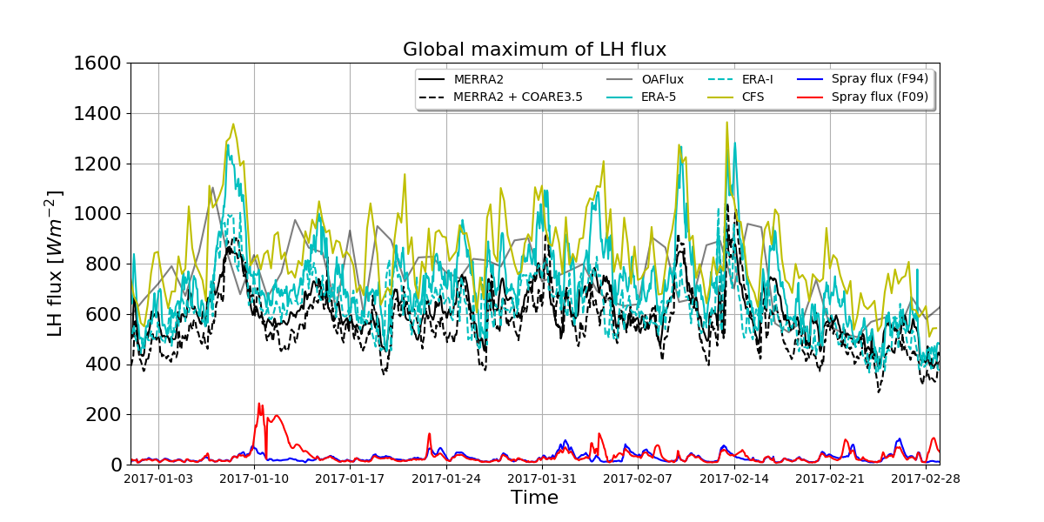

Slide 11
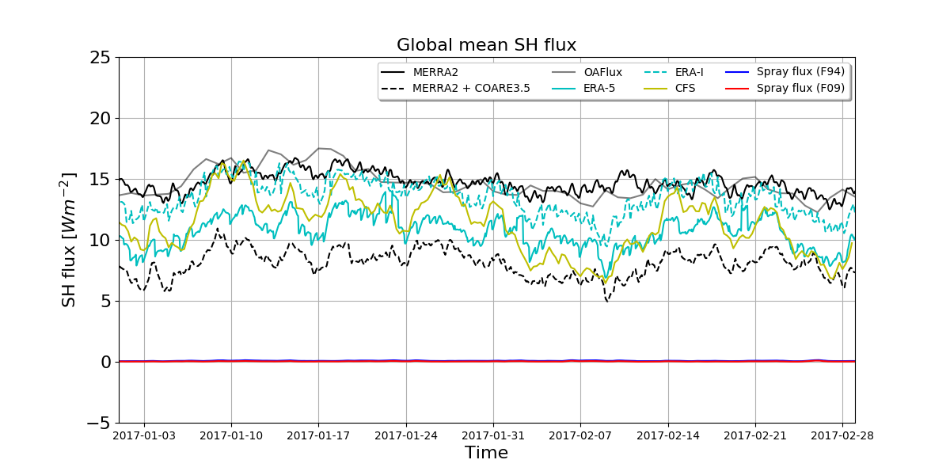

Slide 12
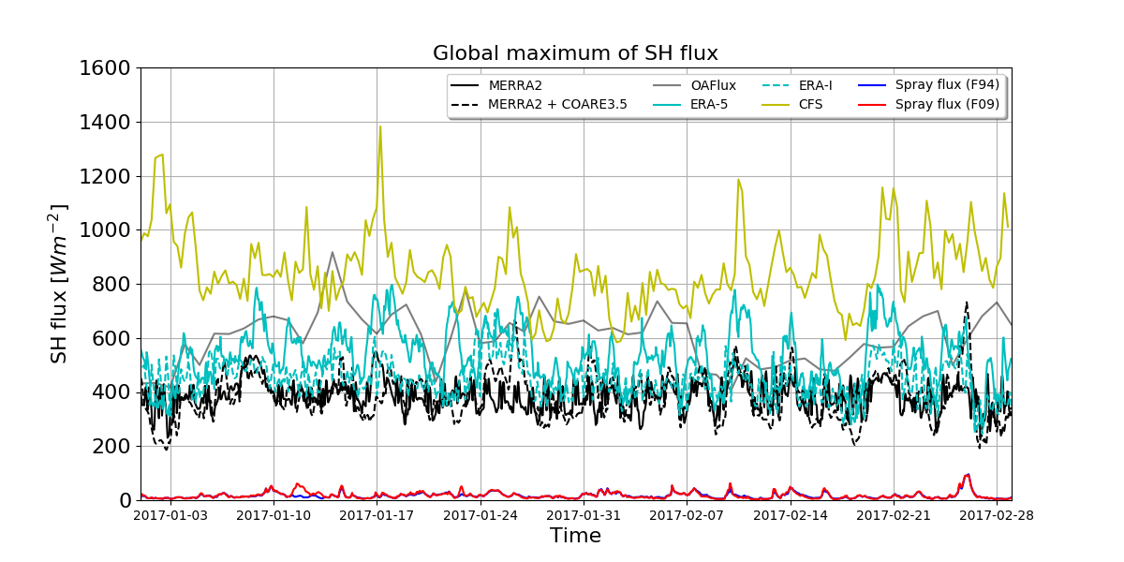

Slide 13
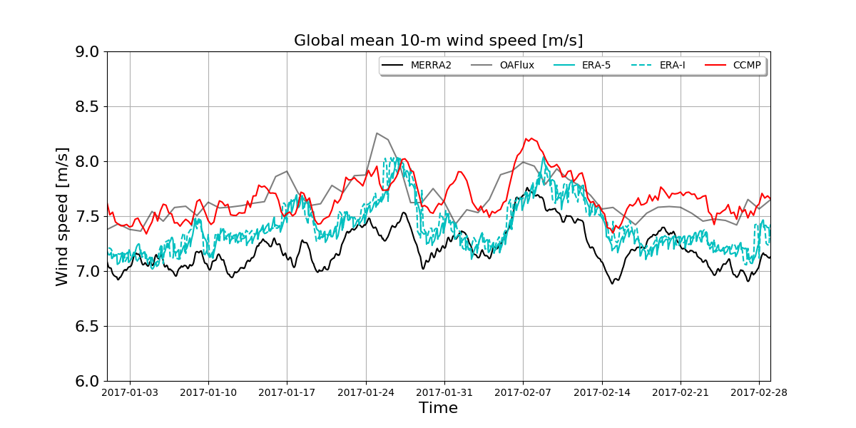

Slide 14
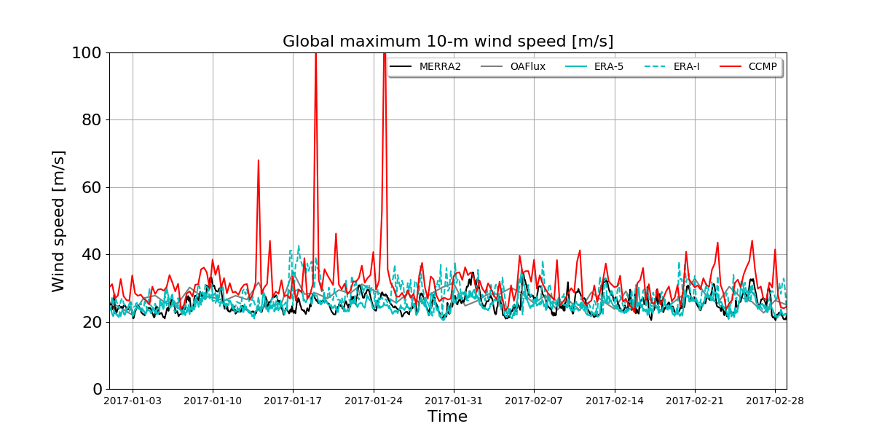

Slide 15
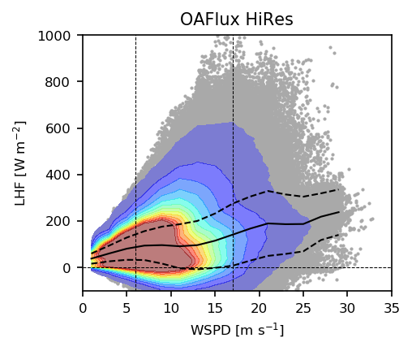
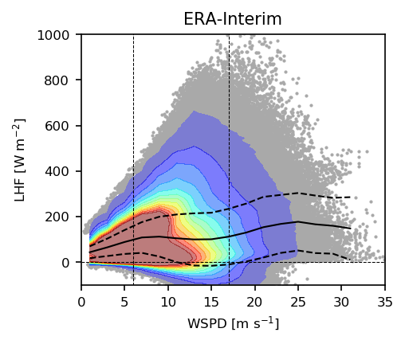
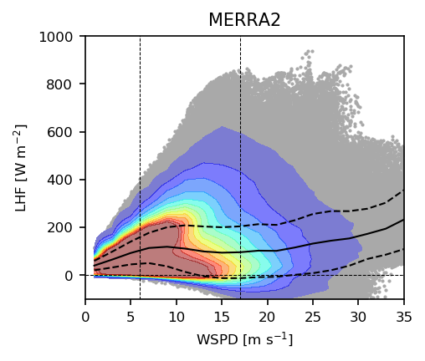
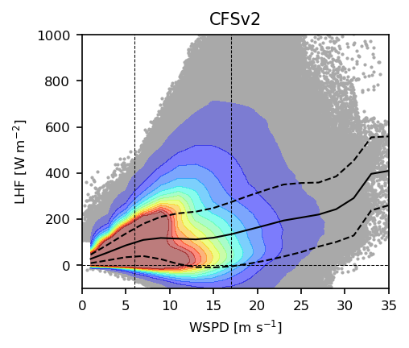
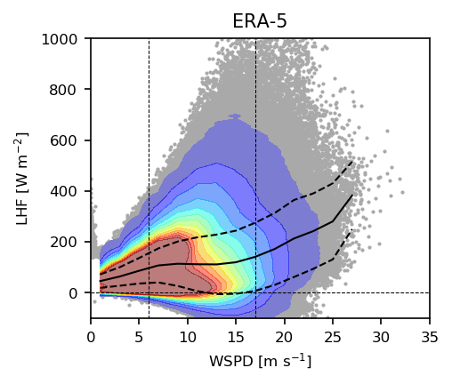
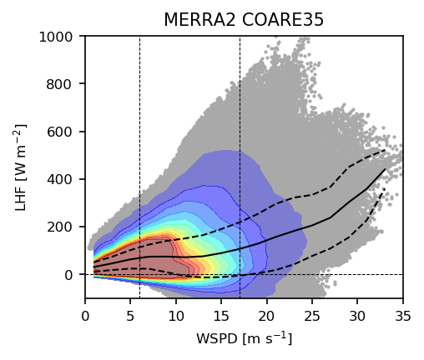
Latent Heat Fluxes

Slide 16
