Slide 1
Rain Impact on SFMR Measurements
Heather M. Holbach^{1,2,3},
B. W. Klotz^{3,4}, and M. A. Bourassa¹
¹Florida State University, ²Northern Gulf Institute, ³NOAA/AOML/HRD, ⁴University Of Miami/CIMAS

Slide 2
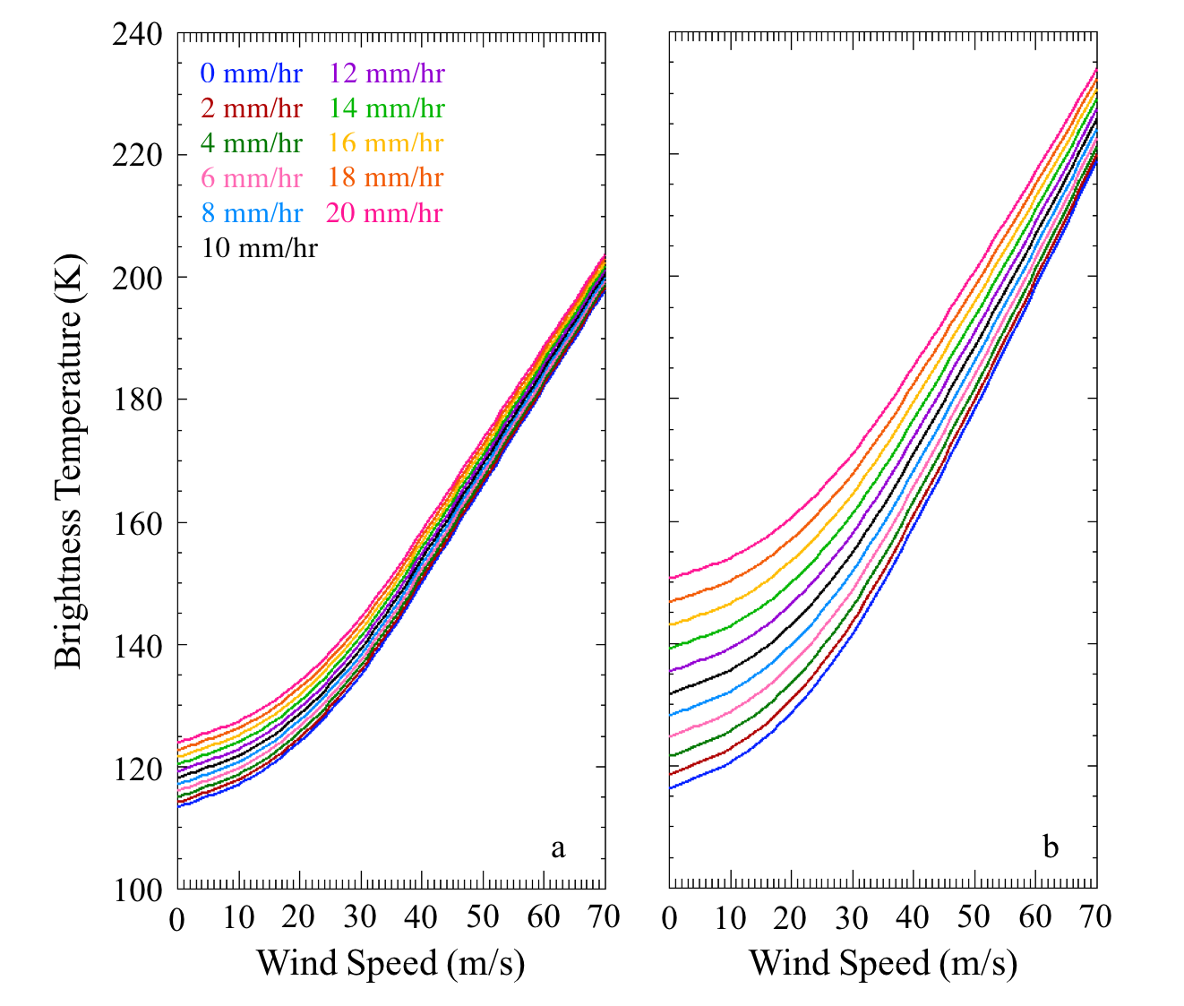
Stepped-Frequency Microwave Radiometer (SFMR)
Airborne C-band microwave radiometer
NOAA P-3 and Air Force C-130
Designed to obtain surface wind speed and rain rate measurements in tropical cyclones
Stepped-frequency design allows for rain rate retrievals
Larger differences with increasing rain rate at lower wind speeds
4.74 GHz
7.09 GHz

Slide 3
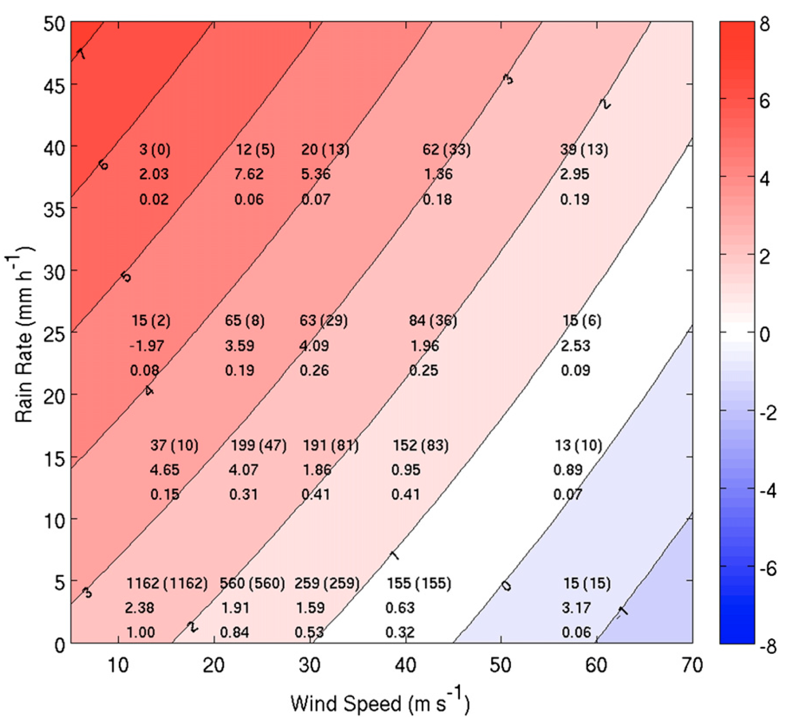
Rain Bias in Previous Algorithm (Uhlhorn et al. 2007)
Comparison to radar-derived rain rates indicated overestimate of weak rain rates and underestimate of strong rain rates (Jiang et al. 2006)
Klotz and Uhlhorn (2014) found that SFMR wind speeds were overestimated in weaker wind speeds coupled with heavy precipitation
Bias (m/s)
Figure 2 in Klotz and Uhlhorn (2014)
Notes:
Text on the figure indicates the total number of pairs within the random sample (with real pairs in parentheses, similar to Table 1), the bin-mean wind speed bias, and the bin standard deviation weight applied during the model development

Slide 4
Rain Column Height
Prior algorithm used a constant height of 4 km above the surface for rain column height
Freezing level height (H) is now estimated using flight level temperature (T_{amb}) and altitude (h) assuming a typical hurricane temperature profile (mean lapse rate, 𝛾 = 5.22 x 10⁻³ K m⁻¹ from Zhang and Uhlhorn 2012)
$$H=h+ γ^{−1}T_{amb}$$

Slide 5
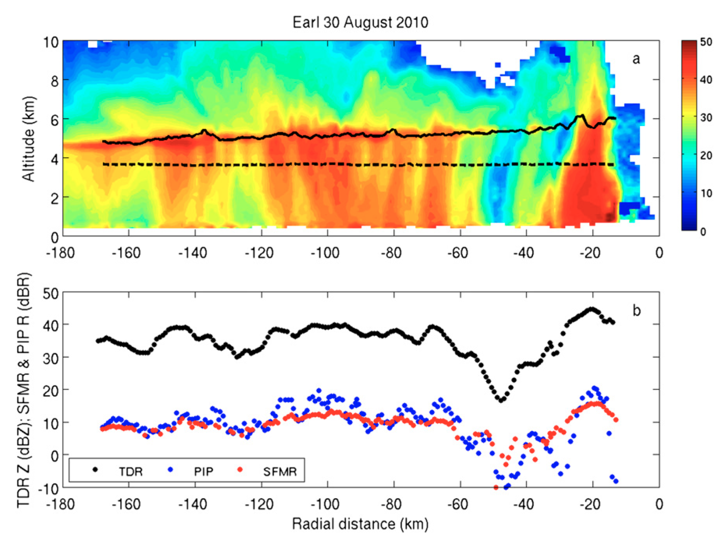
Radar Reflectivity and Rain Rate Comparison
PIP: Droplet Measurement Technologies Precipitation Imaging Probe
TDR: Tail Doppler Radar
Resulted in updated Z-R relationship:
$$Z=456R_{pip}^{1.07}$$
Reflectivity (dBZ)
Figure 5 in Klotz and Uhlhorn (2014)

Slide 6
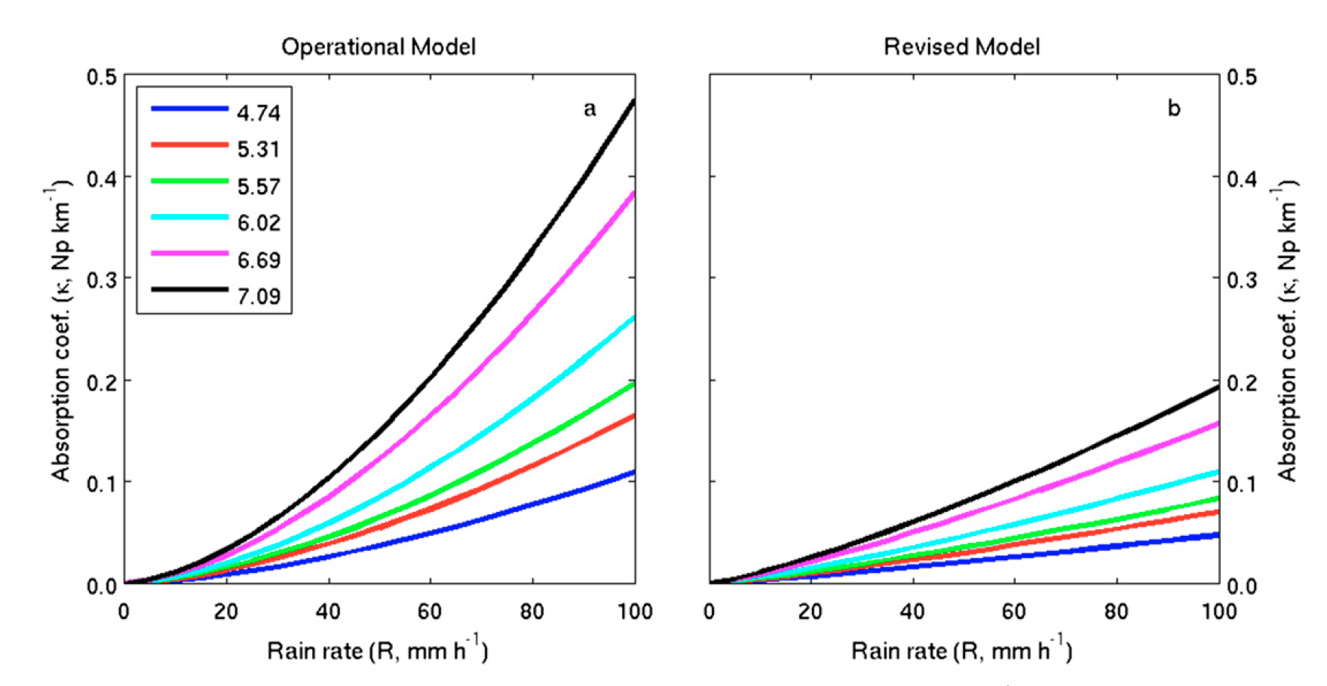
Updated Rain Absorption Coefficient
Developed by computing rain rates from the TDR and comparing to absorption coefficients computed from updated SFMR wind-induced emissivity measurements

Slide 7
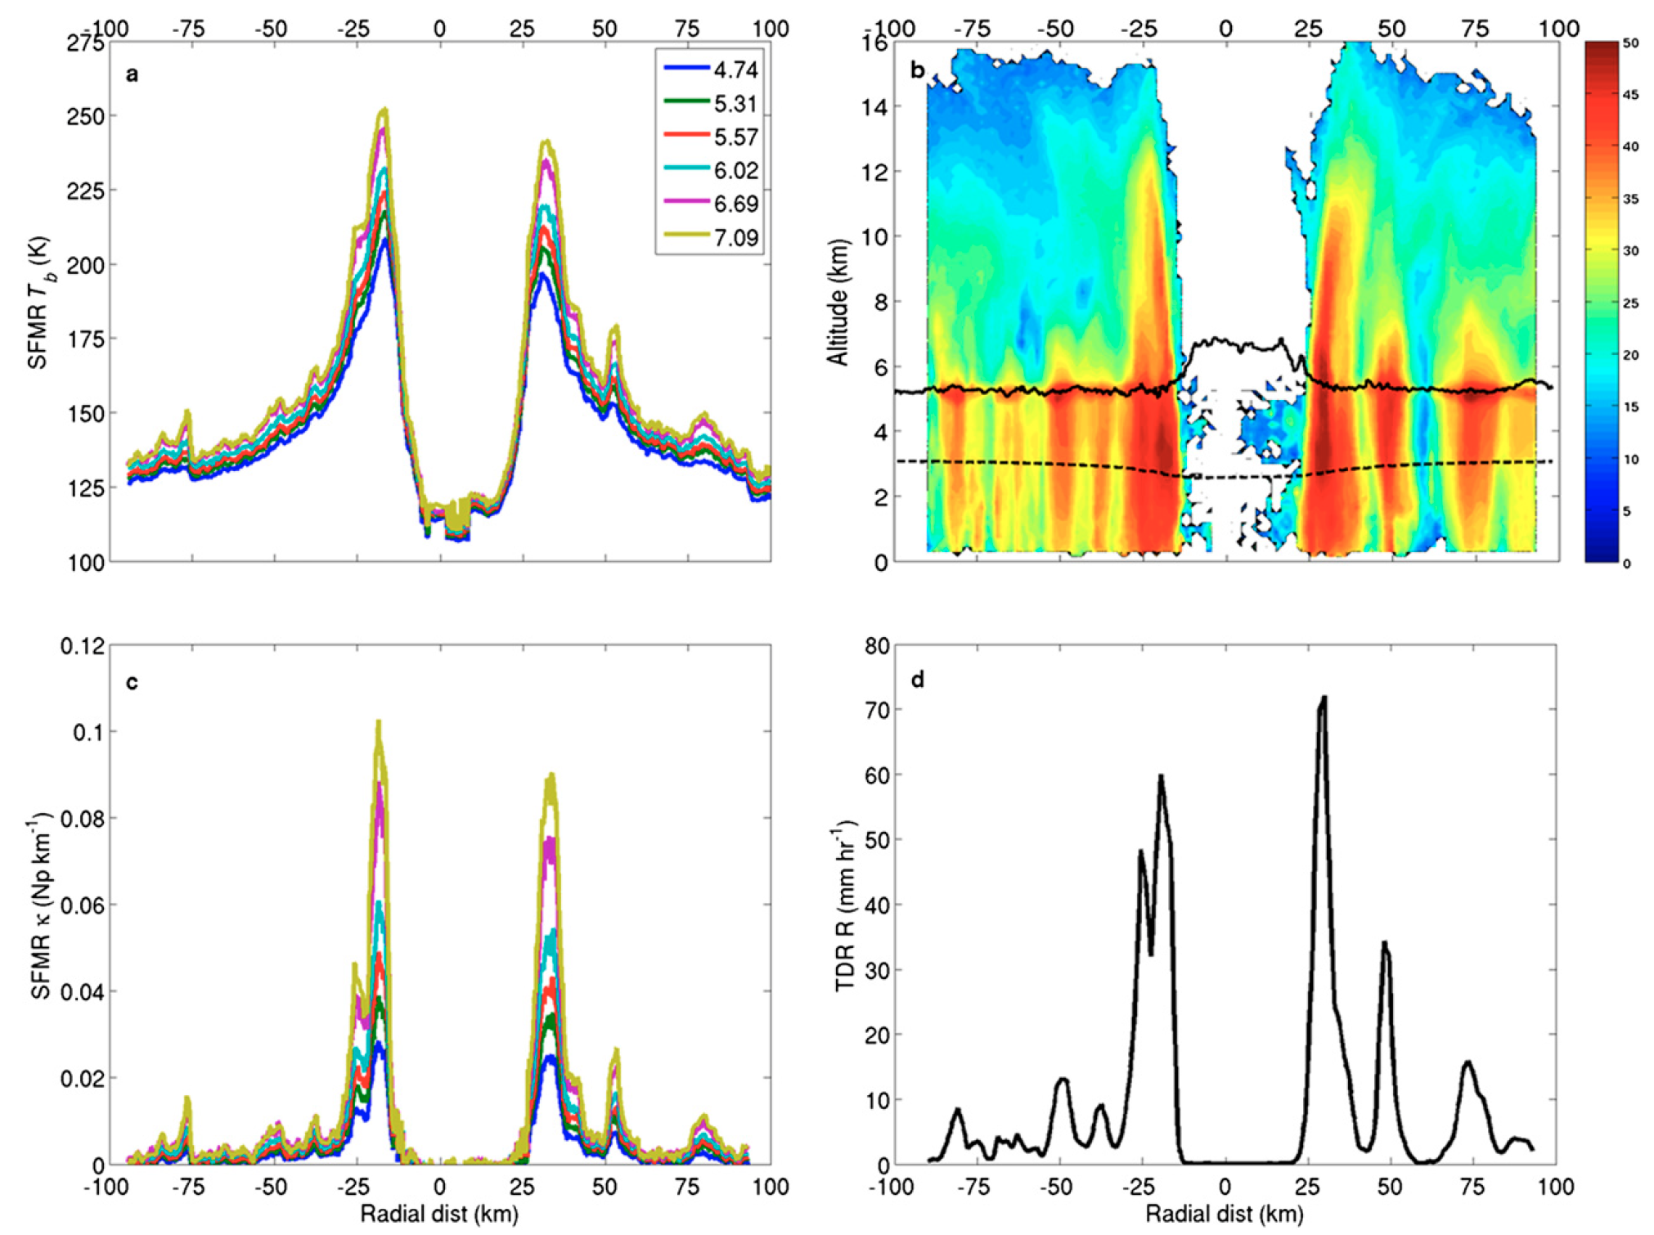
Frequency Sensitivity to Rain
SFMR T_{B}
TDR Reflectivity (dBZ)
SFMR Absorption Coefficient
TDR Rain Rate

Slide 8
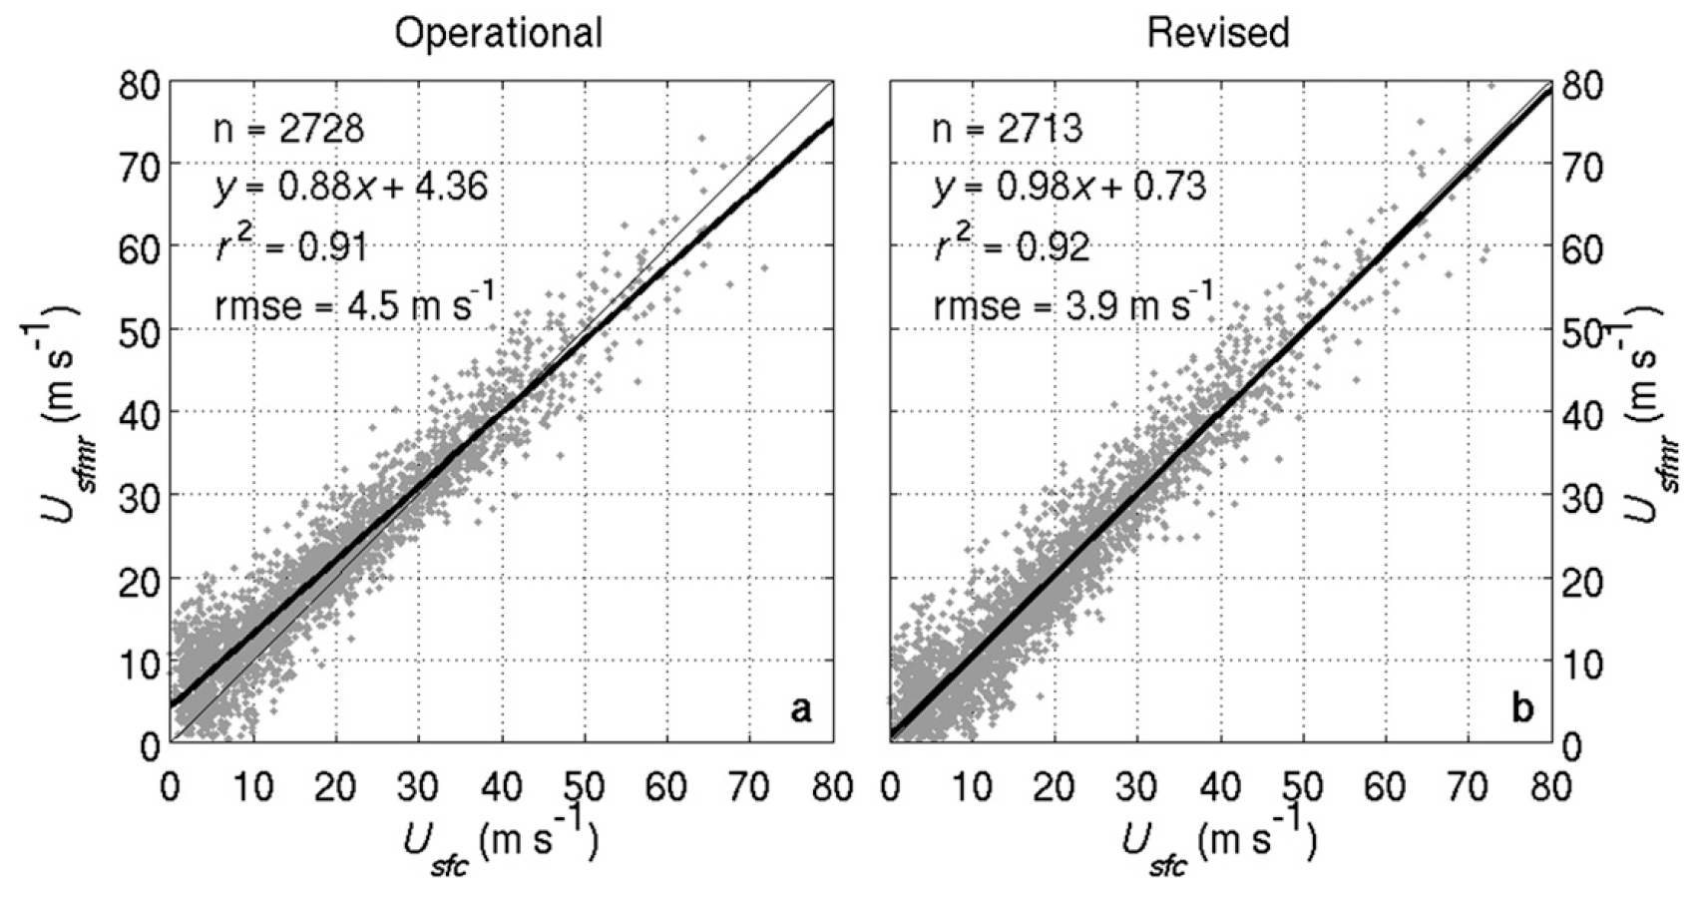
Wind Speed Improvements
Previous
Operational

Slide 9
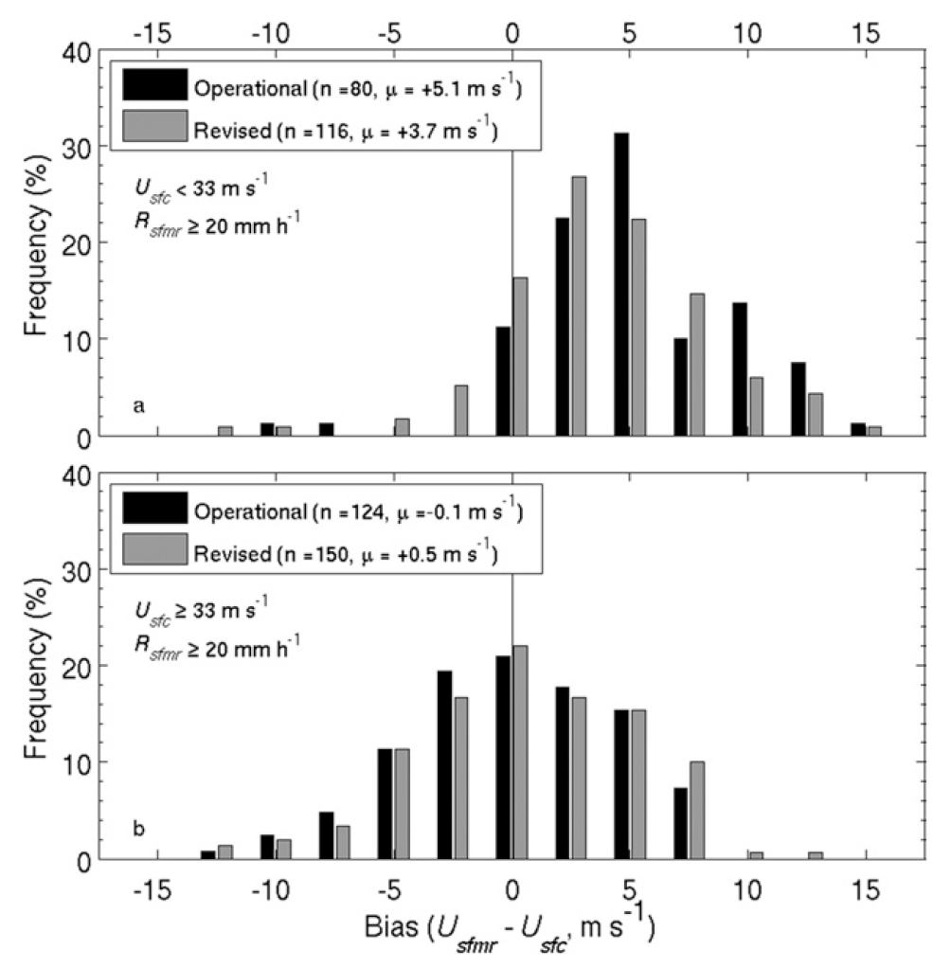
Improved Bias

Slide 10
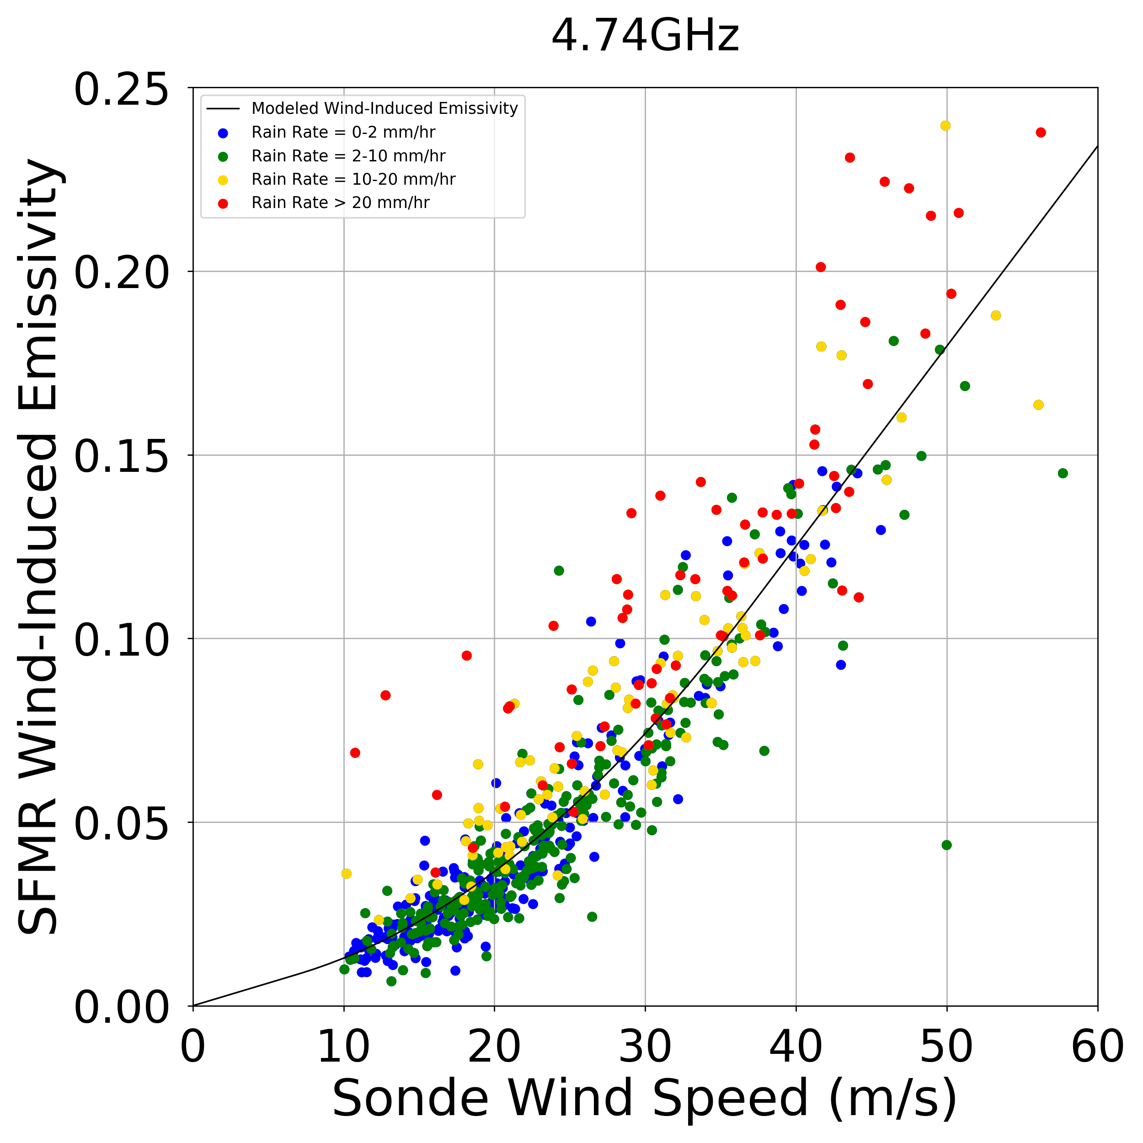
Further Room For Improvement

Slide 11
Summary
Klotz and Uhlhorn (2014) greatly improved the rain-related biases in the previous SFMR algorithm
Largest impact at low wind speeds coupled with high rain rates
All data from 1998-present has been re-processed using this new algorithm.
Data can be found here: ftp://ftp.aoml.noaa.gov/hrd/pub/data/sfmr/
Future work:
Identify source of remaining high rain-rate error
Investigate impact of rain-related surface water freshening
How does rain impact whitewater/foam/spray at very high wind speeds?
I am new HRD SFMR contact: heather.holbach@noaa.gov

Slide 12
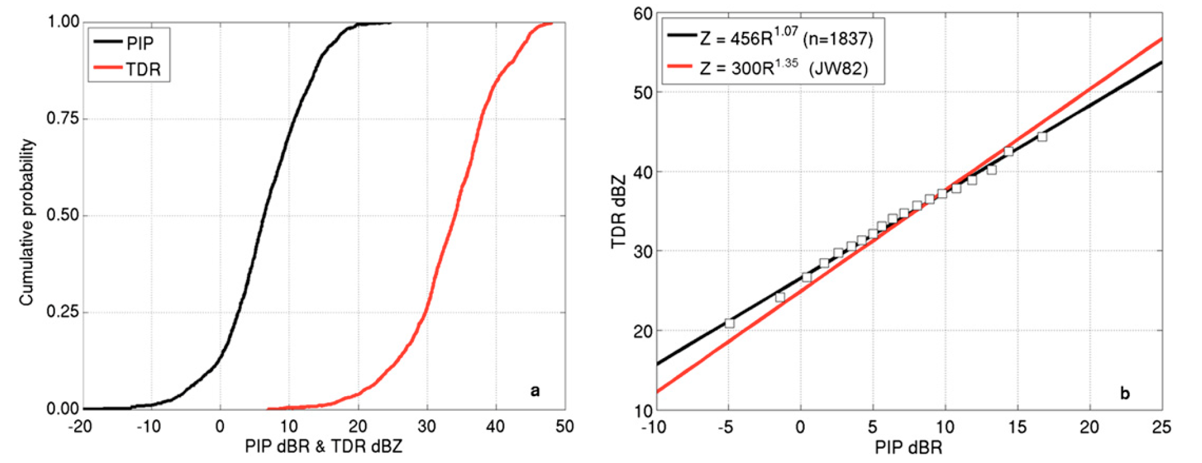
New Z-R Relationship
Estimated using statistical probability matching
Figure 6 in Klotz and Uhlhorn (2014)

