Slide 1

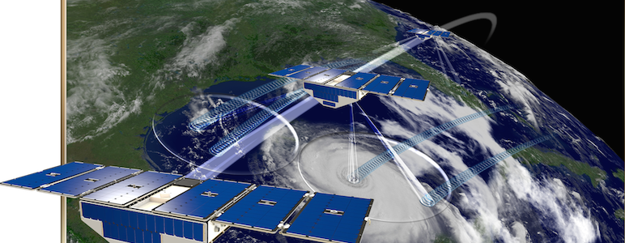
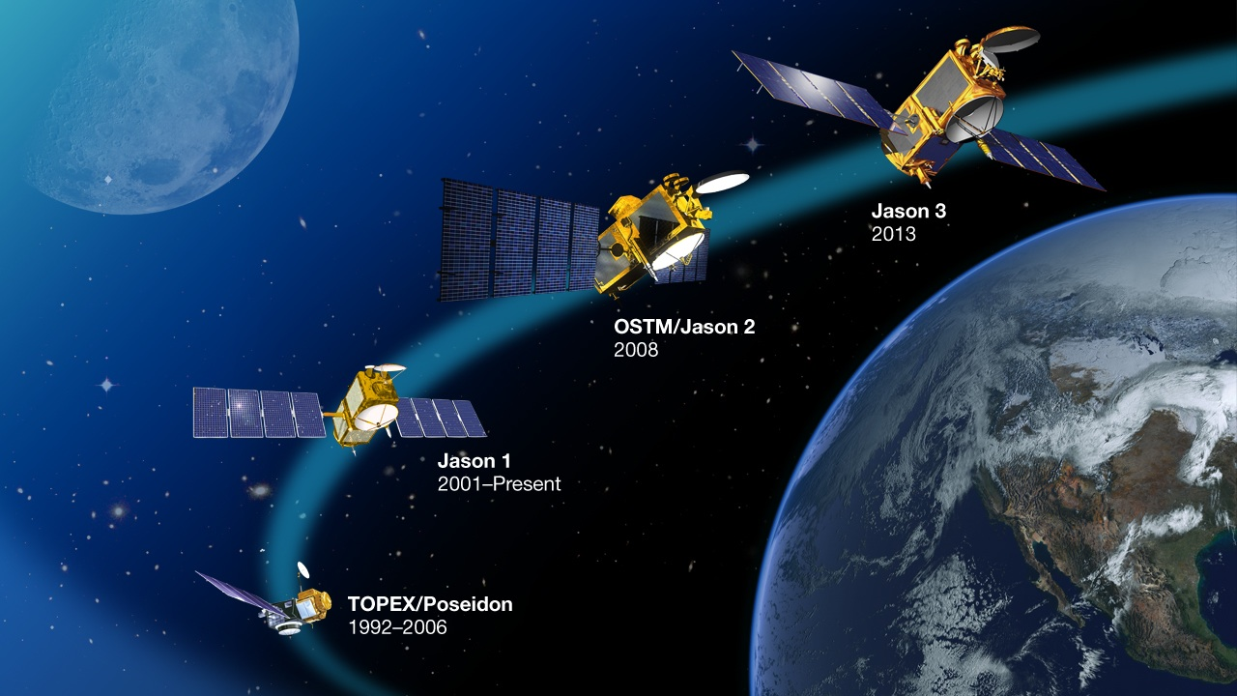
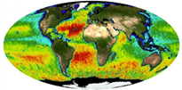
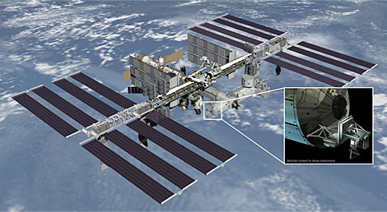
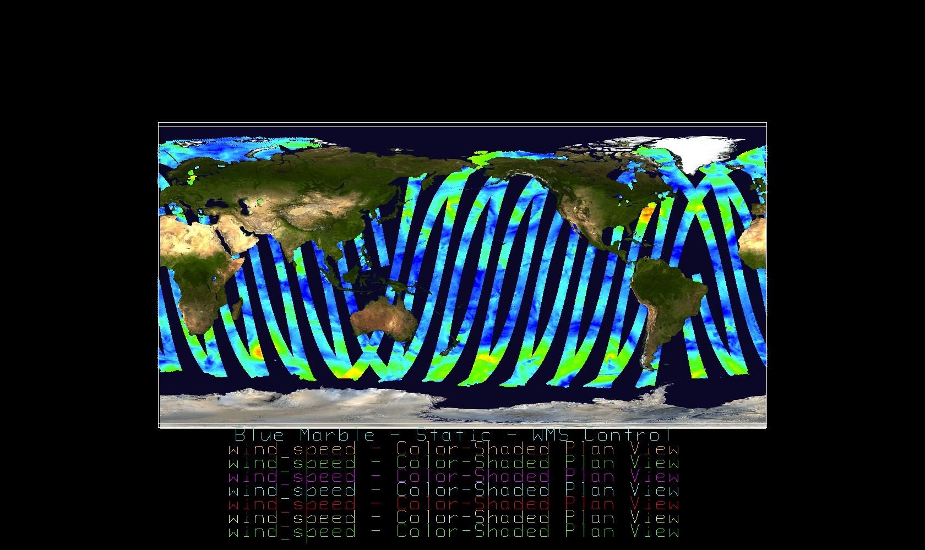
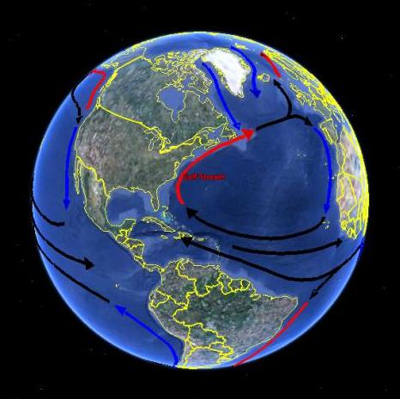
Latest Datasets and Services at the:
David Moroni
David.F.Moroni@jpl.nasa.gov
PO.DAAC Data Stewardship and User Services Team Manager
Jet Propulsion Laboratory, California Institute of Technology, Pasadena, CA
© 2018 California Institute of Technology. Pasadena, CA. Government sponsorship acknowledged.

Slide 2
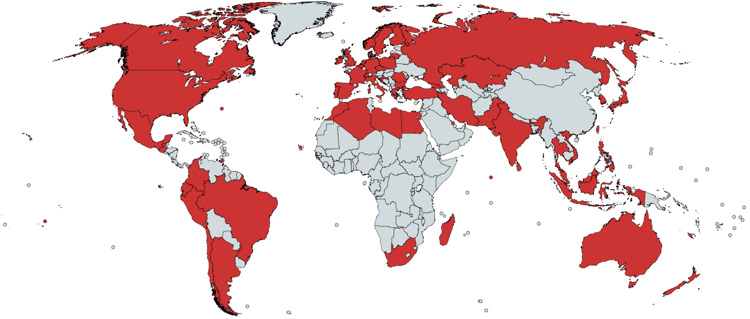
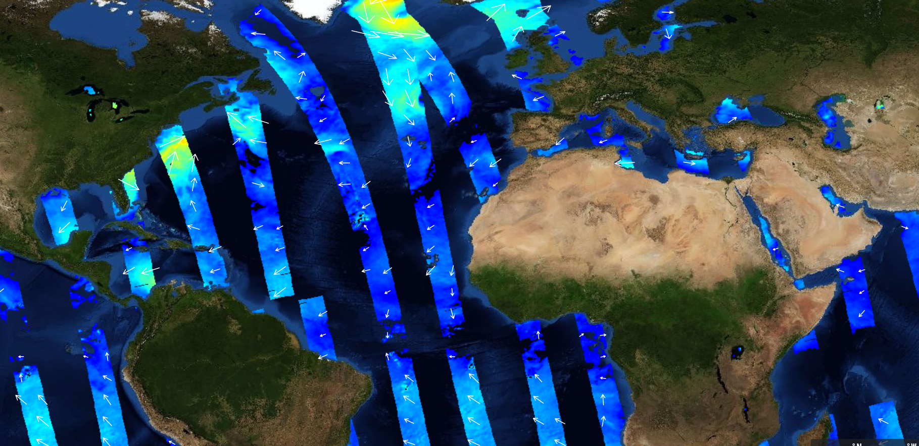
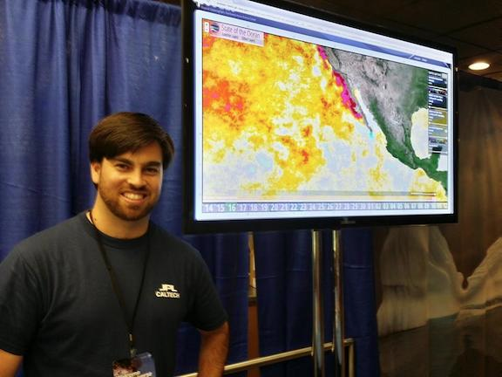
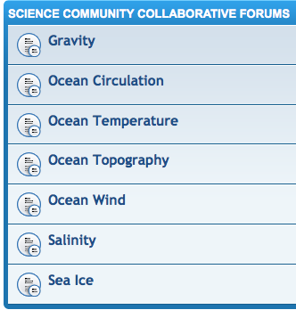
The Role of PO.DAAC
Data Management & Stewardship
Data Access
Preserve and distribute oceanographic data for the benefit of future generations domestically and abroad.
Provide intuitive services to discover, select, extract and utilize oceanographic data.
Information Services and Forum
Science data specialists
Human-to-human interaction
Knowledgebase and FAQs
Guidance and resource materials

Slide 3
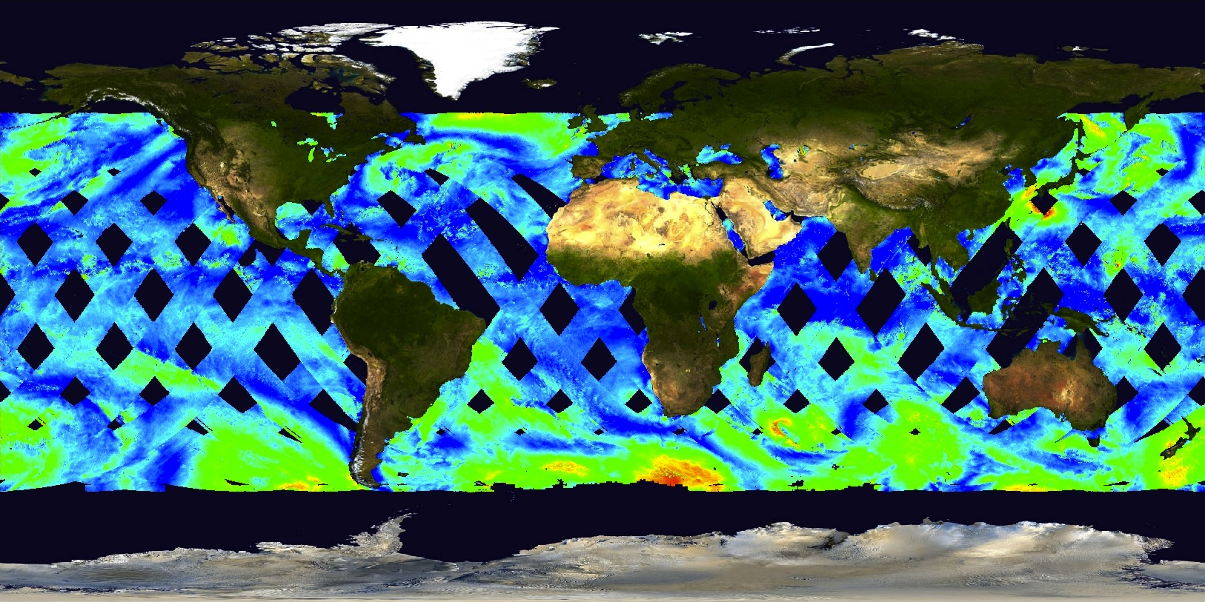
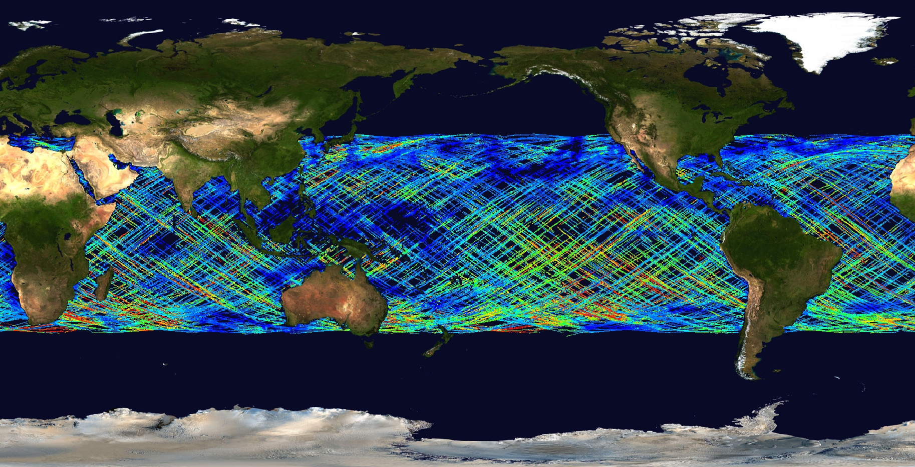
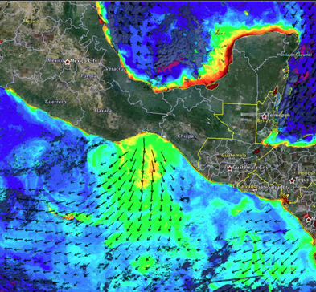
Overview of Data Sources
Supported NASA Missions & Projects
Other Missions & Projects
Seasat, TOPEX/Poseidon, Jason-1, NSCAT, SeaWinds on ADEOS-II, CYGNSS, QuikSCAT, ISS-RapidScat, Terra, Aqua, GRACE, GHRSST, MeASUREs, Aquarius, SPURS
AVHRR-Pathfinder, DMSP (SSMI, SSMIS), GEOS-3, GOES, MetOp-A/B,
Oceansat-II, WindSat.
Physical Oceanographic Data
600 Publicly Distributed Datasets
72 Near-Real-Time (NRT)
RapidScat L2B Wind Speed
Gravity
Ocean Circulation & Currents
Ocean Surface Salinity
Ocean Surface Topography
Ocean Vector Winds
Sea Surface Temperature
Sea Ice
ASCAT L2 Coastal Winds
MODIS Chlorophyll-A
CYGNSS V2.0 Wind Speed

Slide 4
15 New Wind Datasets
Version 5.0 Aquarius/SAC-D Wind Speed
  Released 7 Dec. 2017.
  Daily, 7 day, monthly, seasonal, annual
SMAP L2/L3 CAP Version 4.0 (JPL) Wind Speed Released 22 Feb 2018.
  Daily, 8-Day, Monthly; 60 km L2; 0.25x0.25 degree L3.
RapidScat L2B Climate Version 2.0, 12.5-km netCDF-4
  Released 11 April 2018
  SST-dependent GMF with cross-swath bias corrections.
  Simplified flagging schema with new flags.
QuikSCAT L2B Version 4.0 @ 12.5 km, netCDF-4
  Released 5 April 2018.
  Complete historical reprocessing, provides closer land retrieval using Land Contamination Ratio (LCR) algorithm.
MetOp-A ASCAT L2 Wind Vector CDR
  12.5-km (Coastal) and 25-km
  Consistently reprocessed, CMOD7, 1Jan2007 to 31Mar2014
CYGNSS Version 2.0 L1, L2, and L3 netCDF
  Released 19 Dec. 2017.
  First science quality, full public release.
  18 March 2017 to present day.
  6-day latency.
Note: DOIs are now available for all “Open” Datasets! Please cite accordingly when publishing.
https://podaac.jpl.nasa.gov/CitingPODAAC

Slide 5
File Transfer Protocol (FTP): ftp://podaac.jpl.nasa.gov
Open-source Project for a Network Data Access Protocol (OPeNDAP):
http://opendap.jpl.nasa.gov
FTP Replacement: PO.DAAC Drive interface with WebDAV client:
https://podaac-uat.jpl.nasa.gov/drive/
Thematic Real-time Environmental Distributed Data Service (THREDDS):
https://thredds.jpl.nasa.gov
Web Services (search/subset/extract):
https://podaac.jpl.nasa.gov/ws
PO.DAAC-PY (Python Library Toolkit):
https://github.com/nasa/podaacpy
Data Recipes: http://bit.ly/datarecipes
State of the Oceans (SOTO) upgraded to Version 4.2.1.
Enhanced Map functionality and Full Time Series Backfill!
Added layers: Sea-Ice Concentration, Soil Moisture, Surface Precip.
Extended browser compatibility: Chrome, Firefox, Safari.
https://podaac-tools.jpl.nasa.gov/soto/
HiTIDE L2 Subsetter Updated: Version 4.2.0
Granule Merge Feature
ASCAT, QuikSCAT, and RapidScat Available!
CYGNSS coming soon!

Slide 6
Upcoming Datasets and Services
Datasets:
Cyclone Global Navigation Satellite System (CYGNSS):
Version 2.1: Science Team evaluation is nearly complete.
ASCAT: MetOp-B and MetOp-A CDR (TBD in 2019, KNMI).
Salinity Continuity Project (SCP): Periodically re-processed salinity and wind speed datasets from SMAP.
Includes datasets coming from both RSS and JPL.
  Services:
  SOTO Next Generation:
  On-demand Analytics + More Data Layers
  More wind layers: RapidScat, QuikSCAT, and CYGNSS.
  HiTIDE Data Infusion:
  CYGNSS, QuikSCAT v4, RapidScat v2.
  Drive Version 1.4.2:
  More consistent browser UX vs. FTP.
  WebDav directory structure more consistent with FTP.

Slide 7
Comments/Questions Always Welcome!
FTP-Retirement coming very soon, likely by end of 2018.
Tutorials: http://bit.ly/podaactutorials
User Forum: https://podaac.jpl.nasa.gov/forum/
  Data Recipes (server-side subsetting, numerical analysis, machine learning, etc…)
  Tutorials (search, extract, subset, tools, services, etc…)
  Frequently Asked Questions (FAQs)
  User Questions
  Ocean Stories
How to get URS Account: https://urs.earthdata.nasa.gov/users/new
Join our Mailing list: podaac@podaac.jpl.nasa.gov

