Slide 1
Validation of CYGNSS winds using microwave scatterometers/radiometers
Lucrezia Ricciardulli, Thomas Meissner and Frank Wentz
Remote Sensing Systems, Santa Rosa, CA, USA
IOVWST Meeting, April 2018
Barcelona, Spain
Acknowledgements: This work is supported by the NASA OVWST and SMAP Science

Slide 2
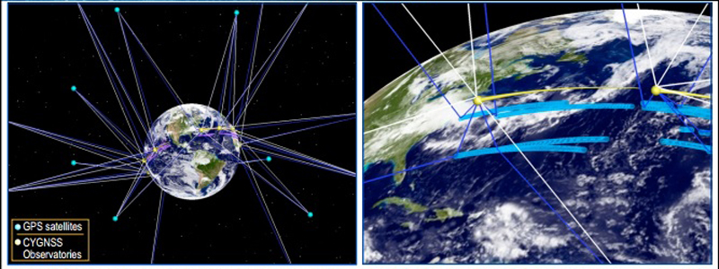
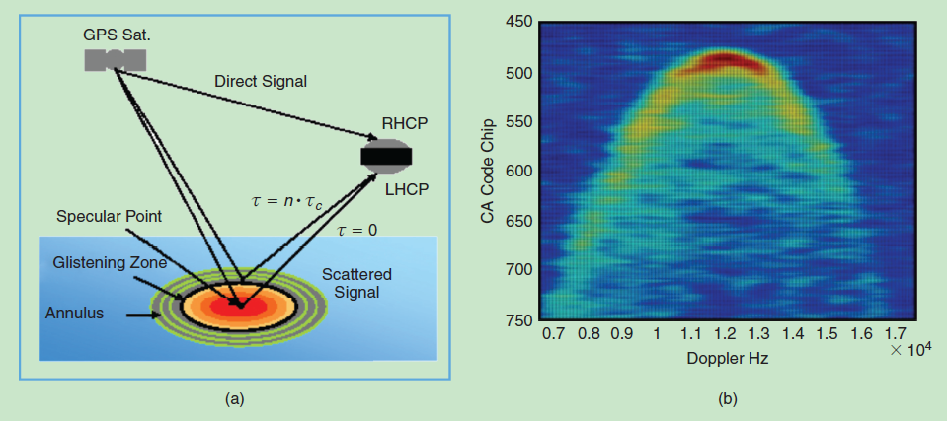
CYGNSS
Cyclone Global Navigation Satellite System
Mission launched Dec 2016
Objective: New approach to reduce cost and gather more data in tropical cyclones.
PI: Chris Ruf, University of Michigan Ann Arbor
8 LEO micro satellites: Use GPS technology to measure wind speed in the tropics (40NS)
GPS bi-static scatterometry measures ocean surface winds at all speeds and under all levels of precipitation.
The direct signals pinpoint S/C positions, while the reflected signals respond to ocean surface roughness, from which wind speed is retrieved.
Observations by Doppler Delay Mapping:
Specular point
CYGNSS satellites collect direct GPS signal (L-band) and signal scattered off the ocean surface around specular points.
Glistening zone
(width depends on surface roughness)

Slide 3
SCIENCE DATA Release history:
Launch: Dec 2016
Version 1.1: June 2017 (beginning of Hurricane season): Significant calibration issues
Version 2.0: December 2017: Quality improved but not yet sufficient for reliable TC observations
Version 2.1: To be released before summer: Major calibration improvements expected
Some errors were fixed
Changes in Quality Control/Flagging
Possibly different GMF

Slide 4
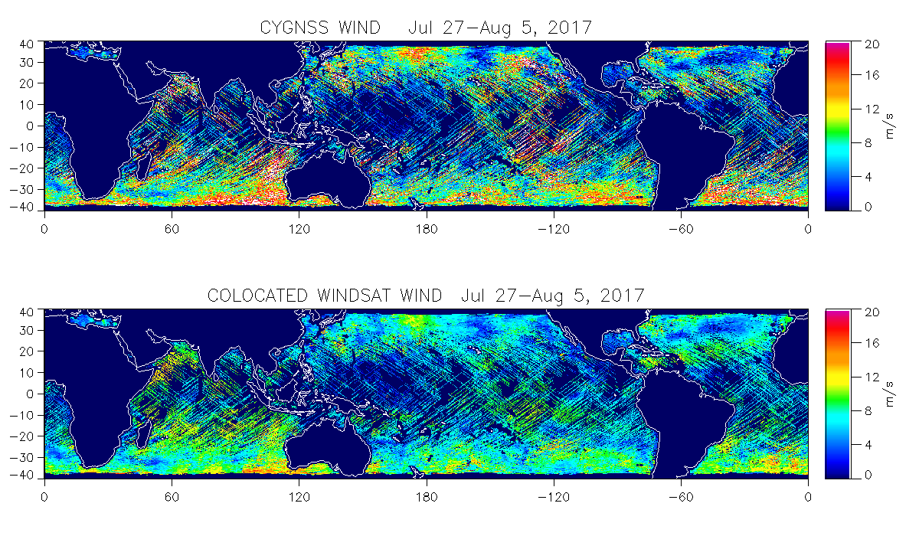
VERSION 1.1: FIRST LOOK, SEP/OCT 2017
10-day average of colocations with WindSat
CYGNSS V1.1
Major biases at high winds, poorly intercalibrated individual receivers
WindSat
(3 hr colocations shown)
In CYGNSS V1.1, higher winds are on average higher than WindSat
Notes:
Might skip…

Slide 5
RSS Analysis of CYGNSS V2.0 vs SMAP and ASCAT
METHOD
We colocated CYGNSS vs SMAP and vs ASCAT within 60 minutes
Used CYGNSS V2.0 Level 3 (L3) complete dataset, from March 2017 to mid February 2018
ASCAT was rain flagged using scatterometer rain flag
SMAP data is not rain flagged because is not affected by rain
We found about 5 million colocations with SMAP, 8 millions with ASCAT
At very high winds w> 20 m/s, we found 4500 colocations with SMAP.
Note: SMAP winds below 15 m/s are not as accurate as ASCAT
The strength of SMAP retrievals is for w> 15 m/s, up to 70 m/s
Statistical analysis of biases, and analysis of some sample storms

Slide 6
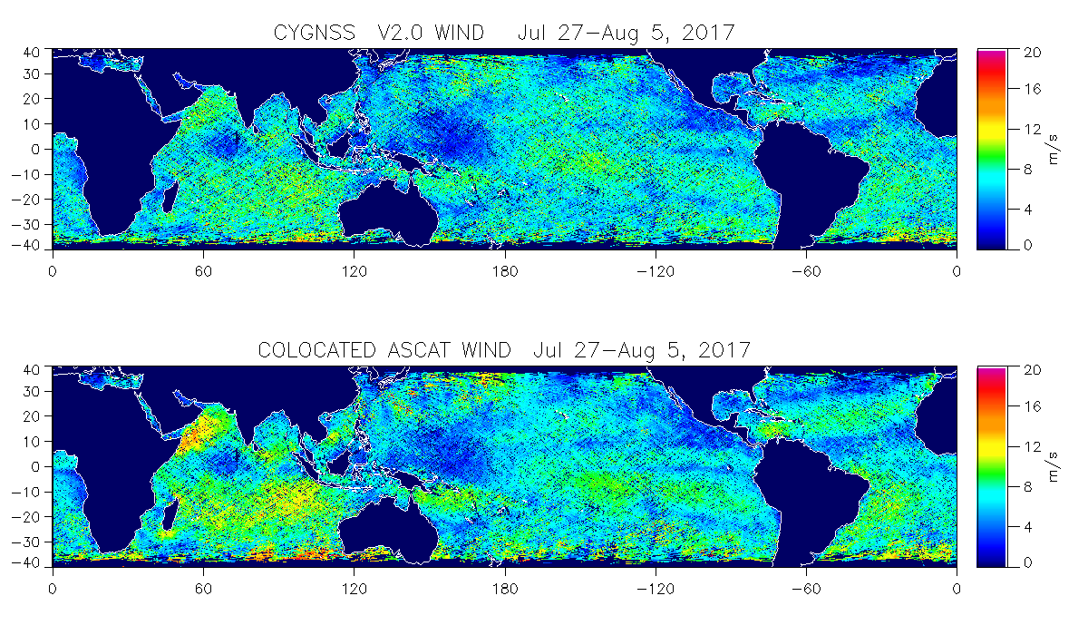
CYGNSS V2.0
Col. ASCAT
In CYGNSS V2, higher winds are significantly lower than ASCAT or other satellite winds

Slide 7
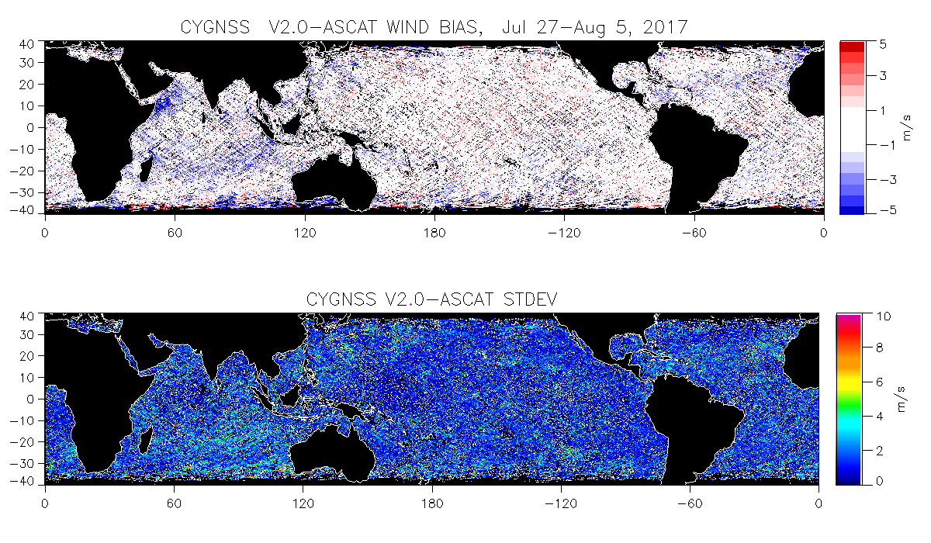
CYGNSS V2.0-ASCAT bias
CYGNSS V2.0-ASCAT St Dev

Slide 8
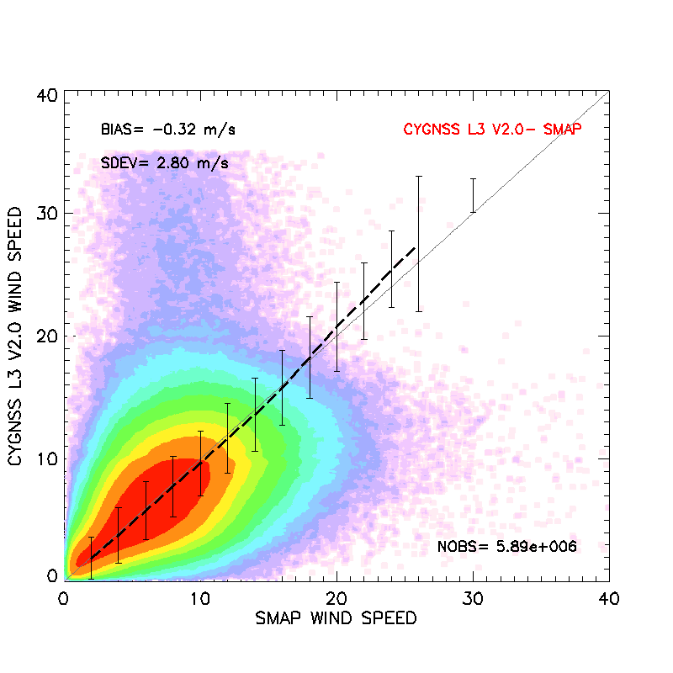
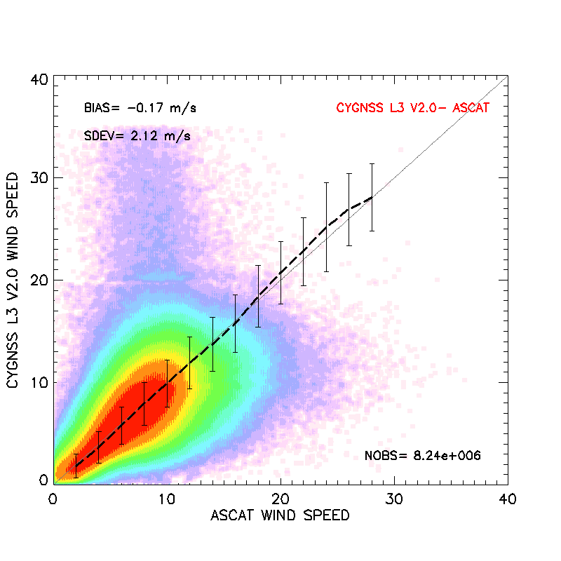
Comparison CYGNSS V2.0 vs SMAP and ASCAT
CYGNSS
CYGNSS
SMAP
ASCAT
The average bias line (dashed) might seem good, but on a closer look, those high winds in CYGNSS are just bad retrievals.
The real high winds are missing in CYGNSS V2 L3. See next slides

Slide 9
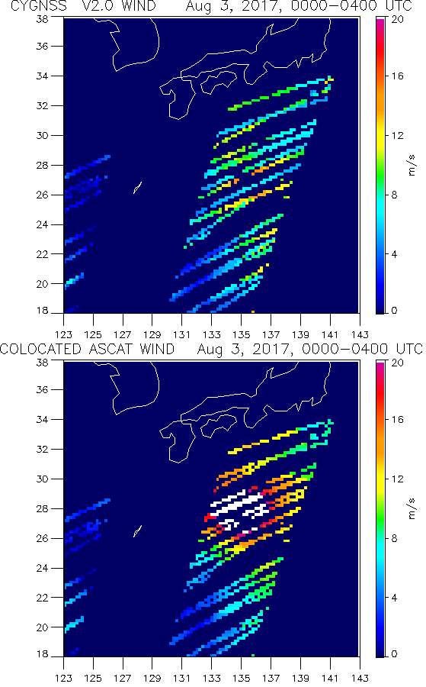
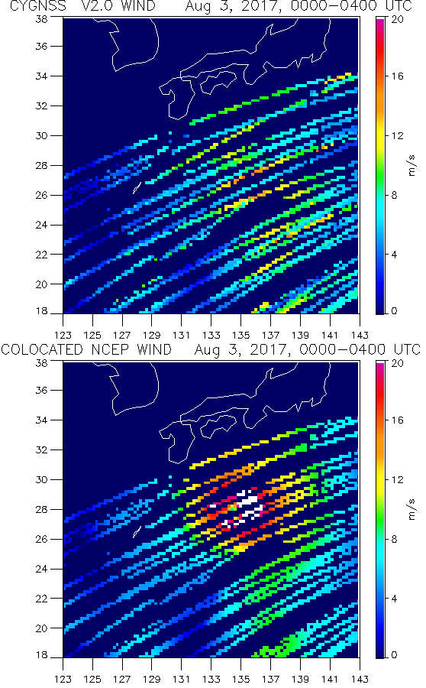
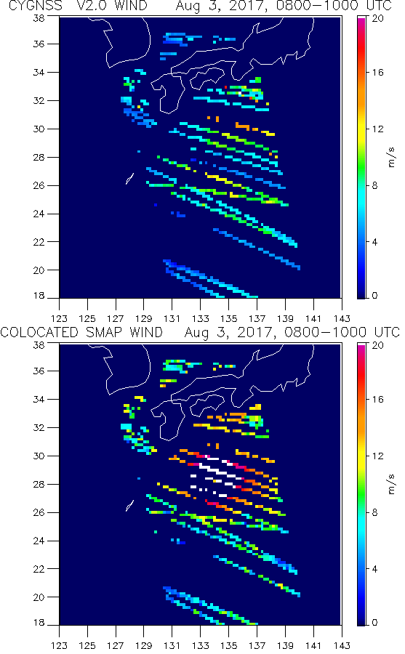
NORU super typhoon (Cat 5 !), CYGNSS V2.0: Almost no sign of a storm in V2 L3 data
CYGNSS V2
CYGNSS V2
CYGNSS V2
ASCAT
NCEP GDAS
SMAP

Slide 10
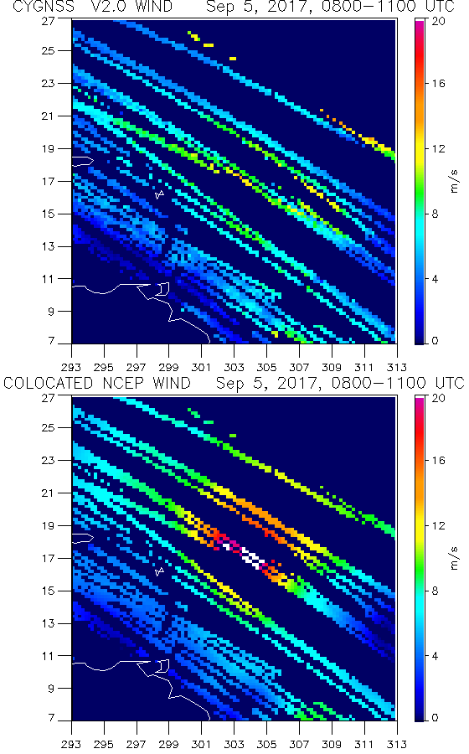
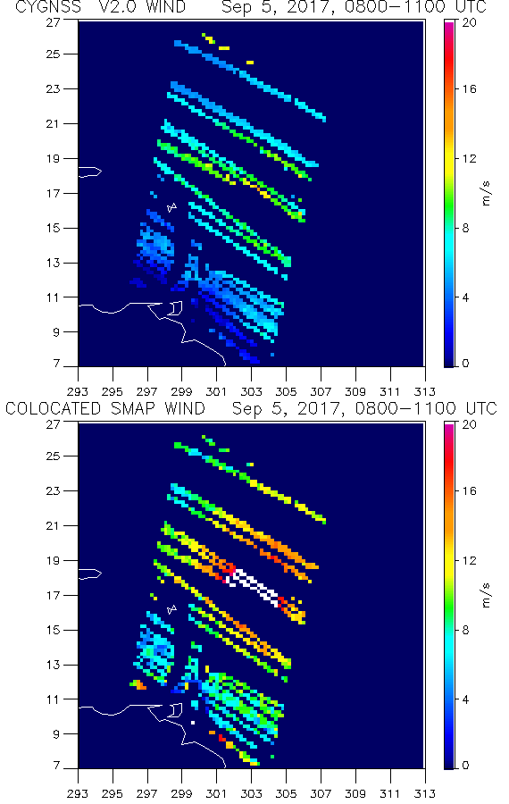
IRMA
CYGNSS V2
CYGNSS V2
NCEP GDAS
SMAP

Slide 11
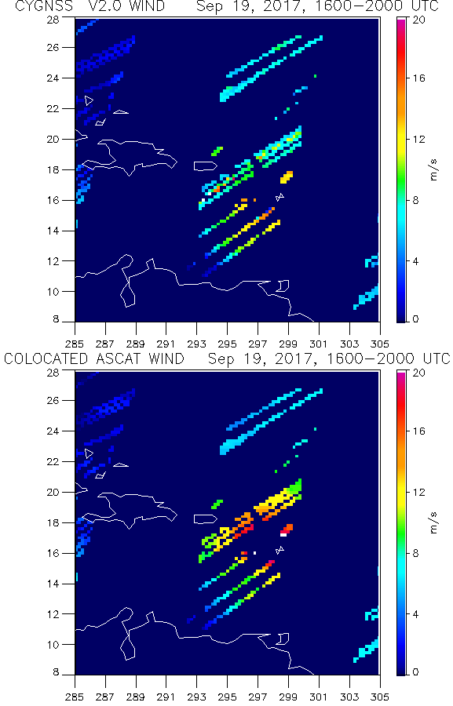
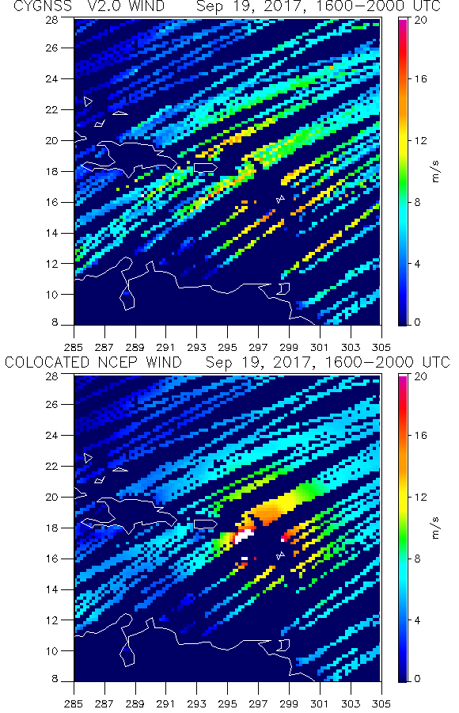
MARIA
CYGNSS V2
CYGNSS V2
ASCAT

Slide 12
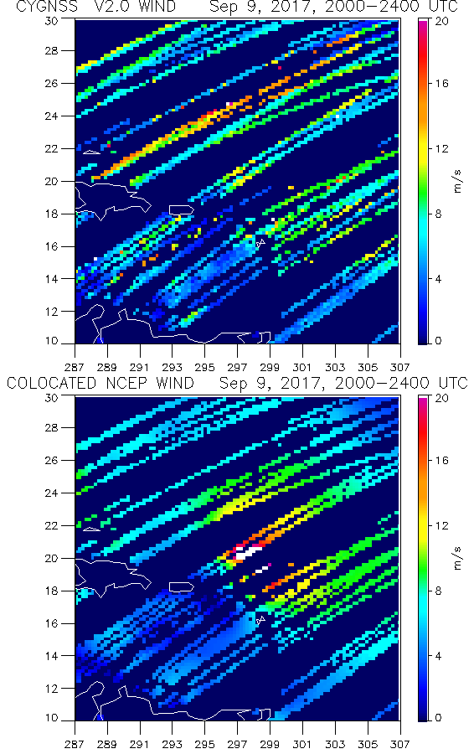
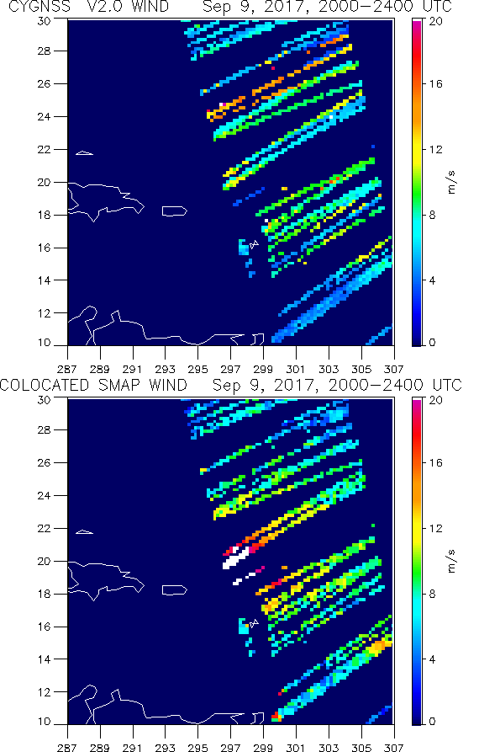
JOSE
CYGNSS V2
CYGNSS V2
NCEP GDAS
SMAP

Slide 13
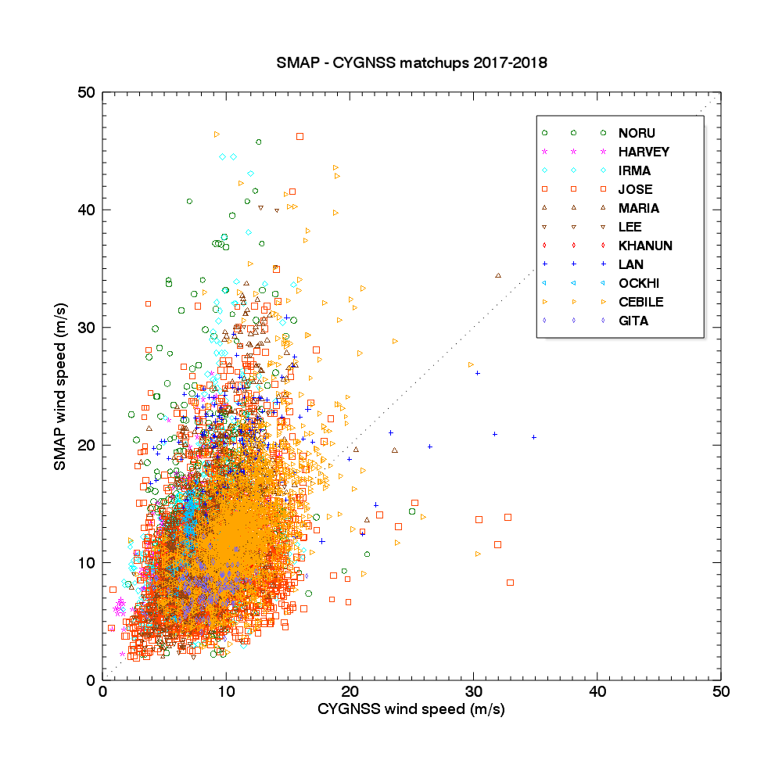
Comparison of
SMAP winds vs CYGNSS V2
During last hurricane season
Storm winds observed by SMAP in the range 25-50 m/s are instead 5-20 m/s in CYGNSS

Slide 14
CYGNSS PROPOSAL
Submitted Nov 2017, ROSES 2017; Granted February 2018, 3 yr project;
Title: User-Oriented Level 4 Ocean Wind Products from the CYGNSS Wind Retrievals
L. Ricciardulli, C. Mears ,T. Meissner; Collaborator: Z. Jelenak (NOAA/NESDIS) and C.Sampson (NRL/NAVY)
Main objective: Facilitate use of CYGNSS wind data, repackage winds in user-friendly form
L4 product: CYGNSS wind speed with added ancillary wind direction from models/satellite
Assimilate CYGNSS in CCMP, benefit of filling rainy areas where radiometers have no data
Incorporate CYGNSS winds into RSS Storm Watch page, determine intensity and size of storms, similar to SMAP
Side products:
Extensive Cal/Val using all available radiometers/scatterometers
Use SMAP winds for in depth Validation of CYGNSS winds in Tropical Cyclones
Determine bias adjustments for the 8 different receivers, if needed
Determine actual uncertainty maps: Right now L3 data has a theoretical uncertainty associated that is far from reality

Slide 15
Summary of CYGNSS L3 comparison with ASCAT/SMAP
CYGNSS winds compare well to SMAP and ASCAT for w< 15 m/s, but with standard deviation higher (2+ m/s) than other satellite data (typically 1 m/s or less)
At high winds > 15 m/s CYGNSS V2 L3 winds lose correlation with SMAP winds, and they are significantly lower
We think that SMAP could be useful for calibrating CYGNSS very high winds, if CYGNSS has enough sensitivity.
We created colocation files for each storm scene in 2017/2018 written in ASCII format.
CYGNSS V2.0: Overall bias is much decreased and Standard Deviation is much reduced too compared to V1
BUT: L3 not good at TC wind intensity (only Fully Developed Sea GMF used, invalid at high winds).
For high winds, L2 dataset provides additional wind product based on different Geophysical Model Function
for high winds (Young Sea/Limited Fetch GMF, Ruf et al., 2018)
What’s next:
Science Team announced that a new and improved version V2.1 will be released before Atlantic Hurricane season 2018
Significant improvements in calibration of the L1 (sigma0) was presented to Science Team
No L2,L3 (wind) data available yet
Science Team experimenting with different GMFs for winds and working on other issues
We will focus on validation of L2 data for both FDS and YSLF wind data products

