Slide 1
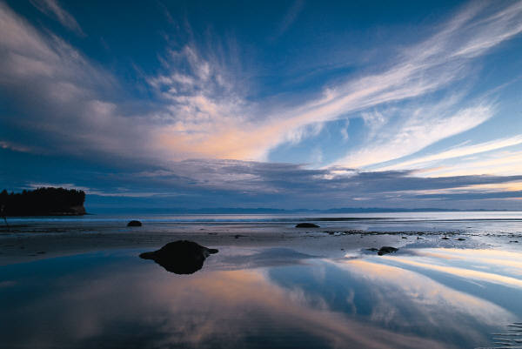
A novel azimuth cut-off implementation to improve sea surface wind retrievals from SAR images
V. Corcione, G. Grieco, M. Portabella, F. Nunziata, M. Migliaccio

Slide 2
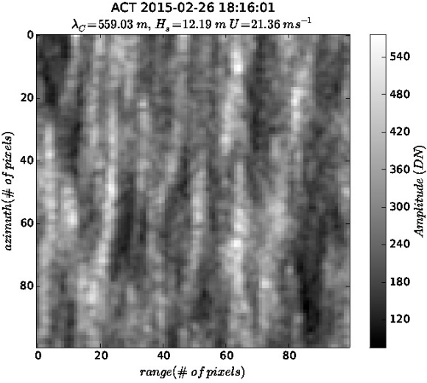
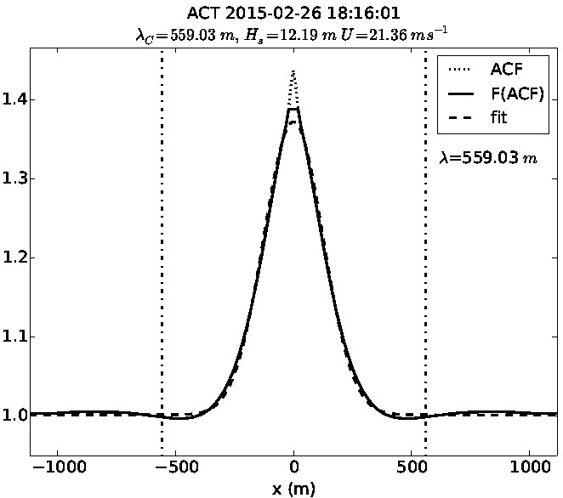
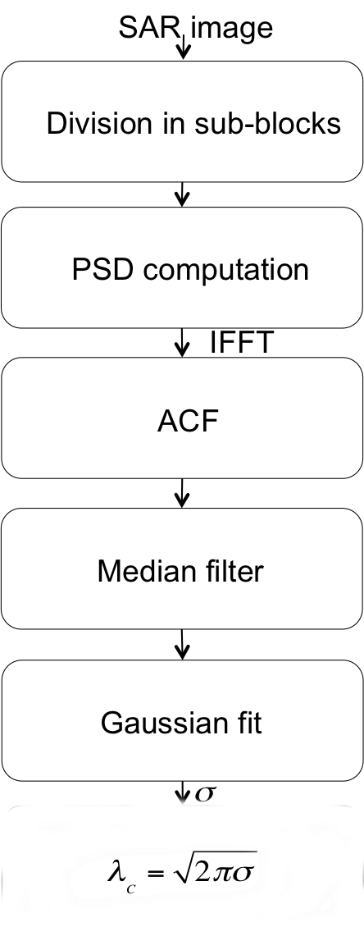
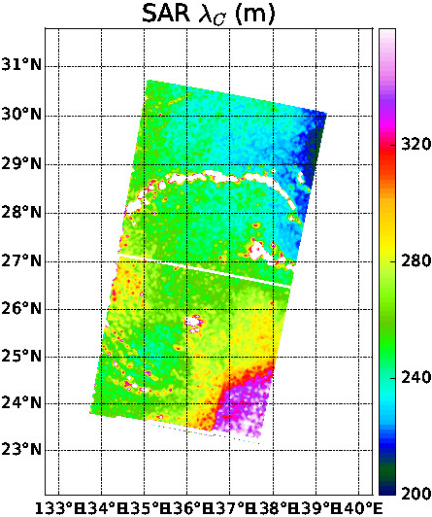
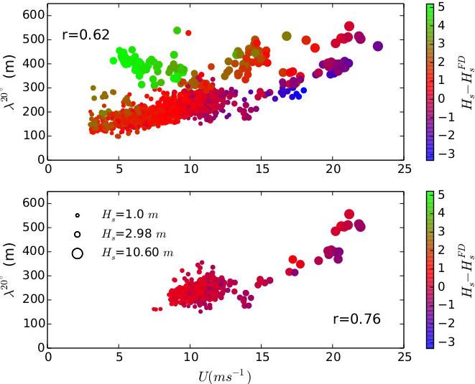
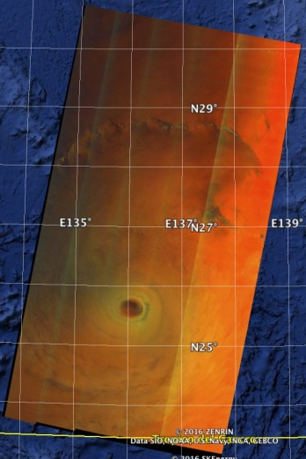
Azimuth cutoff
The azimuth cut-off can be successfully used to retrieve H_{S} (and U¹⁰?)
Good agreement in FD state
Not good in extreme cases. Why? Work in progress

Slide 3
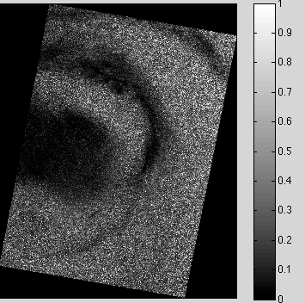
Dataset
Typhoon Megi
DATASET:
TerraSAR-X ScanSAR mode
Date: October 21, 2010
Time UTC: 22:05:16
Resolution: 8.25 m

Slide 4
Experiments
Resolution 33 m
R
Resolution 8 m
Resolution 17 m
Resolution 66 m
256x256
512x512
128x128
256x256
64x64
128x128
32x32
64x64
1024x1024
512x512
256x256
128x128

Slide 5
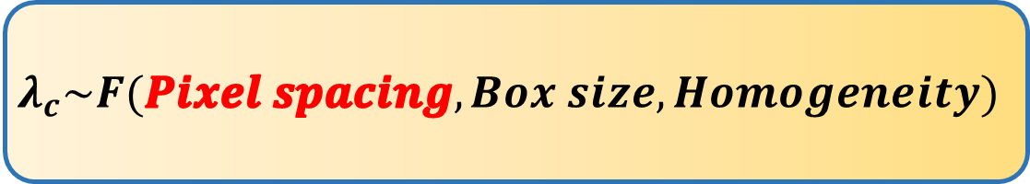
Acf fits at different resolutions and fixed median filter window: 11
Results
Acf fits at different resolutions and variable median filter window
$$λ_{c}\sim F(Pixel spacing, Box size, Homogeneity)$$

Slide 6
Acf fits at different resolutions and fixed median filter window: 11
Results
Acf fits at different resolutions and variable median filter window
$$λ_{c}\sim F(Pixel spacing, Box size, Homogeneity)$$
Median filter window should be fixed at about 100-120 m

Slide 7
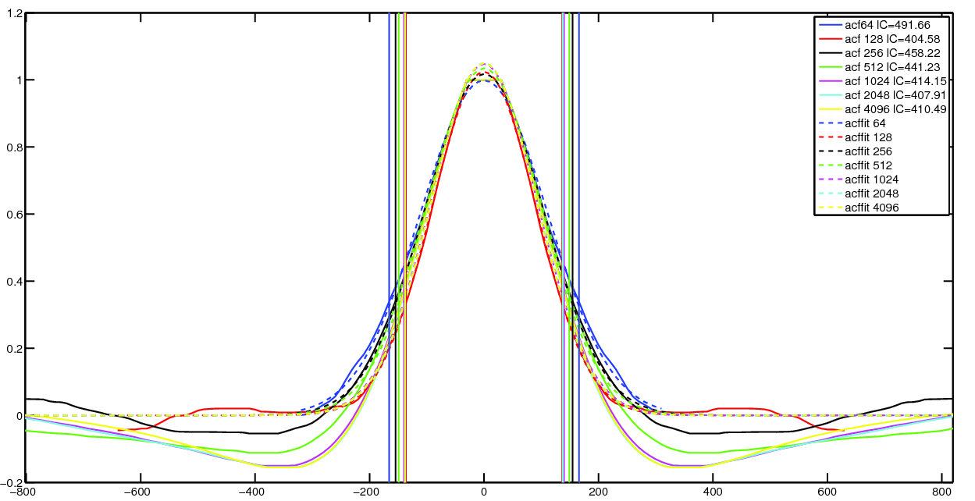
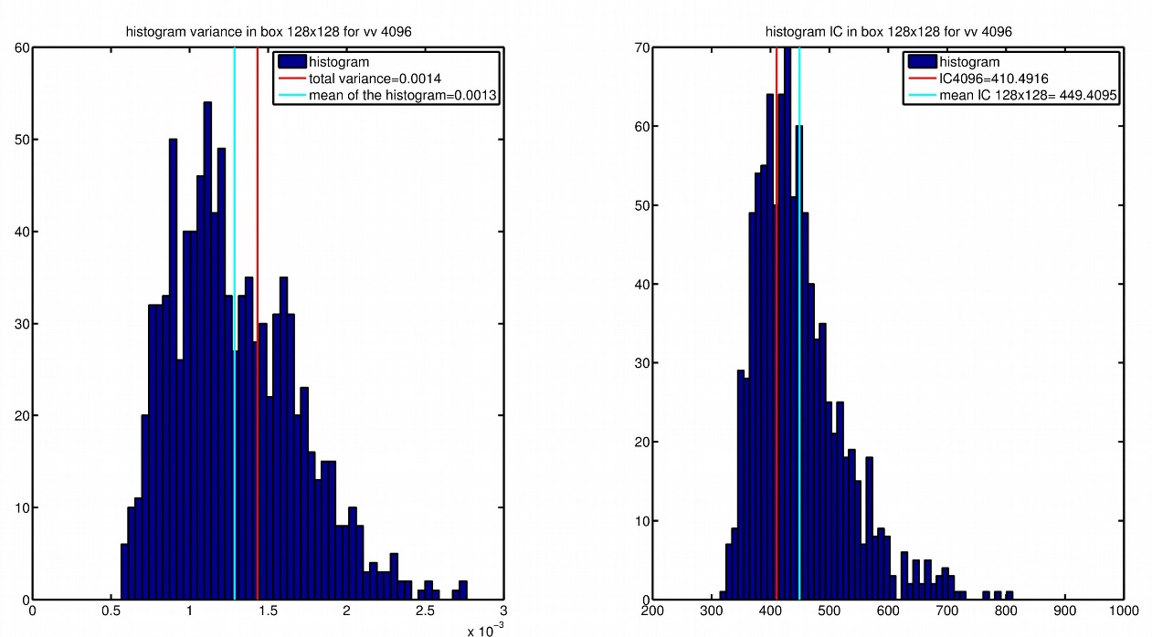
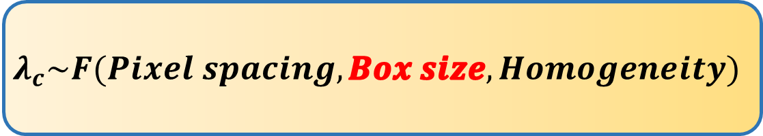
Results
mean(λc) ± std(λc)
Std(λc)~5%
Std(λc)~13%
$$λ_{c}\sim F(Pixel spacing,Box size, Homogeneity)$$

Slide 8
Results
mean(λc) ± std(λc)
Std(λc)~5%
Std(λc)~13%
$$λ_{c}\sim F(Pixel spacing,Box size, Homogeneity)$$
Tolerance is of about 13%

Slide 9
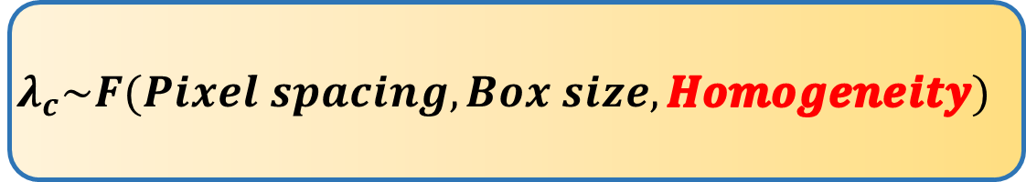
Results
3 Sentinel-1 dataset GRD Stripmap mode
VV polarization
10m pixel spacing
November 2014 – May 2015
Less homogeneity and high wind speed
More homogeneity and high wind speed
Less homogeneity and low wind speed
$$λ_{c}\sim F(Pixel spacing, Box size,Homogeneity)$$

Slide 10
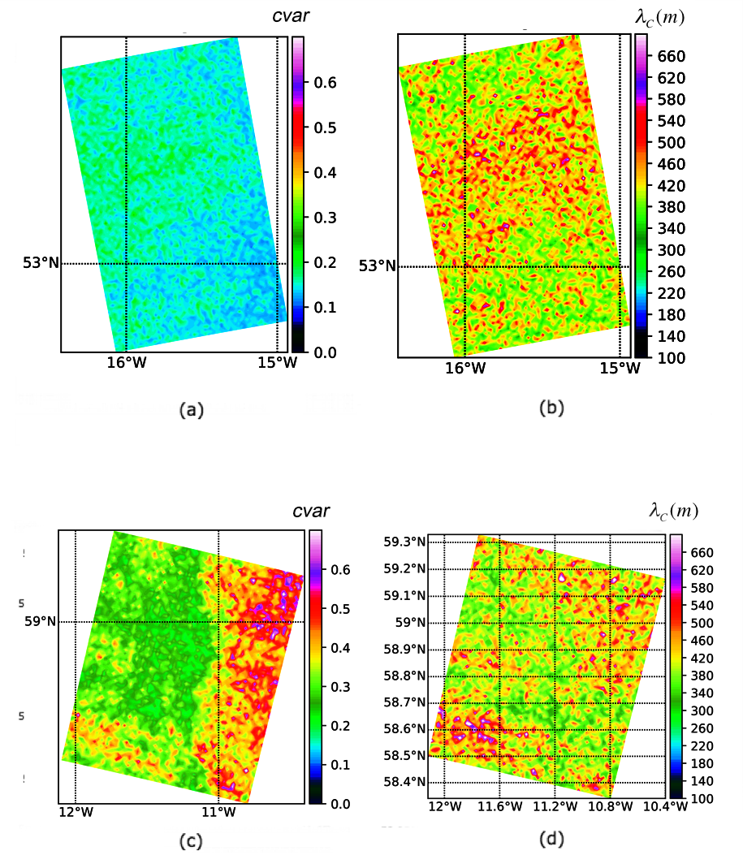
Results
Dataset 1
Dataset 2
$$λ_{c}\sim F(Pixel spacing, Box size,Homogeneity)$$

Slide 11
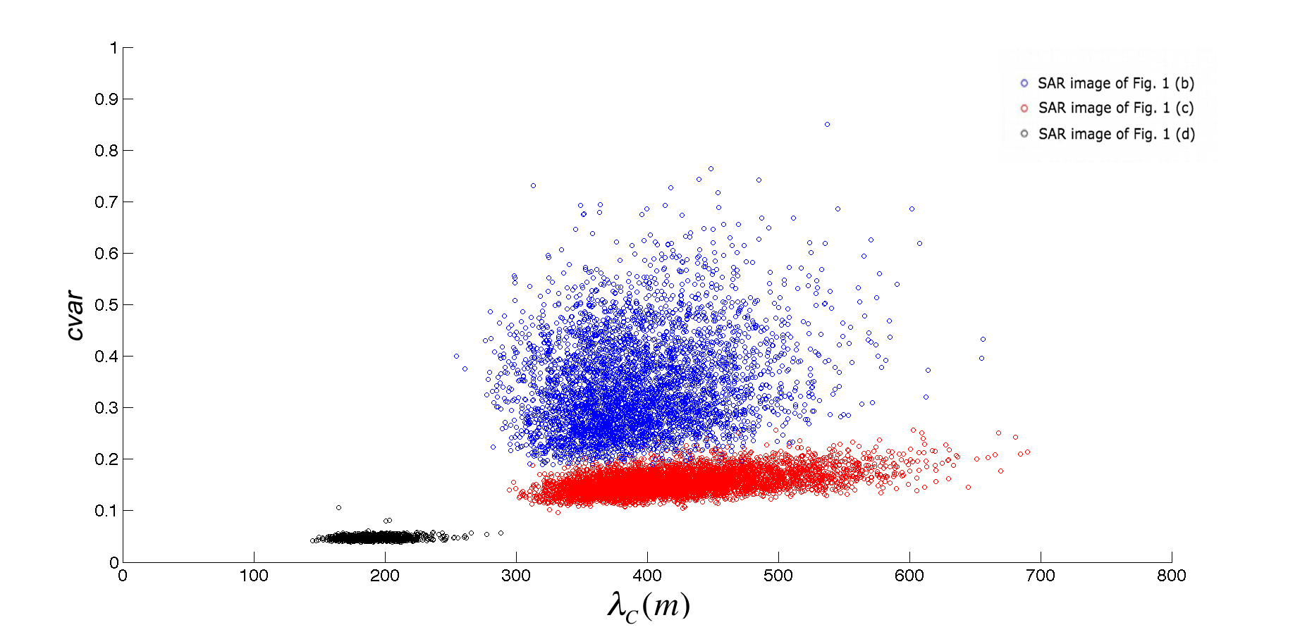
Results
$$λ_{c}\sim F(Pixel spacing, Box size,Homogeneity)$$
A preliminary analysis of std rel can be useful to apply lC approach

Slide 12
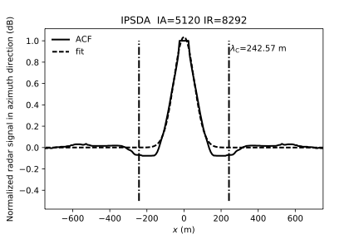

Results
Chi2=chisquare(acf-acffit)
$${2λ}_{c}/√\left(2\right)π$$

Slide 13
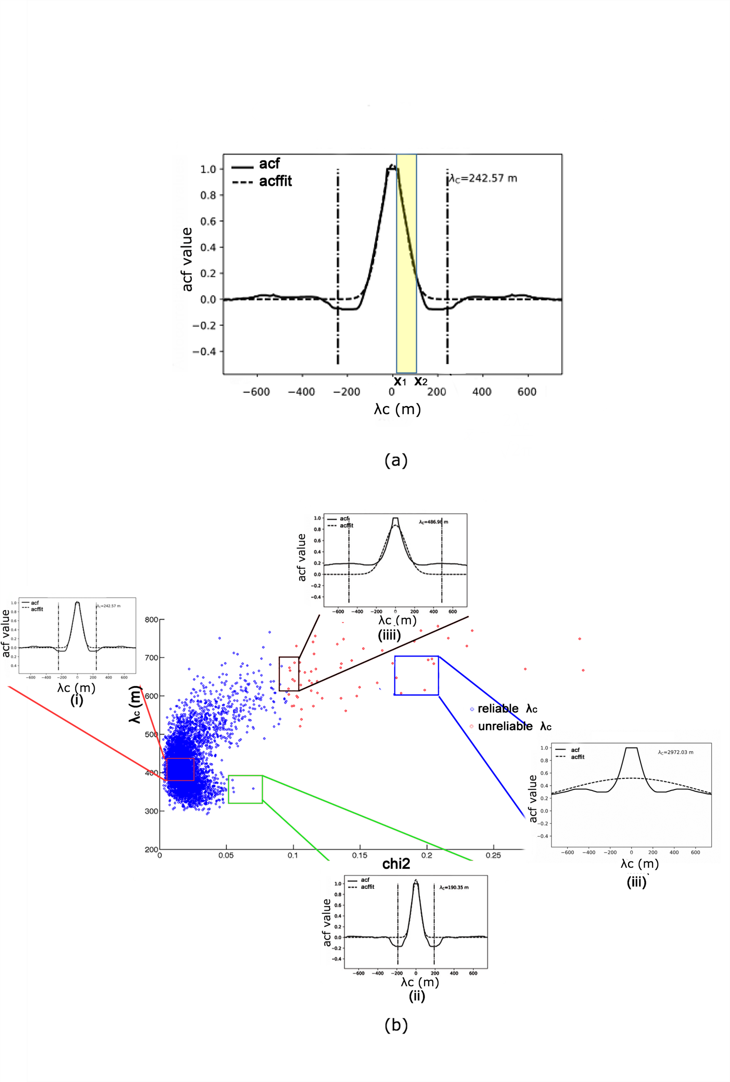
Results

Slide 14
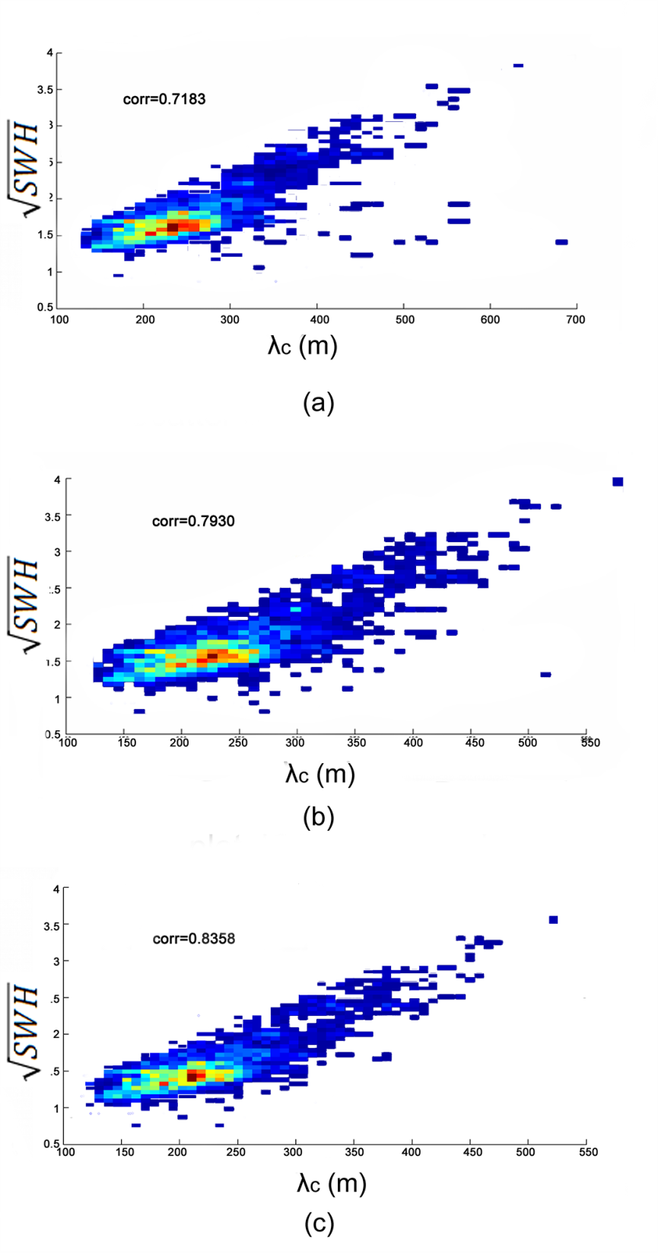
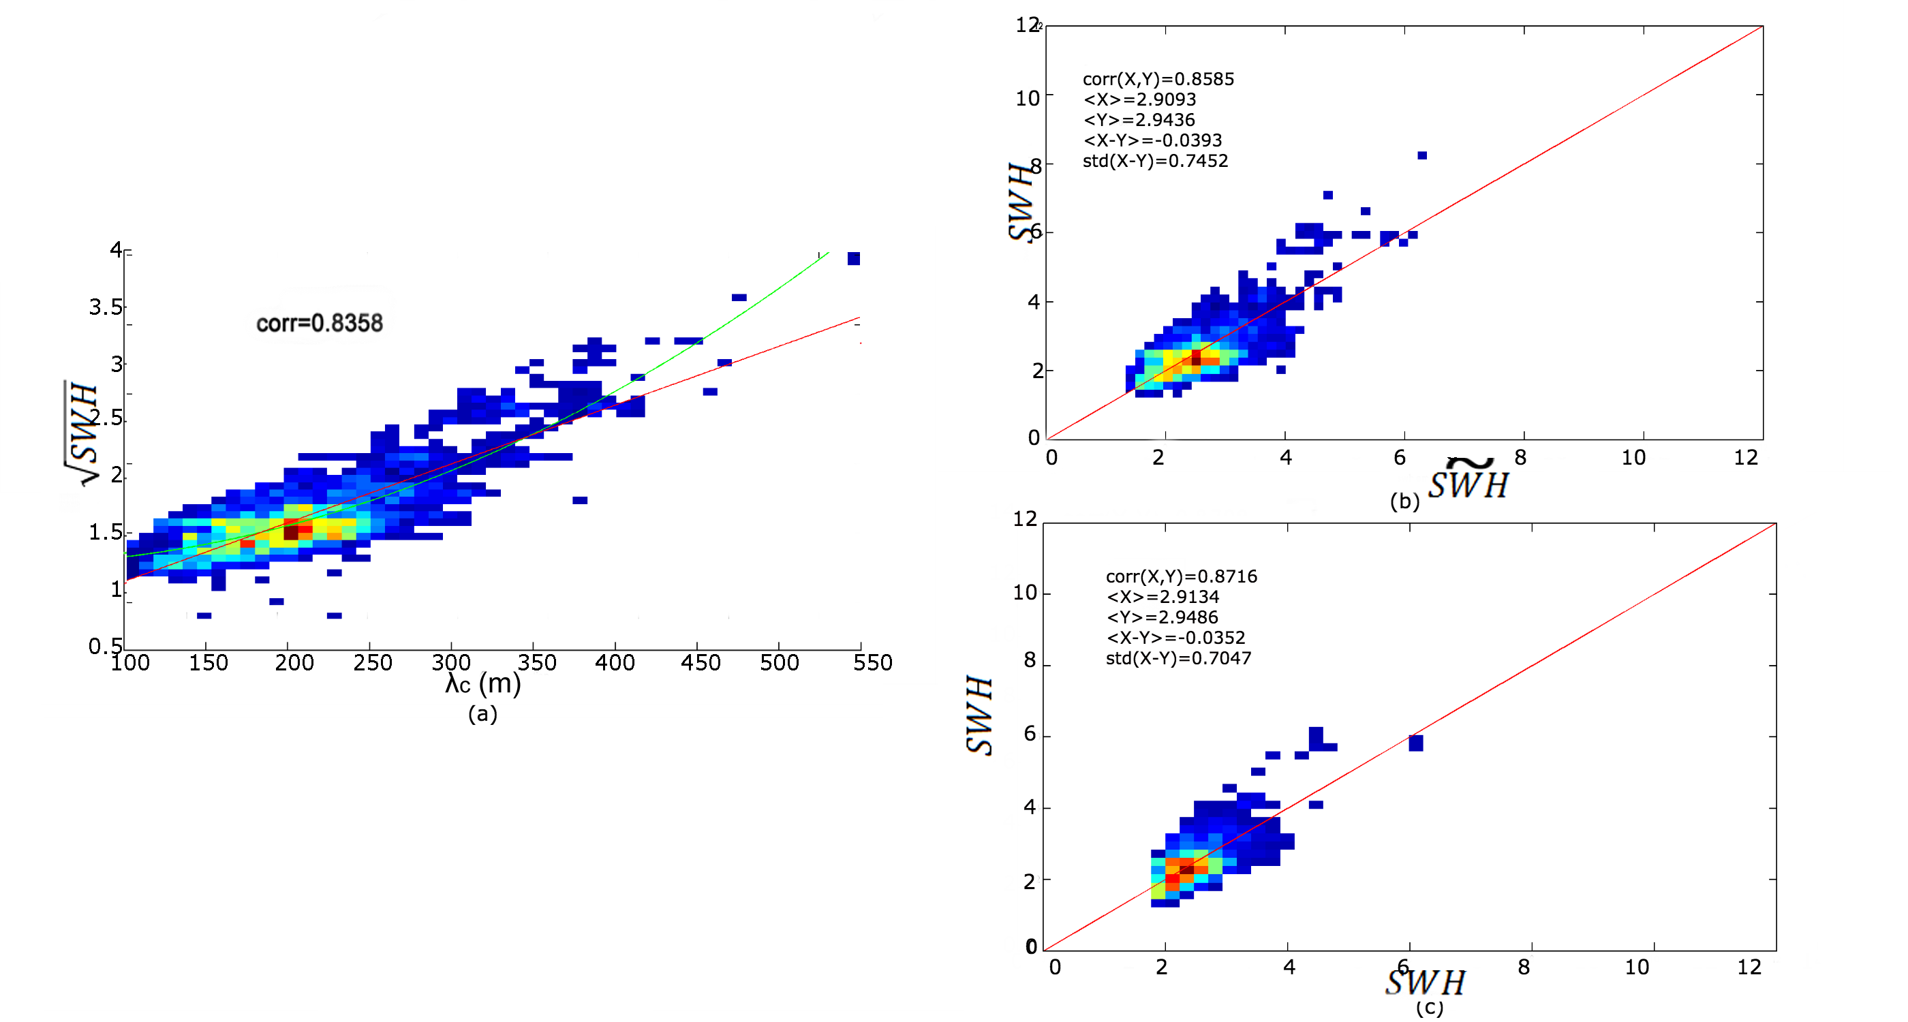
Results
No filter
Lc<700m
Lc<700m & Chi2<0.06

Slide 15
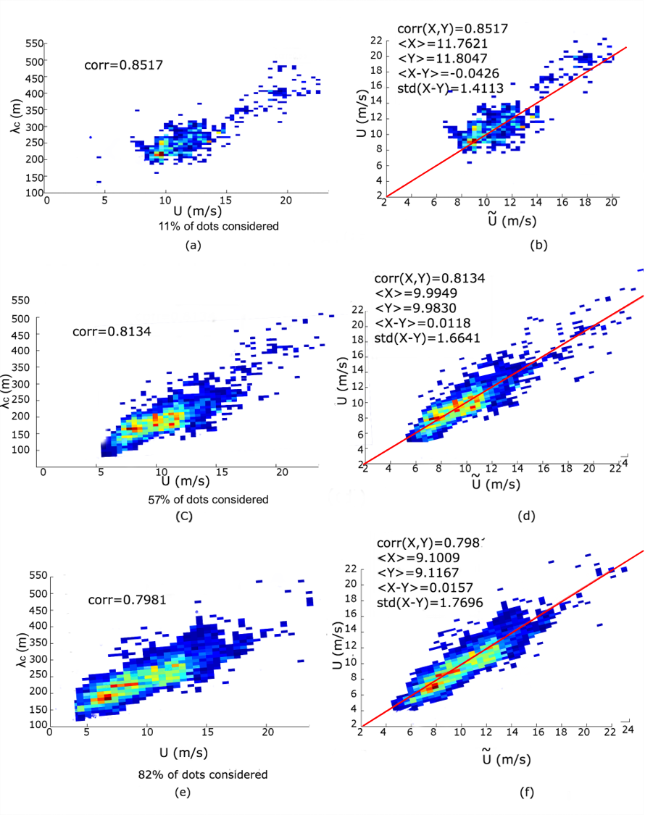
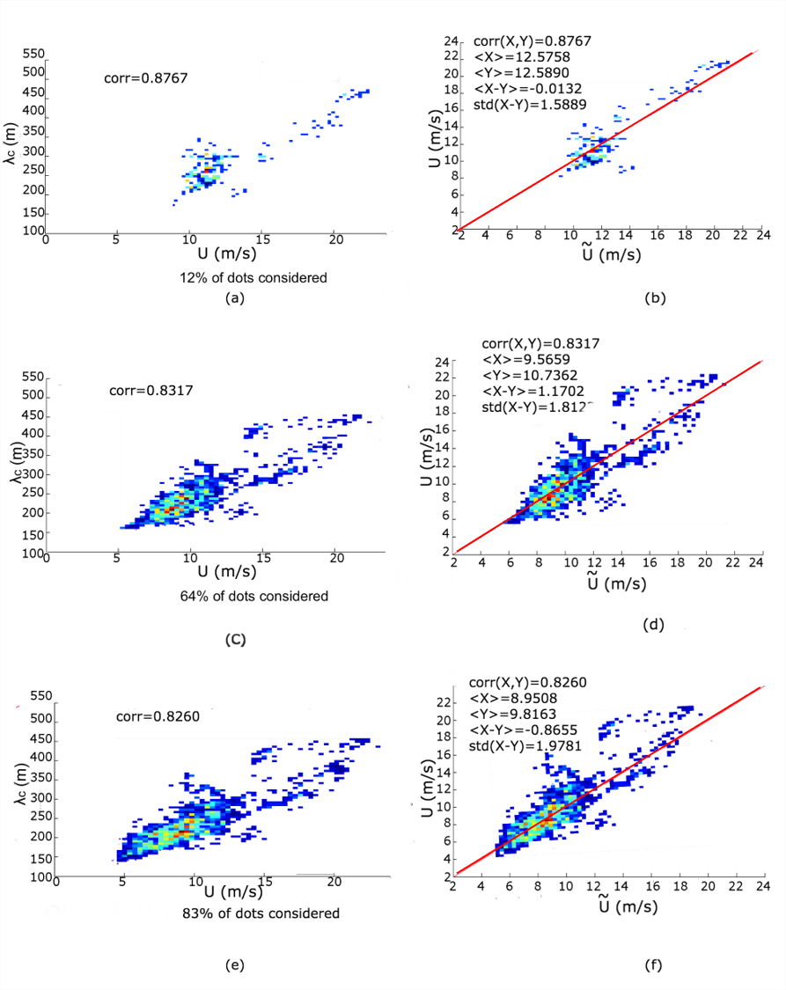
Results
Fully-developed sea
Sea state
FD + some young seas & swell

Slide 16
Conclusions
By downgrading the backscatter resolution and increasing the size of the boxes, the azimuth cutoff values increase.
The azimuth cutoff depends on backscatter resolution (or pixel spacing), box size and homogeneity.
A stand-alone criterion of the goodness of the azimuth cutoff is set for each dependent parameter.
Also Chi square goodness of fit criterion is used to exclude non reliable azimuth cutoff values.
The more robust and accurate estimation of the azimuth cut off leads to higher correlation values with both SWH and wind speed.
A less conservative criterion on the Pierson-Moscovitz threshold allows the wind retrieval of about 80% of the data with an accuracy of about 1.7 m/s. Only swell-supected data are filtered out.
Next step: Apply this methodology to more extreme wind conditions

Slide 17
Thank you for attention

